Slide 1
Group Safety Representatives Meeting Spring 2026
Graduate Safety Committee
January 29th, 2026

Slide 2
Meeting Agenda
Separate Halogenated and Non-Halogenated Waste
NEW 2026 Self-Audit Checklist
SDS Quick Reference Open Resource
Other Announcements/Reminders

Slide 3
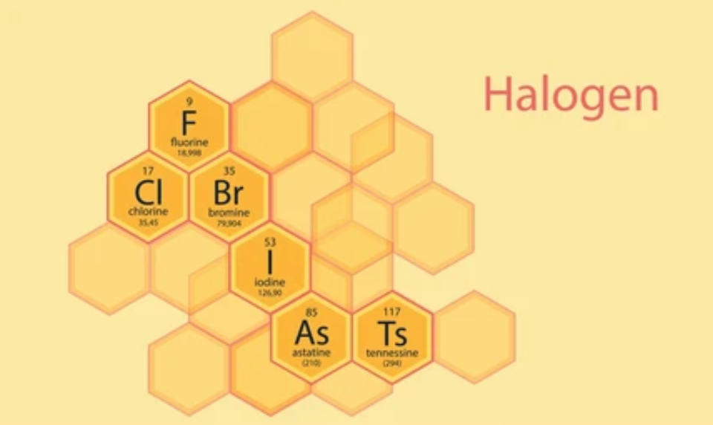
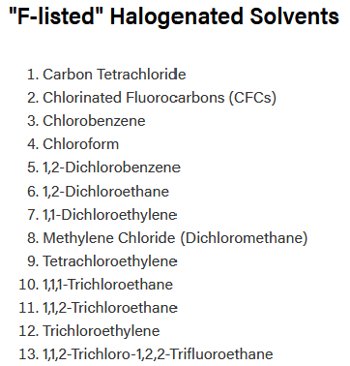
Separate all halogenated waste
EHS cites an increase in halogen presence in unmarked halogenated waste
2026 Goal: All halogenated solvent disposed of in separately identified halogenated waste.
For mixed waste: halogens < 1% by weight or volume
  0.1 wt% is the true permissible limit.
Not indicating halogenated waste results in:
  Higher waste processing cost.
  Longer waste processing time.
https://www.purdue.edu/ehps/rem/environmental-programs/waste/hazwaste.html

Slide 4
Oil Recycling and Disposal
Defining the difference between used oil and waste oil
Used Oil Definition
Used oil is petroleum-based or synthetic oil that has been put into service and, through use, has become contaminated with physical or chemical impurities (i.e., metal shavings, water, etc.).
Used oils that can be recycled:
Lubricants
Hydraulic fluids
Motor oil
Pump oil
All oil needs to be picked up by EHS for recycling or disposal
Waste oils include:
Refrigeration oil
Heat transfer oil
Oil contaminated with
  Fuels
  Creosote
  Solvents
  Duplicating fluid
  Aromatic hydrocarbons
  Petroleum Distillates
Waste Oil Definition
Oil mixed with hazardous substances (i.e., solvents, fuels, antifreeze, aromatic hydrocarbons), making it hazardous waste requiring specialized disposal.

Slide 5
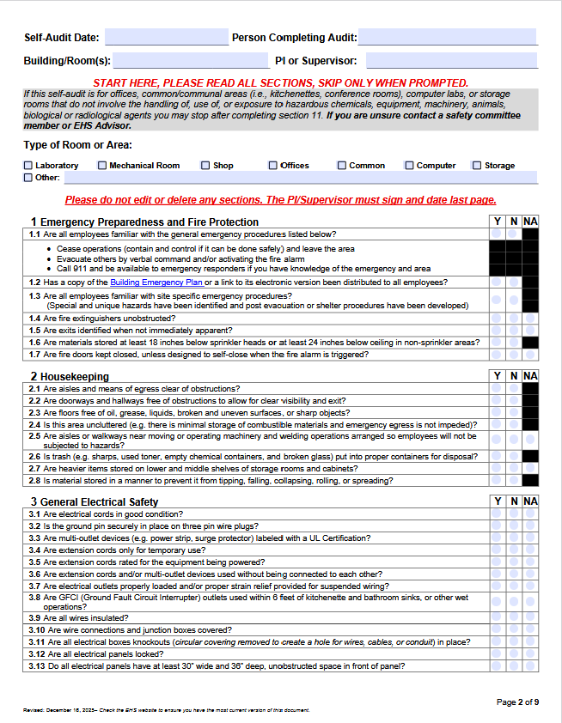
NEW 2026 ISP Self-Audit Checklist
Starting this year EHS is adopting a new ISP checklist for lab audits
New and Expanded Sections of Interest:
Section 4: 3D Printers Safety
Section 5: Step Stool and Ladder Safety
Section 6: Contractor Safety
Section 7: Occupational Biological Hazards
Section 8: General Chemical Safety (Expanded)
New ISP checklist is uploaded to the ChemSafety Webpage
https://www.purdue.edu/ehps/rem/documents/forms/ispcheck.pdf

Slide 6
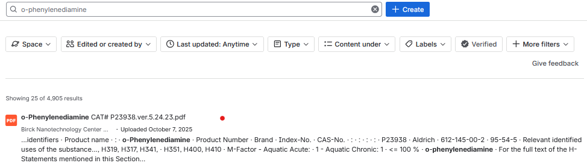

SDS Quick Check Resource
An open source for quickly checking sds info supported by Birck Nanotechnology Center
Shareable SDS quick reference repository.
Is useful for experimental planning and waste compatibilities.
Please share with colleagues
https://purdue.atlassian.net/wiki/spaces/BNCWiki/pages/6247010/BRK+SDS+Repository

Slide 7

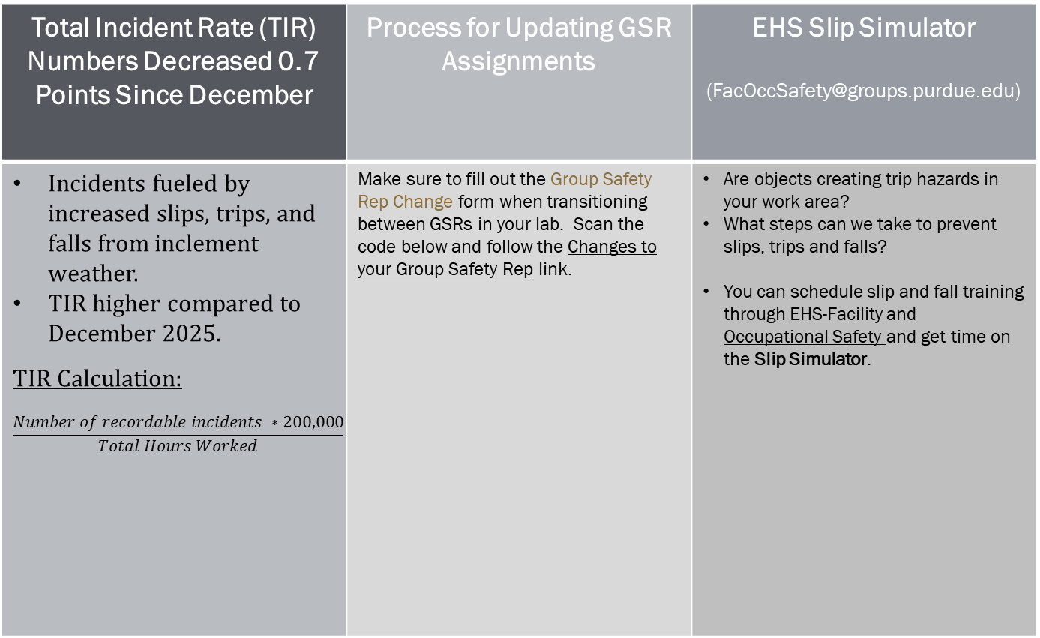
Other Announcements and Reminders
Total Incident Rate (TIR) Numbers Decreased 0.7 Points Since December | Process for Updating GSR Assignments | EHS Slip Simulator (FacOccSafety@groups.purdue.edu)
Incidents fueled by increased slips, trips, and falls from inclement weather. TIR higher compared to December 2025. TIR Calculation: $$\frac{Number of recordable incidents ∗200,000}{Total Hours Worked}$$ | Make sure to fill out the Group Safety Rep Change form when transitioning between GSRs in your lab. Scan the code below and follow the Changes to your Group Safety Rep link. | Are objects creating trip hazards in your work area? What steps can we take to prevent slips, trips and falls? You can schedule slip and fall training through EHS-Facility and Occupational Safety and get time on the Slip Simulator.
Safety Awareness is the Key Ingredient
https://www.chem.purdue.edu/chemsafety/ChemSafetyCom.html
https://www.youtube.com/watch?v=LQxohwStHTU

Slide 8
Thank You
Don’t hesitate to reach out if you have any questions!

