Slide 1
Group Safety Representatives Meeting ..Summer 2026
Graduate Safety Committee
May 15th, 2026

Slide 2
Meeting Agenda
New Safety TA Introduction
Lab Aqueous Waste Postings
Vented Piranha Caps
GSR Cross-Lab Audits

Slide 3

New Safety TA – Ahmed Kangmennaa
EMAIL: akangmen@purdue.edu
OFFICE: WTHR 409
PI: Suzanne Bart
Research: Separation and Recovery of Rare Earth Metals Utilizing Chelating Ligands
“An incident-free workplace is everyone’s responsibility.”

Slide 4
Aqueous Waste Lab Postings
Coordinated aqueous waste lab postings to communicate proper waste disposal and separation
Aqueous Wastestreams | Sink Disposal?
Washing dirty glassware with soap | Yes (Collect acetone/alcohol rinses)
Sterilized biological waste | Yes (Must follow IBC guidelines)
Water Aspirators | Yes
Cooling water lines | Yes
Water and Ice Baths | No (Contact with research sample)
Condensation from water/ice traps | No
Chemical Reaction Aqueous Workups | No
Buffers (including analytical tests) | No*
Aqueous electrolytes | No*
Aqueous non-electrolytes | No*
Leftover drinks and coffee | Dispose outside (Not allowed in lab)
Labs should develop a waste stream for aqueous-rich waste.
Develop lab postings to remind your research lab members what can and can not go down the sink.
Segregated aqueous waste stream helps with groundwater pollution as well as preserving the fuel grade for non-halo waste, which can be repurposed as secondary fuels.
When in doubt, mixed liquids should go into aqueous-rich waste.

Slide 5
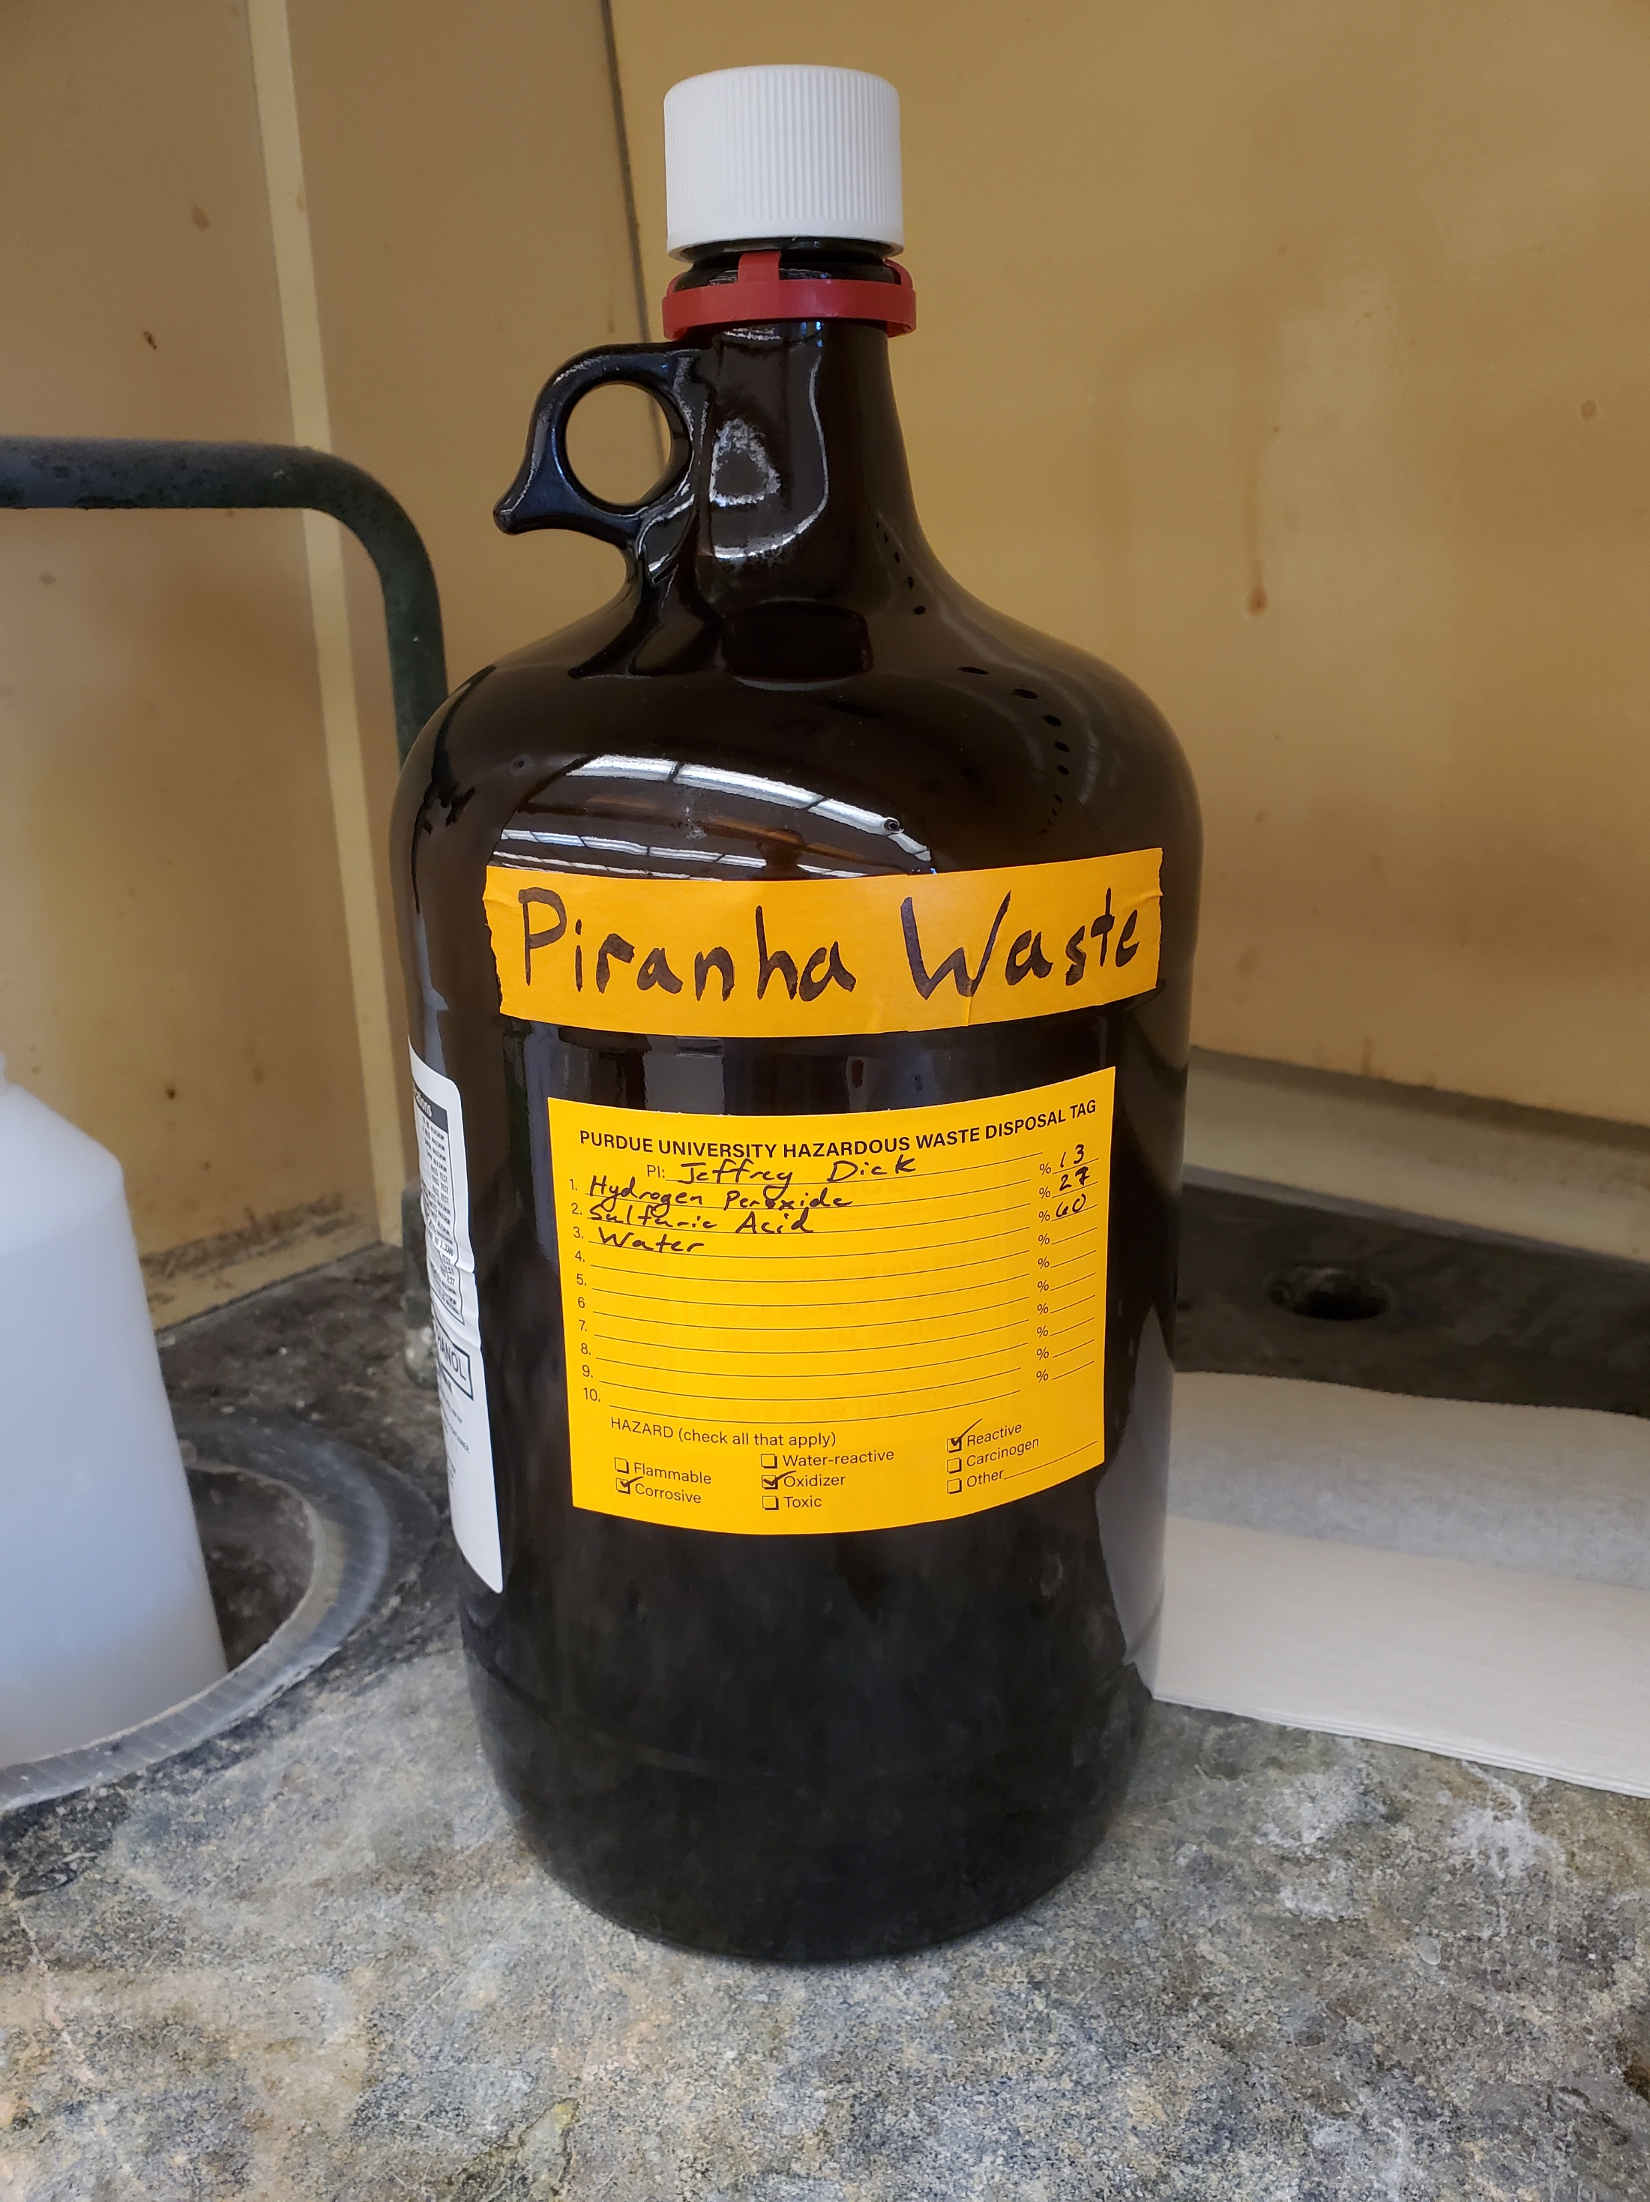
Vented Caps for Piranha Waste
Reminder: Do not neutralize piranha waste.
Per EHS, do not neutralize piranha waste or pour waste down sink.
Piranha waste can be stored in glass bottle containers with vented caps
When submitting piranha waste, remove the vented cap and seal the piranha waste with a normal cap before EHS pickup
Contact hazwaste@purdue.edu to order vented caps.

Slide 6
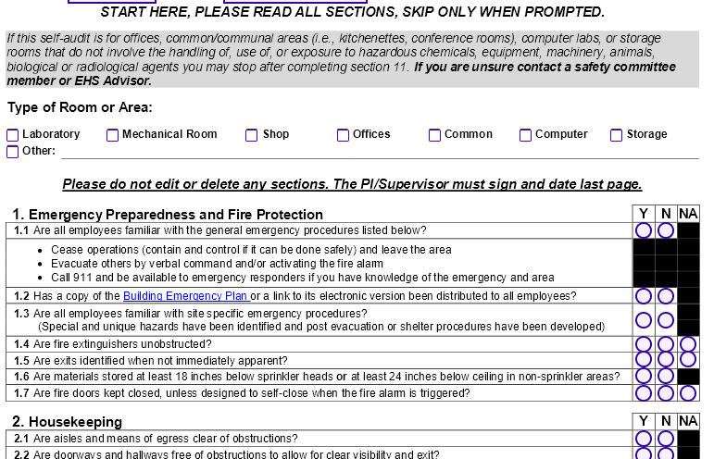
Cross-Lab Audits
We will be conducting cross-lab audits during the month of June with all GSRs.
Cross-Lab audits will be taking place the First week of June
Ahmed will communicate lab assignments to all GSRs. These will be distributed by the end of next week.
The goal is to have GSRs visit our partner labs in the department and go through the ISP safety audit forms.
Side Note: Lab Safety Renewals will be taking place in June.

Slide 7
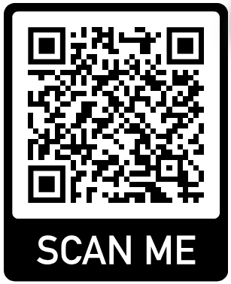
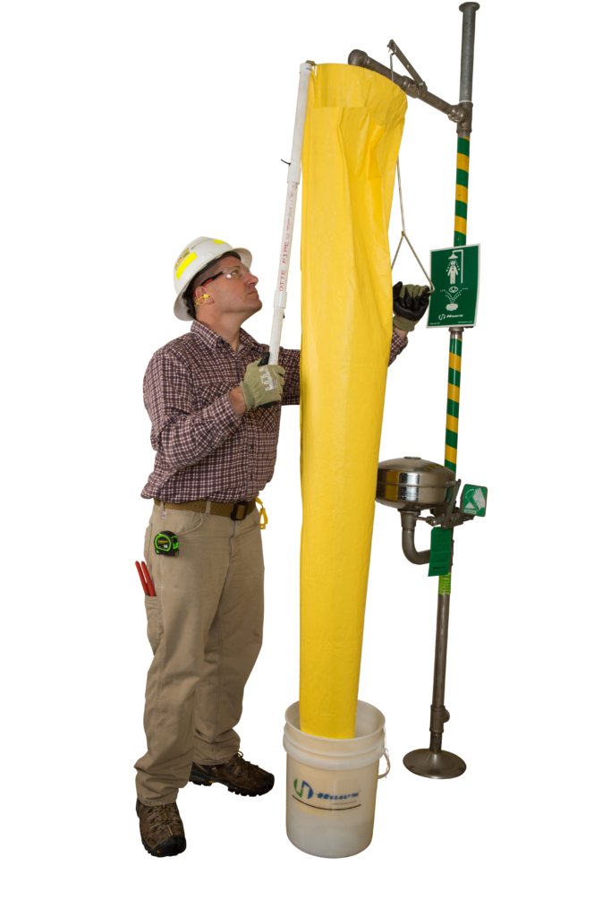
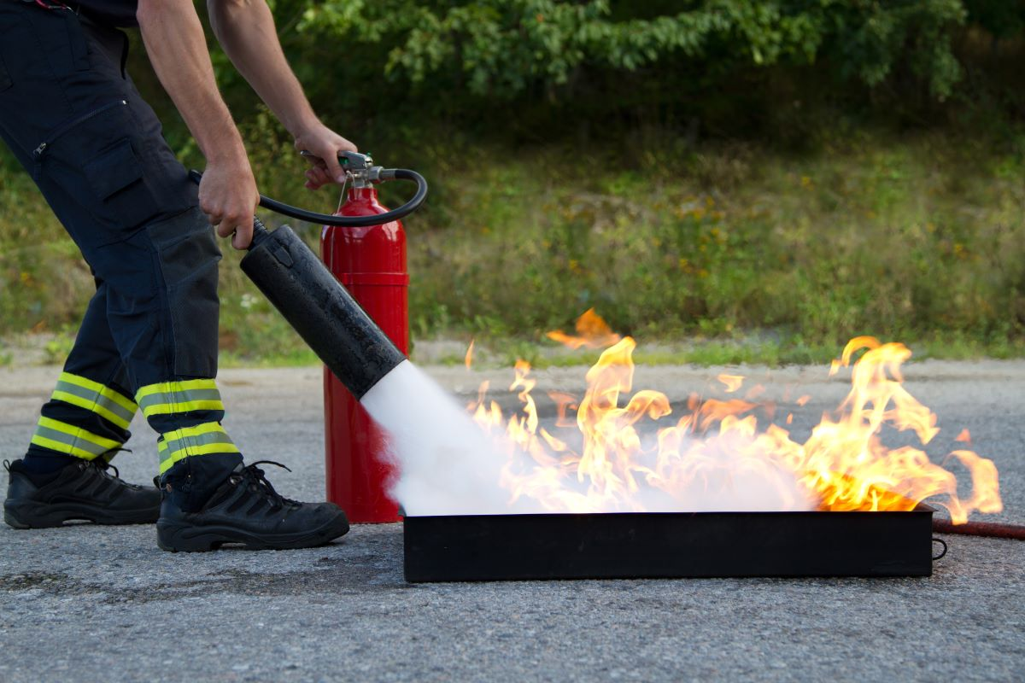
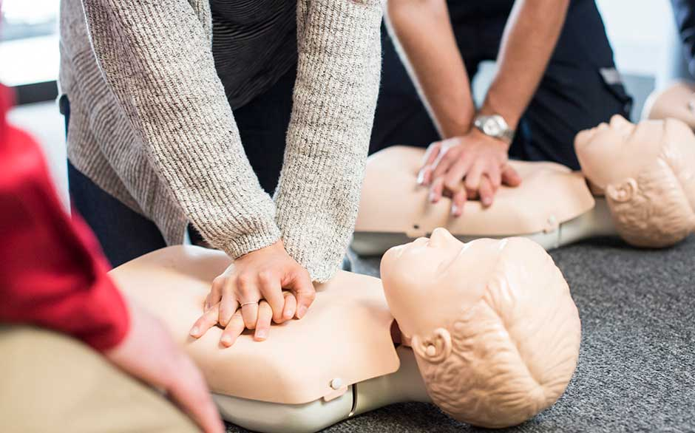
Other Announcements and Reminders
Safety Shower Flushing Passed On to the Department | Process for Updating GSR Assignments | Fire Extinguisher and CPR Training | Department Chemical Archive Temporarily Closed
Safety Shower flushing will now be the responsibility of the department. We are coordinating with Robert Barr on a new SOP for flushing the safety showers in your respective labs. Please stay tuned for more information in the near future. | Make sure to fill out the Group Safety Rep Change form when transitioning between GSRs in your lab. Scan the code below and follow the Changes to your Group Safety Rep link. | We will be trying to coordinate Fire Extinguisher and CPR training with the West Lafayette Fire Department. New Safety TA Ahmed Kangmennaa will work on scheduling for the summer/early fall for training to take place. | The Department chemical archive is temporarily closed. No chemicals can be entered or requested from the chemical archive at this time due to the temporary closure. We will update as soon as more information is available. Thank you all for your understanding!
https://www.chem.purdue.edu/chemsafety/ChemSafetyCom.html

Slide 8
Thank You
Don’t hesitate to reach out if you have any questions!

