Slide 1
College of Science & Pharmacy Procurement
Leslie Martin & Liz Dunning
04/18/2024

Slide 2

How does CoSP Procurement Operate?
Fully remote – Email to cosprocure@purdue.edu
Ticketing system
Expectation 24–48-hour turnaround.
Current turnaround = ~ 2 hours
7 full-time employees
Cross-trained and cross-functional employees.
  Provides office coverage during absences, long-term leaves and vacancies
Follows University Procurement processes
Order of Operations
Ariba – Preferred and non-preferred vendors
  They pay to be preferred!
  If you’re going to use a vendor multiple times, let us know! We can help get them set up as a vendor – even if not “preferred.”
Invoice (ZV60)
Credit Card

Slide 3
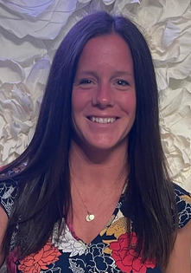






College of Science & Pharmacy Procurement
Liz Dunning
Interim Procurement Lead
eplaspoh@purdue.edu
Meet the Team
Cheyenne Tomlin
Business Assistant
cmtomlin@Purdue.edu
Claire Evans
Business Assistant
muller28@purdue.edu
Karen Benakovich
Business Assistant
kbenakov@purdue.edu
Karen Croussore
Business Assistant
kcrousso@purdue.edu
Tatum Carter
Business Assistant, Associate
carte304@purdue.edu
Heather Sands
Business Assistant, Associate
hrsands@purdue.edu
Notes:
Liz Dunning – started in EAPS business office with account management. Moved to travel center and now with us!
Claire Evan – started our First day of COVID remote work!
Karen Benakovich – came to Science and worked at college level with Lori Arnold prior to center in December 2018
Cheyenne Tomlin – began Fall 2021 from external
Karen Croussore – joined from Pharamcy when center went live in December 2018
Heather Sands – One year down – came from external to Purdue
Tatum Carter – 2023 Purdue Grad. Worked previously in the Engineering Procurement Center as a student.

Slide 4
What changes will Chemistry experience?
Email to cosprocure@purdue.edu CoSP Website
Please only send one vendor per email request
  Multiple orders with the same vendor may be received at one time
  Form 125 (any version) accepted
    Service Portal launching May 1st! Online form submission and tracking functionality!
    Leslie has been on development/implementation team!
Large capital orders, > $10K need to follow central processes – Faculty/Staff/Students will work directly with Central on equipment specs prior to coming to the center.
  Central SharePoint
  Special Purchase Form still required.
    Business Manager will sign off on these forms. Signature or email approval must be present. COSP does not have signature authorization to sign for Chemistry
Must include faculty name, office/lab number and shipping address on requests
Radioactive Materials are never allowed on credit cards. These must ship to HAMP prior to delivery!
Possibly more emails. Customers will be listed as “watchers” on Ariba orders and will receive confirmations, shipping updates. This is for the BOT functionality and transparency on your order request!
More awareness and visibility of your purchasing requests! Tracking functionality outside of email!
Notes:
COSP Website: https://www.purdue.edu/science/about/business-office/procurement.html
Central SharePoint: https://purdue0.sharepoint.com/sites/Procure/requests/Lists/10K%20Request/NewForm.aspx?Source=https%3A%2F%2Fpurdue0%2Esharepoint%2Ecom%2Fsites%2FProcure%2Frequests%2FLists%2F10K%2520Request%2FAllItems%2Easpx&ContentTypeId=0x01009736754CDE5DC546B18D3A862E46CBF6&RootFolder=%2Fsites%2FProcure%2Frequests%2FLists%2F10K%20Request&_ga=2.136266225.1524235781.1712606954-1773769649.1707953858
- Will require sign in – Purdue Career Account

Slide 5
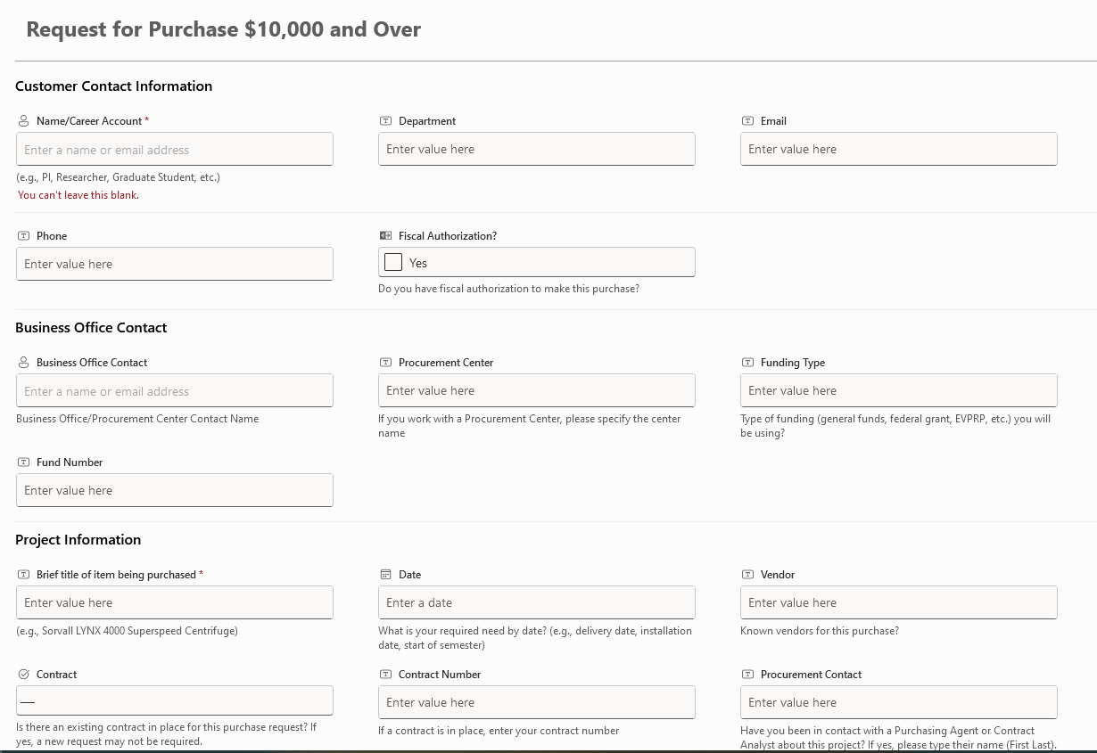
Request for Purchase $10,000 and Over
Purdue Central Procurement SharePoint

Slide 6
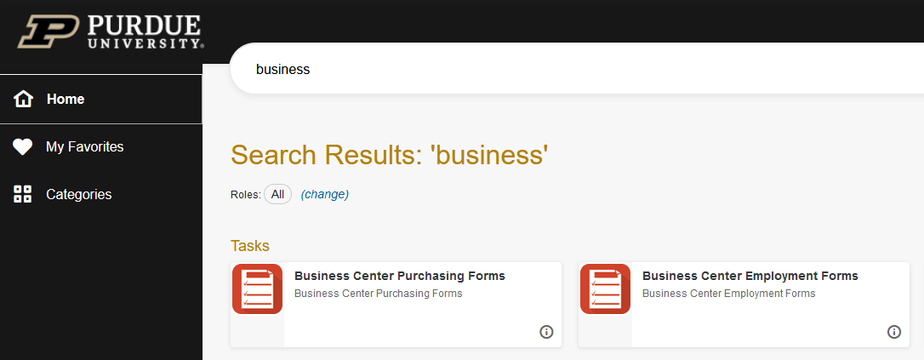
Purdue Service Portal – MAY 1st, electronic forms!
Search OneCampus Portal for Business Center Purchasing Forms
Requires Purdue Boiler Key for login!
Direct link to Purchasing Forms – cosprocure@purdue.edu is still valid!
Electronic form submission is not required! All emails received to cosprocure@prudue.edu will auto flow to the center!

Slide 7
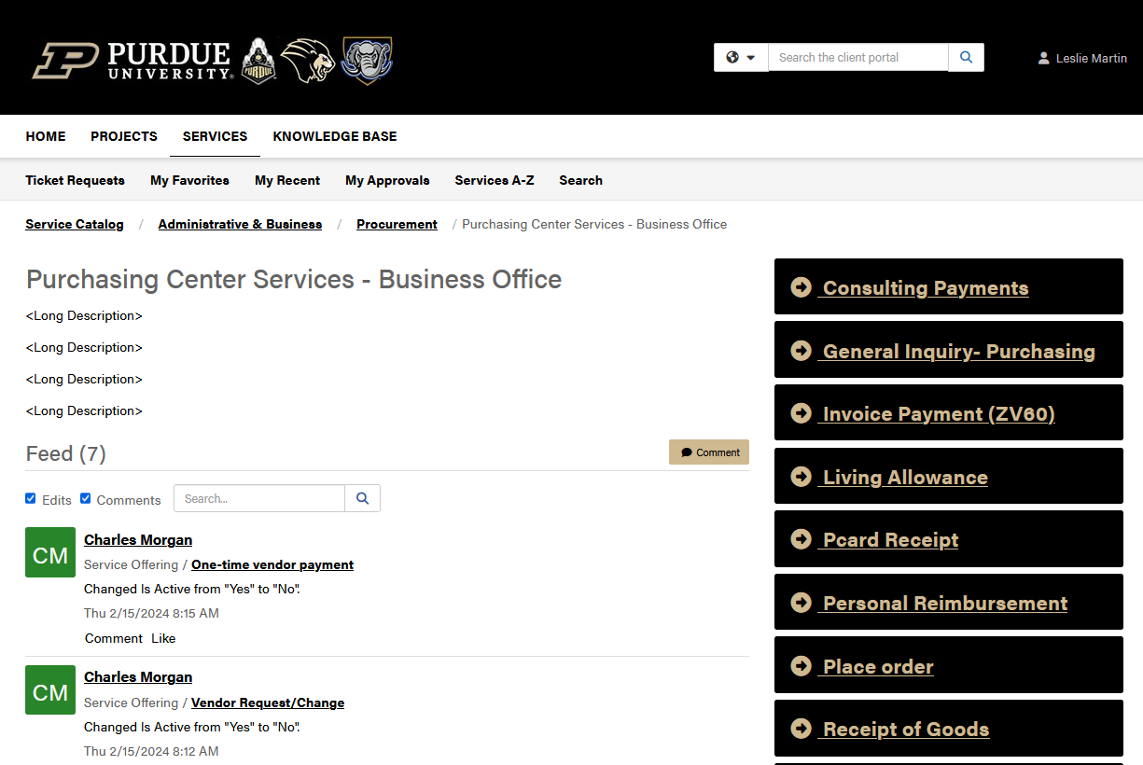
Purdue Service Portal – MAY 1st, electronic forms!
Select “Place Order” to complete request online with no paper form

Slide 8
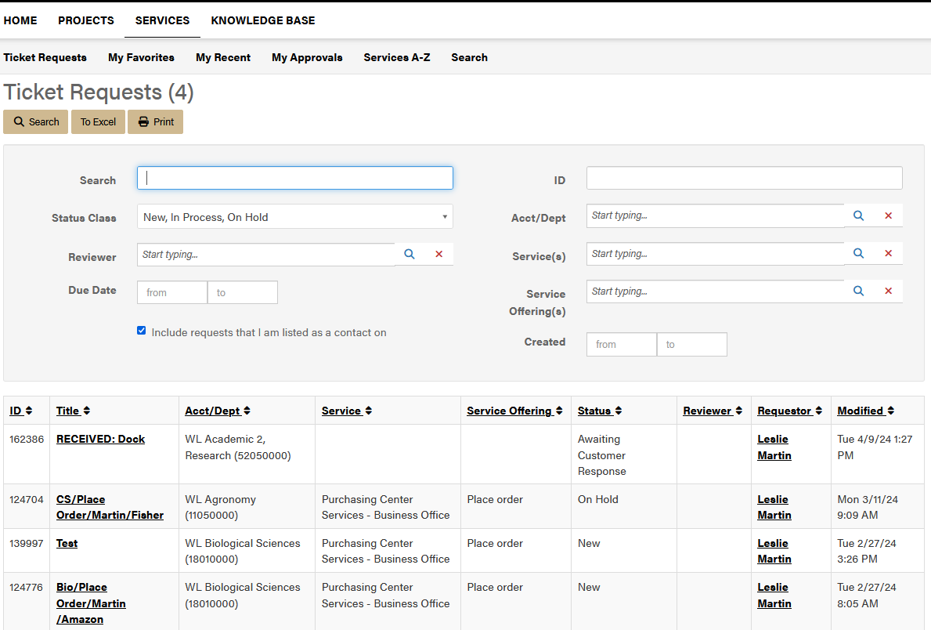
Purdue Service Portal – MAY 1st, electronic forms!
Tracking visibility for all emails AND electronic forms !
Services > Ticket Requests
All submissions for IT, Payroll, and Purchasing will be visible.
Status and request visible on main page
If selected and open, comments, the ability to provide more info and attachments available!
*Examples shown are in testing environment*

Slide 9
Other CoSP Processes
Credit Cards & Receipts
Receiving & Packing Slips
Personal Reimbursements
Check out card from Division Administrative Assistant
Department Specific Reconciler
Chemistry: Claire Evans
Cross-trained for coverage
Alan will remain in Chemistry at the dock.
Will continue to be available for pickup at the doc once email is received for pickup.
Alan to send packing slips to COSP.
No real change. Business Office involved
Prospective employees/grads: Form 17C
Personal reimbursements: Substitute W9, PC form
Alcohol: PRF – requires traditional W9
Email receipts to:
coscreditcard@purdue.edu
Receipts must be legible and contain NO tax.
Email Packing Slips to:
cospackslips@purdue.edu
Must be legible!
Email to:
cosprocure@purdue.edu
Requires original or authenticated signatures!
Notes:
Will need to be sent the account number and gl, if known

Slide 10
Transition Details
Weekly rollout approach – Divisional approach – 4 weeks – Beginning April 22nd
Week 1 – 4/22
Week 2 – 4/29
Week 3 – 5/6
Week 3 Cont’d
Week 4 – 5/13
Analytical
Claridge
Cooks
Dick
Drown
Kenttamaa
A. Laskin
J. Laskin
Mao
McLuckey
Simpson
Jesse Zhang
Materials
- Dong
Bio Chem
Das
Low- Nam
Lyon
Schlebach
Shah
Inorganic
Andrews
Bart
Li
Ren
Tian
Uyeda
Wilker
Mei
Organic
Parkinson
Chmielewski
Thompson
Wei
Ghosh
Lipton
Ngai
Ramachandran
PCHem/Theory
Reppert
Huang
Wenthold
Ming Chen
Hood
Kais
Liu
Slipchenko
Walther
Wasserman
POP/ Lecturers
JRK
Starr
Schmidt
Kern
Conklin
C. Harwood
Nash
Schertz
Prep Lab
Recharges
Admin Support
Faculty located in DRUG Discovery have already converted (Sintim, Chopra, Axelrod, Low)

Slide 11
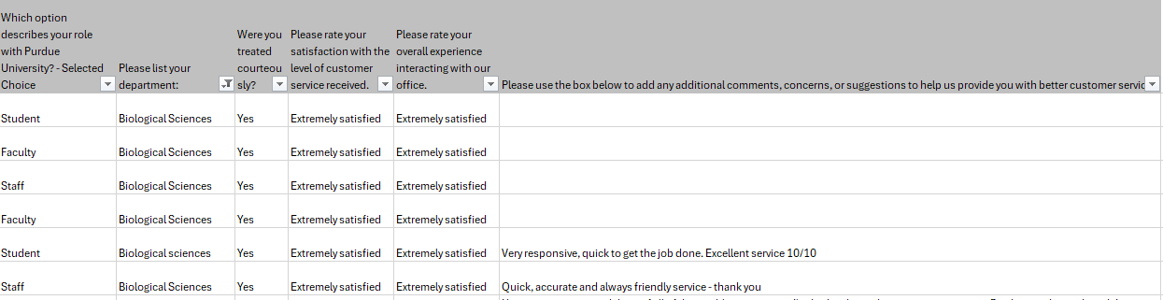
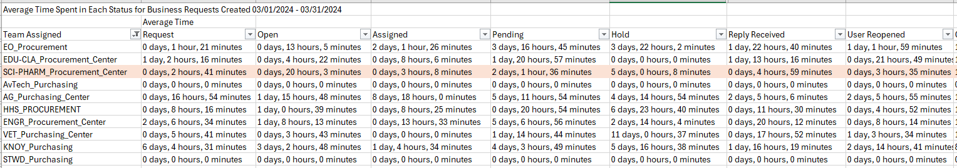
Emails & Questions received to date…
Experience from Biology’s perspective using centralized procurement system?
Will my order be shopped, and I get the best price?
  Much like current operations, we will process what is sent to us. If we know the item is with a preferred vendor and can get free shipping or a discount, we will automatically redirect with reason.
  If there is a clear and large price discrepancy, we will reach out to you prior to placing to confirm the adjustment.
  We do have knowledge on vendors and have similar logins to view Purdue pricing for vendors.
    Can continue to add, as needed, for Chemistry!
What is current turn around time for processing requests?

Slide 12
Emails & Questions received to date…
Complex orders > $10,000
  We have found that there is more time savings and less error when the end users submits request to central for Bid or Special Purchasing. You know the spec and what is desired. As the “middle-man” when launching the center, orders were extremely delayed, and it was not as effective.
Communication
  All communication will be time stamped and transparent. With the new system launching May 1, anyone that submits an order will be able to track and see all comments and where something is at in queue with the ability to add additional comments or attachments via the Purdue Service Portal
  We will communicate to confirms items received, if no packing slips is received. This is to help ensure our vendors are paid timely!
  We will communicate price and quantity variances to all faculty to ensure that you have a full understanding of what you are ordering.
    Price variances will require your approval!
    We will not complete an order without your approval if there is more than a 10% price variance over the listed price. If under, you win and get the cheaper price!
Dedicated Help
  Liz Dunning & Claire Evans for direct questions. Orders will be processed 1st in by all staff
Dry Ice Standing Orders
  Currently working with Indiana Oxygen to help transition and continue this service
Hazardous Shipping
  Will remain with Alan Springer, Department Shipping & Receiving

Slide 13

Send questions directly to Leslie or Liz
lmartin@purdue.edu or eplaspoh@purdue.edu
Available to chat via Teams, Webex, Zoom

Slide 14
Thank You

