Slide 1
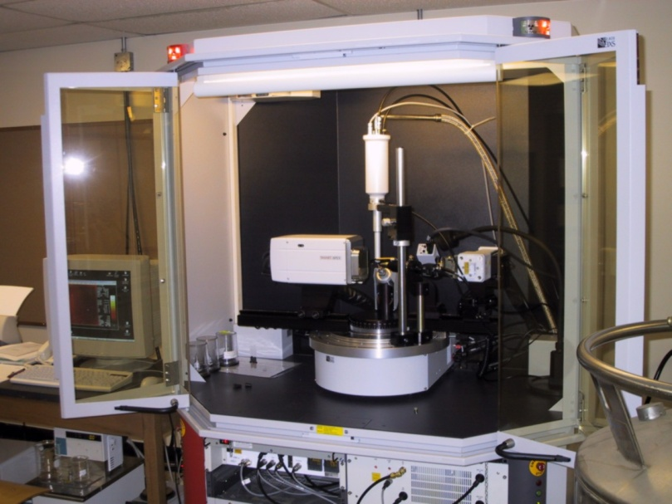
The Process of Crystallography
Practical Aspects of
Single Crystal X-ray Structure Determination
Single Crystal X-ray Diffraction,
Purdue University,
Dr. Matthias Zeller

Slide 2
Introduction to X-ray Crystallography
X-ray Crystallography 12650 - CHM 69600 will consist of:
The course is an introduction to X-ray crystallography and X-ray diffraction.
The main goal is to prepare you to independently use crystallography for your own research and to enable you to evaluate the work of others.
The course is divided in two sections:
  A lecture section focusing on the basics and theory of X-ray crystallography and X-ray diffraction.
  A hands-on laboratory section which aims to prepare you to be able to independently deploy the technique for your own use.
  The main focus: structural analysis of small molecule crystalline materials
  Some aspects of other diffraction techniques will also be covered (powder and multicrystalline XRD, extended solids (metals, ceramics), macromolecular XRD).

Slide 3
Introduction to X-ray Crystallography
Grading and weight of Components:
X-ray Online Safety Quiz: No grade, but the quiz needs to be passed before you can start working independently in the lab.
Homework assignments and take-home exams. 40% Open book. Includes both background / theory assignments as well as structure refinement exercises and at least two full data collections and refinements.
Midterm. 20%. Open book. Focus is on understanding of material covered in class and in previous assignments.
Lab Practical. 20%. Open book.
Final. 20%. Open book. Focus is on understanding of material covered in class and in previous assignments.

Slide 4
Introduction to X-ray Crystallography
The Lab Section of the Single Crystal XRD Class will consist of:
To operate X-ray producing equipment, you need to take and pass Purdue’s Office of Environmental Health and Safety (EHS) “X-ray: General Analytical Training” quiz via Purdue’s HSI system. Instructions are available here (The A4 form is NOT required)
Crystal Selection using an optical microscope; use of polarizing filter
Crystal Mounting, Project Setup; Unit Cell Measuring and Crystal Evaluation, use of Cambridge Database to check if structure is known
Setup of Data Collection; Strategy; Collection; Data Integration; Absorption Correction and Scaling; Exporting of final data files
Examples of easy Data Refinements (Computer Lab):
Refinement of a simple organic structure
Refinement of a simple inorganic structure
Refinement of a moderately complicated organic structure
Refinement of simple disorder / twinning
Several homework assignments examples of easy to moderate Data Refinements

Slide 5
Introduction to X-ray Crystallography
The Lab Section of the Single Crystal XRD Class will consist of: (Cont’d)
Lab Practical. An open book exam. It will be held about halfway through the term during one three-hour period. Students are expected to demonstrate that they are able to independently solve and refine a simple molecular solid-state structure from single crystal data.
No report needs to be prepared (due to time restraints). The work handed in will consist of printouts of the cif and res file (without the appended hkl file) and of the final checkcif report.
The data files (p4p, hkl and abs files) and background on the material (synthesis, solvent of crystallization, color, size and habit of the crystal) will be provided by the instructor.
Students can bring notes and textbooks, and other prepared materials. Internet access provided for running of checkcif report. Special information not generally known, such as unusual Shelxl commands, will be provided by the instructor.

Slide 6
Introduction to X-ray Crystallography
The Lab Section of the Single Crystal XRD Class will consist of: (Cont’d)
Two individual data collections, structure refinements and reports: “Bring your own crystals”. If you do not have any samples one can be provided, with the aim to match the sample to your research interest.
Ideally, the samples should be of a new compound with unknown structure. Individual data collections encompass the whole process of single crystal structure analysis, starting from growing crystals (if not yet available) to the final structural model and preparation of a crystallographic information file (CIF) that could function as the crystal structure part of a scientific publication.
The difficulty of data collection and analysis will naturally differ between samples. Grades will be assigned based on how well the analysis has been done given the complexity of the case, not on the data quality that could be obtained. A low R value does not guarantee an A. A marginal quality data set might be an A+.

Slide 7
Introduction to X-ray Crystallography
Suggested Text Books and Additional Literature:
Crystal Structure Analysis, Principle and Practice (International Union of Crystallography Monographs on Crystallography 13), Blake, Clegg, Cole, Evans, Main, Parsons, Watkin, Editor William Clegg
Crystal Structure Refinement: A Crystallographer's Guide to SHELXL (International Union of Crystallography Monographs on Crystallography) Peter Müller, Regine Herbst-Irmer, Anthony L. Spek, Thomas Schneider, and Michael Sawaya
A refresher of the basics:
W. Clegg, Crystal Structure Determination, Oxford Chemistry Primers No 60, Oxford University Press, 1998. ISBN: 0198559011. (96 pages)

Slide 8
Introduction to X-ray Crystallography
References and Further Reading
The SHELX homepage (references and software downloads)
http://shelx.uni-goettingen.de/
The Shelxle homepage
https://www.shelxle.org
Mercury web page
https://www.ccdc.cam.ac.uk/solutions/software/mercury/
Platon web page (homepage)
http://www.cryst.chem.uu.nl/spek/platon/
Platon web page (windows version)
http://www.chem.gla.ac.uk/~louis/software/platon/

Slide 9
Introduction to X-ray Crystallography
References and Further Reading
International Tables for Crystallography
http://it.iucr.org/ or http://it.iucr.org.ezproxy.lib.purdue.edu/
The latter address has access to full content, via the “Indexes” links.
A printed copy of several volumes is available in the X-ray lab. Ask Dr. Zeller if you’d like to check out a volume.
Checkcif web page
http://checkcif.iucr.org/
FinalCif
https://dkratzert.de/finalcif.html
IUCr Tools page (tables from cif files, Ortep plots, etc)
http://publcif.iucr.org/services/tools/
Background on Structure Validation and Checkcif:
Structure validation in chemical crystallography, Anthony L. Spek, Acta Cryst. D (2009). 65(2): 148–155.

Slide 10
Introduction to X-ray Crystallography
Scattering and Diffraction
The Basics

Slide 11
Introduction to X-ray Crystallography
The Basics of Scattering and Diffraction
Atomic scale structures of molecules and materials are too small to
resolve using classical optical microscopy methods or X-ray
absorption (computed tomography) techniques.
The highest resolution electron microscopy techniques can resolve
atoms, but they do only yield two dimensional images or low
resolution 3D reconstructions (“Cryo-EM”).
Instead, diffraction of X-rays, neutrons or (increasingly) electrons is used for
the determination of the structure of crystalline solids.
X-ray diffraction is the only standard method to establish the molecular
or atomic structure of any material.

Slide 12
Introduction to X-ray Crystallography
X-ray crystallography has been fundamental in the development of
all scientific fields that rely on the accurate knowledge of structure and bonding
at the atomic level.
Fundamental Physics of Structure and Bonding
Chemistry, Mineralogy, Materials Science (metals, alloys, ceramics,
electronics, etc),
Structure and Function of Biological Molecules
(vitamins, drugs, proteins, RNA, DNA, etc).
30+ Nobel prizes have been awarded for work related to, or involving the use
of X-ray crystallography (in Physics, Chemistry, and Physiology or Medicine)
http://www.iucr.org/people/nobel-prize

Slide 13
Introduction to X-ray Crystallography
Scattering:
Scattering describes the interaction of matter with waves.
Scattering is coherent (elastic), when the incoming and outgoing waves have the same wavelength/frequency.
Scattering is incoherent (inelastic) if some of the energy of the incoming photon is lost (frequency of the emitted wave is longer than that of the incident beam).
Elastic scattering at the electrons of atoms (Thompson scattering) is the effect we make use of in X-ray crystallography.

Slide 14
Introduction to X-ray Crystallography
In principle, X-ray scattering from even a single molecule could be
used for the determination of its molecular structure. Practically, the
signal has to be amplified, which is done by using many molecules
arranged in a regular fashion in a lattice (i.e. a crystal). This converts
X-ray scattering into X-ray diffraction. The diffracted intensity scales
with the square of the number of scatterers (atoms) in the crystal.
The wavelength to be used has to be of the same order of magnitude
as what one would like to measure. It is not necessarily limited to light
waves (i.e. X-rays), but particle waves (such as electrons or neutrons of
an appropriate speed/wavelength) can be used as well. Neutrons
interact with the nuclei of atoms, X-rays with the electron clouds of
atoms, electrons with the combined coulomb field of nuclei and electrons.

Slide 15
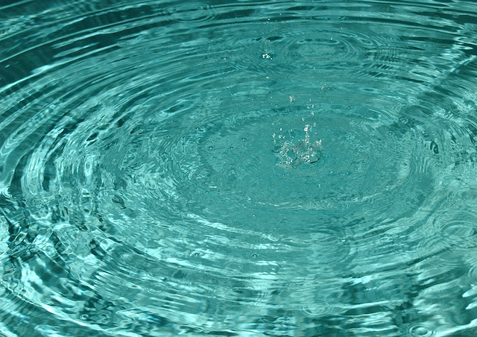
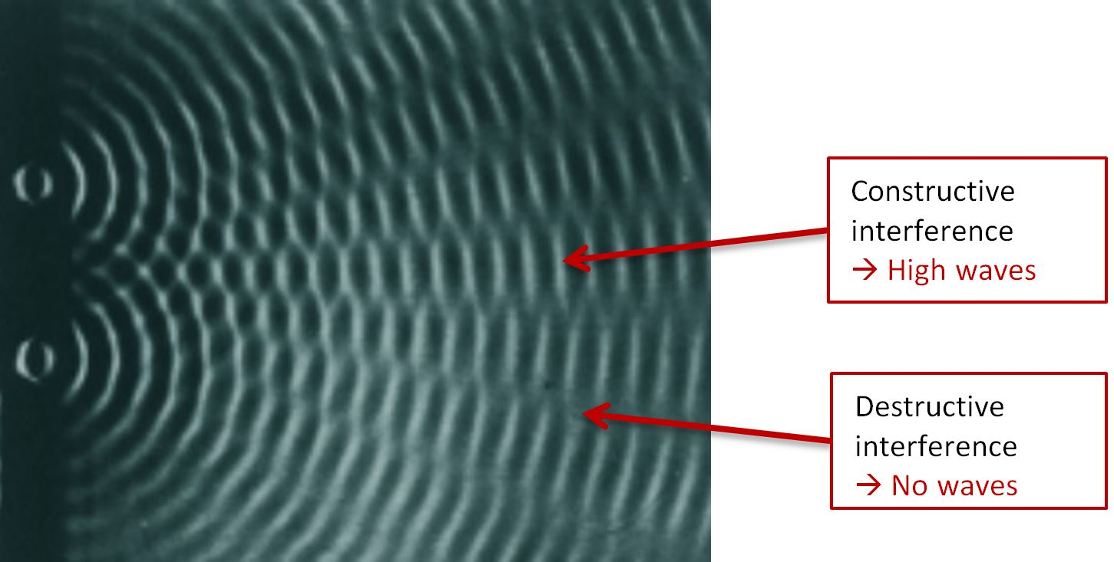
Introduction to X-ray Crystallography
Scattering:
Coherent waves emanating from a raindrop impact on water.
http://www.lookingatnothing.com/index.php/archives/1494
Diffraction:
http://blog.anton-paar.com/wave-and-particle-light-is-both/

Slide 16
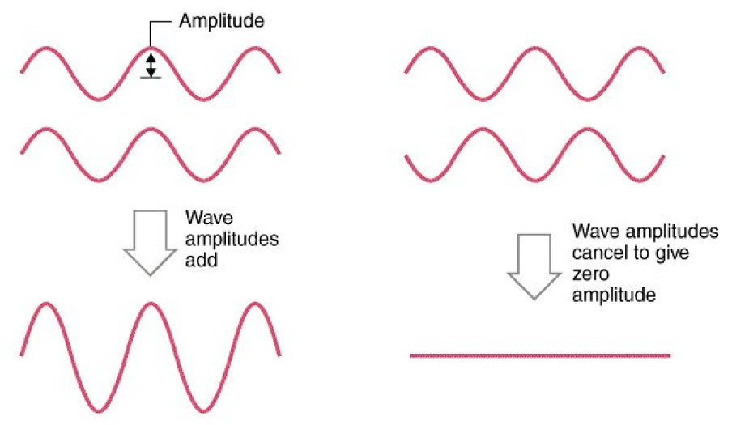
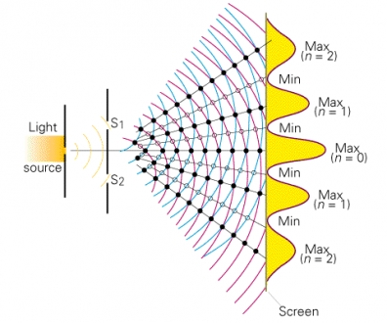
Introduction to X-ray Crystallography
Constructive and destructive interference of waves:
Diffraction:
Double-slit experiment with monochromatic light
http://www.cobocards.com/pool/de/card/7puji0113/online-karteikarten-beugung-und-interferenz-am-doppelspalt/

Slide 17
Introduction to X-ray Crystallography
Braggs’ Law
&
Miller Planes

Slide 18
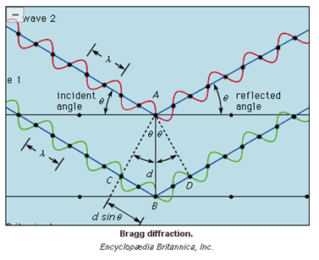
Introduction to X-ray Crystallography
Braggs’ Law (Gen Chem Version):
If the difference of path lengths
of X-ray beams “reflected” at
parallel lattice planes is a
multiple of the X-ray wavelength,
constructive interference results
⇒
“Reflection” at lattice planes
becomes a diffraction spot.
In all other cases: destructive
interference, no signal.
2d sinθ = nλ
Lawrence and William Henry Bragg, 1912; Nobel price 1915

Slide 19

Introduction to X-ray Crystallography
What do planes and reflections have to do with scattering of light at electrons????
2d sinθ = nλ
Lawrence and William Henry Bragg, 1912; Nobel price 1915

Slide 20
Introduction to X-ray Crystallography
Braggs’ Law:
Reality Check: There is no such thing as a “reflection” on a “lattice plane”. All scattering happens at atoms (interaction of wave with the atom’s electrons).
The regular arrangement of atoms in a crystal lattice leads to constructive and destructive interference if the path length of the X-ray is a regular fraction of the unit cell repeat units (or combinations thereof, i.e. the d-spacing).
The result looks like as if X-ray beams are “reflected” at “planes” constructed from fractions of the unit cell repeat units (lattice planes).
In reality, there is only diffraction of waves, no reflection of beams.
2d sinθ = nλ

Slide 21
Introduction to X-ray Crystallography
In that Encyclopedia Brittanica sketch, why are there two full waves inn the path length difference?
2d sinθ = nλ
Lawrence and William Henry Bragg, 1912; Nobel price 1915

Slide 22
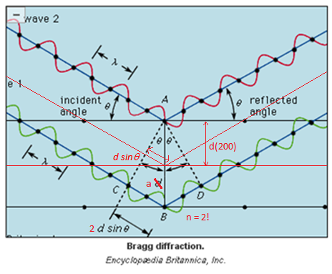
Introduction to X-ray Crystallography
Braggs’ Law:
In reality: There is no such thing as a “reflection” on a “lattice plane”. All scattering happens at atoms (interaction of wave with the atom’s electrons).
The regular arrangement of atoms in a crystal lattice leads to constructive and destructive interference if the path length of the X-ray is a regular fraction of the unit cell repeat units (or combinations thereof, i.e. the d-spacing).
The result looks like as if X-ray beams are “reflected” at “planes” constructed from fractions of the unit cell repeat units (lattice planes).
In reality, there is only diffraction of waves, no reflection of beams.
2d sinθ = nλ
n=2, this is the (200) reflection !!!

Slide 23
Introduction to X-ray Crystallography
More about Braggs’ Law in Q2 and Q3 of Homework 1

Slide 24
Introduction to X-ray Crystallography
Miller Indices and planes (brief):
The regular fractions of the unit cell repeat units that lead to constructive interference (i.e. the d-spacings that create diffraction spots) have to be somehow sorted in a meaningful way and made sense of with respect to crystal structure and unit cell.
Planes are defined perpendicular to every d-spacing that fulfills Braggs’ Law. These planes are called Miller planes (William Hallowes Miller, 1801-1880).
Every Miller plane is given a number, the Miller Index, that relates to the fraction that the plane is shifted along the a, b and c axis of the unit cell. The distance between parallel planes of the same index is the d-spacing.
The Miller Index is made up from the three inverse numbers of the fractions along a, b and c, placed in parentheses, called the h k l indices. A plane perpendicular to a, and repeating every unit cell once would be (1 0 0), etc.
The totality of all Miller planes, represented as vectors made up by the Miller Indices, makes up diffraction space, or reciprocal space (as opposed to real space). The vectors are most often reduced to the end point of the vector.

Slide 25
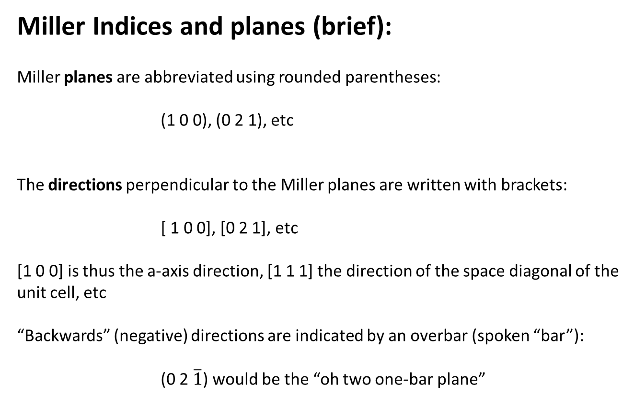
Introduction to X-ray Crystallography
Miller Indices and planes (brief):
Miller planes are abbreviated using rounded parentheses:
(1 0 0), (0 2 1), etc
The directions perpendicular to the Miller planes are written with brackets:
[ 1 0 0], [0 2 1], etc
[1 0 0] is thus the a-axis direction, [1 1 1] the direction of the space diagonal of the unit cell, etc
“Backwards” (negative) directions are indicated by an overbar (spoken “bar”):
(0 2 $\overline{1}$) would be the “oh two one-bar plane”

Slide 26
Introduction to X-ray Crystallography
Finding the Miller Indices for a Crystal Plane:
Write down the fraction along each of the three unit cell edges where the plane intersects that edge.
Take the reciprocal (inverse) of the fraction from Step 1.
If necessary, multiply the result from Step 2 by the highest common denominator to avoid fractions.
4. The generic symbol for a crystal plane is (hkl); the (1 0 0) plane is read as the ‘one oh oh’ plane

Slide 27
Introduction to X-ray Crystallography
Finding Miller Indices for a Crystal Plane - Example:
• Plane cuts cell edges a, b, & c at:
∞, 0.5, ∞
• Miller indices of the plane are:
(1/∞, 1/0.5, 1/∞) = (0 2 0)

Slide 28
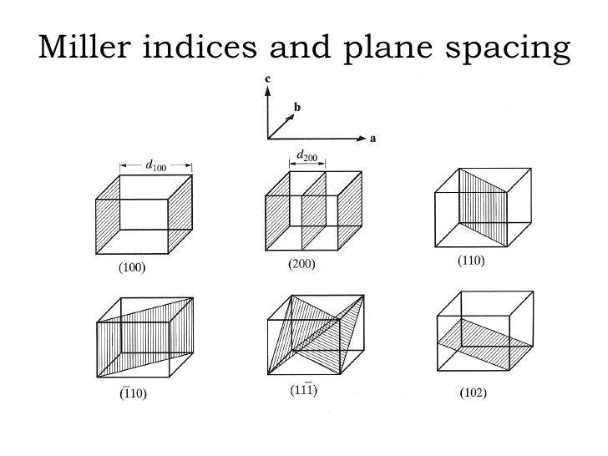
Introduction to X-ray Crystallography
http://www.slideshare.net/praying1/972-b3102005-cullity-chapter-2

Slide 29
Introduction to X-ray Crystallography
D-spacing:
• The d-spacing d_{(hkl)} is the distance between two closest parallel Miller planes of the same index hkl
• The value depends on the size and shape of the unit cell: the length of the axes a, b and c, and the angle α, β, γ
• Easy for all-90° angles. Not so easy for low symmetry unit cells.
d₍₀₂₀₎ = 0.5 b

Slide 30
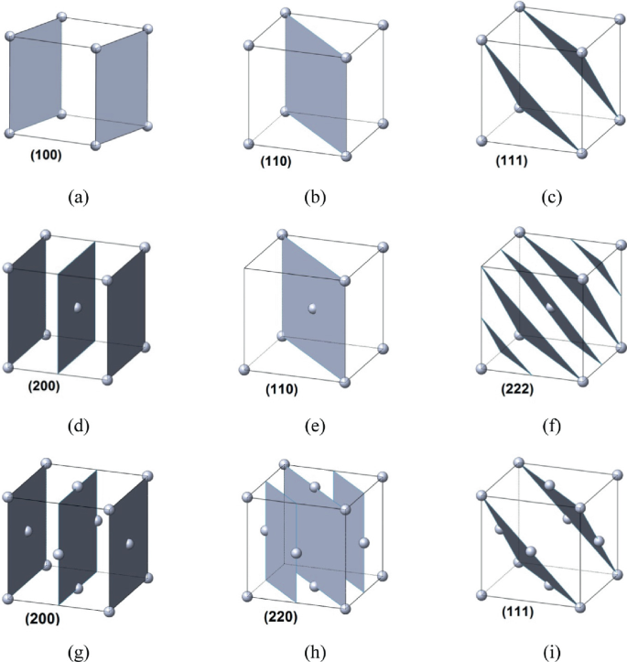
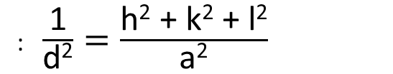
Introduction to X-ray Crystallography
D-spacing:
• The d-spacing d_{(hkl)} is the distance between two closest parallel Miller planes of the same index hkl
• The value depends on the size and shape of the unit cell: the length of the axes a, b and c, and the angle α, β, γ
• Easy for all-90° angles. Not so easy for low symmetry unit cells.
Some cubic cases (a=b=c, α=β=γ=90°)
: $\frac{\text{1}}{\text{d}\text{2}}=\frac{\text{h}\text{2}\text{ + }\text{k}\text{2}\text{ + }\text{l}\text{2}}{\text{a}\text{2}}$

Slide 31
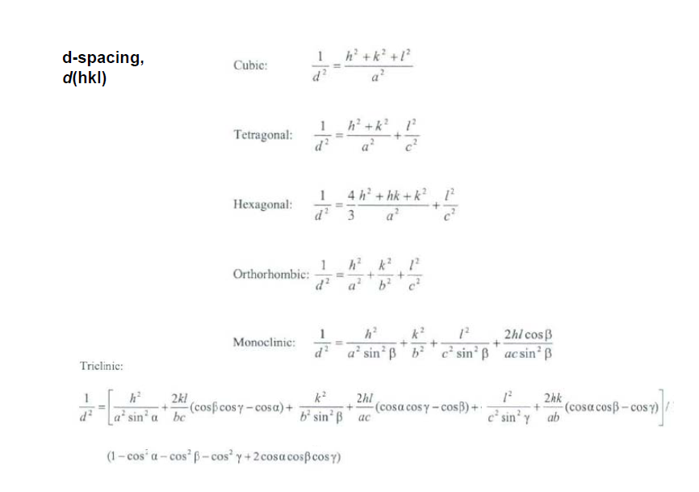
Introduction to X-ray Crystallography

Slide 32
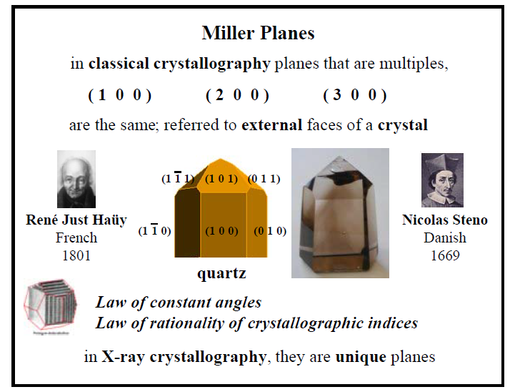
Introduction to X-ray Crystallography
Miller planes relate to crystal faces in well formed crystals:
From: 4latt.pdf

Slide 33
Introduction to X-ray Crystallography
Homework assignment 1:
Miller planes and Braggs' Law.

Slide 34
Introduction to X-ray Crystallography
X-ray Crystallography
in a (very small) nutshell

Slide 35
Introduction to X-ray Crystallography
In a Nutshell (adapted from Wikipedia):
In Single Crystal X-ray diffraction, a crystal is mounted on a goniometer and
gradually rotated while being bombarded with X-rays, producing a diffraction
pattern of regularly spaced spots known as “reflections”. The two-dimensional
images taken at different rotations are converted into a three-dimensional
model of the density of electrons within the crystal using the mathematical
method of Fourier transforms, combined with chemical knowledge about
the sample.

Slide 36
Introduction to X-ray Crystallography
Layout of a single crystal diffractometer:

Slide 37
Introduction to X-ray Crystallography
Data obtained from X-ray Crystallography:
Directly:
Positions of reflections
Intensities of reflections and their estimated standard deviations.
Indirectly, from reflection positions:
Smallest crystallographic repeating unit (the “unit cell” of the structure,
a, b and c-axes, α, β, γ angles).
Metric symmetry of the structure (apparent lattice centering and
Laue symmetry).
Indirectly, from reflection intensities:
Symmetry of the structure (actual lattice centering, Laue symmetry
and space group)
Phases of reflections (from model)
Positions and thermal parameters of atoms
Bond distances and angles, molecular symmetry, etc

Slide 38
Introduction to X-ray Crystallography
Add Flowchart here …

Slide 39
Introduction to X-ray Crystallography
Lattices, Unit Cells, Lattice Centering,
Crystal Systems & Reciprocal Space

Slide 40
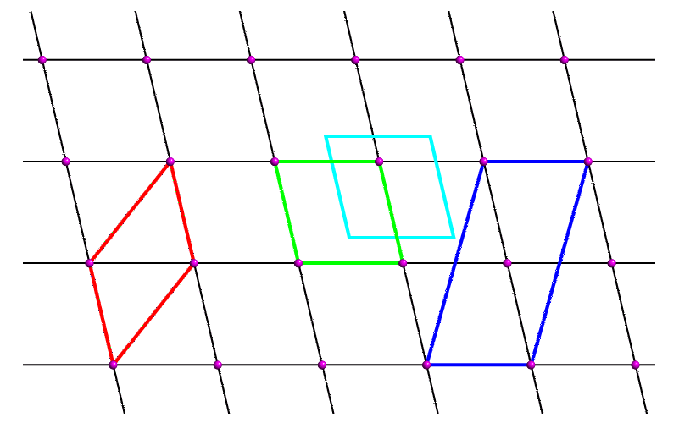
Introduction to X-ray Crystallography
Unit Cell, Lattices and Translational Symmetry
In structure determination, crystals are used (for signal enhancement).
Crystals consist of a regular lattice composed of repeating units, called Unit Cells.
Many choices exist for which repeating unit to use. The usual pick is the one with the smallest volume that completely reflects the symmetry within the unit cell.
Definitions also exist where to place the origin (based on internal symmetry).
Angles should be as close to 90° as possible.
“Lattice points”
2D lattice with several choices of unit cells
http://pd.chem.ucl.ac.uk/pdnn/symm1/trans1.htm

Slide 41
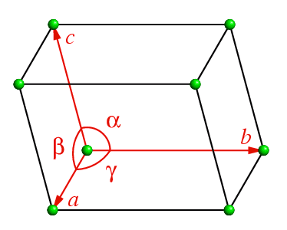
Introduction to X-ray Crystallography
Unit Cell, Lattices and Translational Symmetry
3D Unit Cell
http://pd.chem.ucl.ac.uk/pdnn/symm1/trans1.htm

Slide 42
Introduction to X-ray Crystallography
Unit Cell, Lattices and Translational Symmetry
Not all unit cell shapes and symmetries
are possible. They are constrained by
internal symmetry as well as restrictions
what can be densely packed into a three
dimensional lattice.
Mirror planes require two 90° angles.
Five- or seven-fold symmetry is not
compatible with lattice translations.
Six-fold symmetry (bee-hive) is possible.
etc
http://pd.chem.ucl.ac.uk/pdnn/symm1/trans1.htm

Slide 43
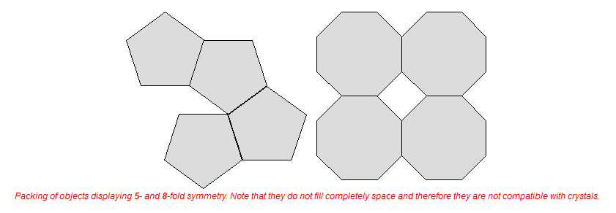
Introduction to X-ray Crystallography
Unit Cell, Lattices and Translational Symmetry
http://www.xtal.iqfr.csic.es/Cristalografia/parte_03_1_1-en.html

Slide 44
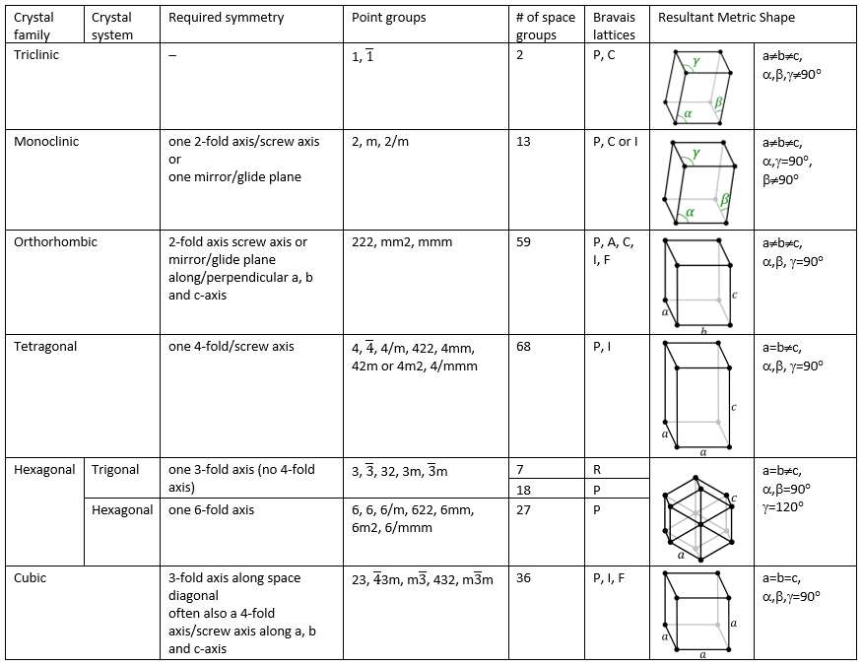
Introduction to X-ray Crystallography

Slide 45
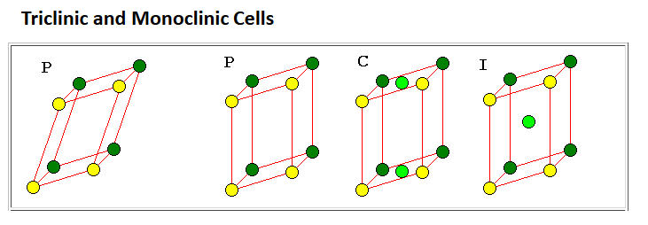
Introduction to X-ray Crystallography
Bravais Lattices and Lattice Centering
Symbols
P – Primitive: simple unit cell
A, B, C-centered: additional lattice point at the center of the A, B or C face
I-centered: additional lattice point at the center of the cell
R-centered: two additional lattice points inside the cell, trigonal only
F-centered: additional lattice points at the center of the A, B and C face
https://www.uwgb.edu/dutchs/symmetry/bravais.htm

Slide 46
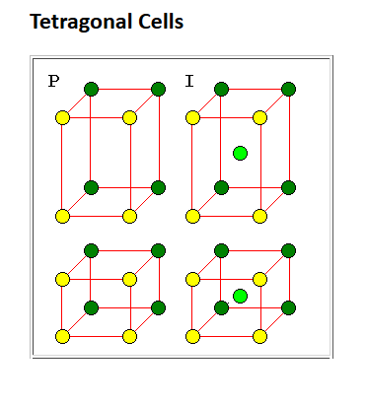
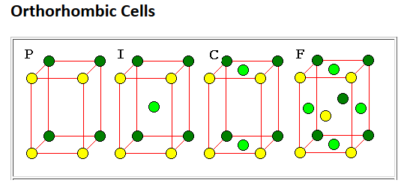
Introduction to X-ray Crystallography
Bravais Lattices and Lattice Centering
A-centering also possible for orthorhombic cells.
https://www.uwgb.edu/dutchs/symmetry/bravais.htm

Slide 47
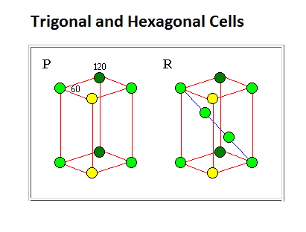
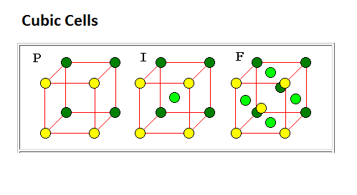
Introduction to X-ray Crystallography
Bravais Lattices and Lattice Centering
https://www.uwgb.edu/dutchs/symmetry/bravais.htm

Slide 48
Introduction to X-ray Crystallography
Lattice Centering – What is it all about?
The concept of Lattice Centering is mathematically completely sound and absolutely necessary for an accurate description of symmetry in crystallography.
But why is there a need for unit cells other than primitive?
This requires to explain the concept of lattice points. Lattice points are positions in the lattice that have the exact same environment. Each of these lattice points must have the same number of neighbors as every other such point and the neighbors must always be found at the same distances and directions. In a primitive cell, all lattice points are created from each other by unit translations along the unit cell axes of the cell.
However, there might be unit cells with more than one lattice point per unit cell, related by non-unit translations. It is always possible to define a primitive cell for the lattice with only one lattice point. But often, other symmetry considerations support the choice of a non-primitive unit cell with more than one lattice point.

Slide 49
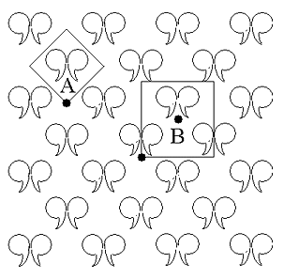
Introduction to X-ray Crystallography
Lattice Centering – What is it all about?
A visual example:
Cell A on the left contains one set of mirror-related objects and thus one lattice point, but the cell isn't oriented with the mirror along one of the axes. It has a mirror plane, thus should be monoclinic* with the mirror plane perpendicular to one of the cell’s axes. By simply rotating the cell the mirror could be made parallel to an axis, but then the translational symmetry would be lost.
Cell B on the other hand, although it's twice as big with two lattice points, is easier to deal with because of the orientation of the axes and the mirror plane. The additional lattice point making this a non-primitive cell is "centered" in the cell and located at 1/2, 1/2. It is an I-centered monoclinic* cell.
From: http://faculty.washington.edu/stenkamp/bstr515/nbsym.html
* In a 2D case: rectangular (“plane group” cm)

Slide 50
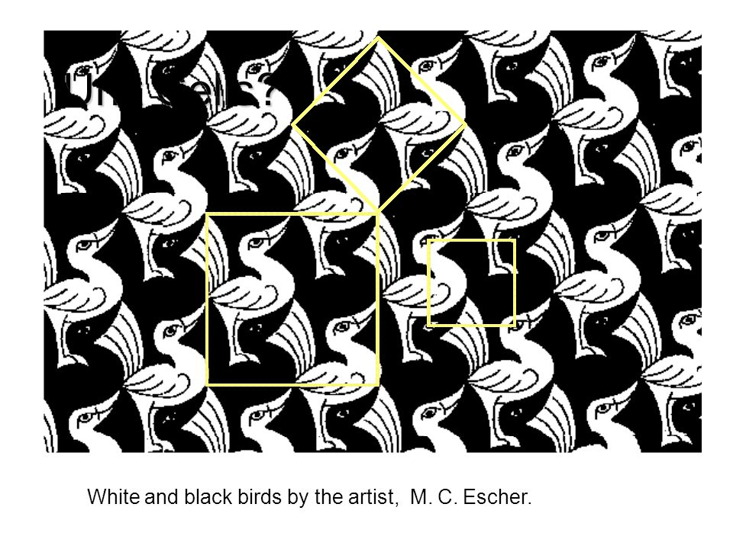
Introduction to X-ray Crystallography
Lattice Centering – What is it all about?

Slide 51
Introduction to X-ray Crystallography
Lattice Centering Conventions for Monoclinic Crystals
Monoclinic centered cells can in principle be A, B, C, I or F centered.
Only C and I centered cells are considered “conventional”.
B-centered cells can be converted into a monoclinic primitive cell of half the size (no need for centering).
A and F centered cells can be converted into a C or I centered cell.
C and I centered cells can also be converted into each other. The cell with the smaller β-angle should be used (many software packages are not set up to handle I-centered monoclinic cells and often the C-centered cell is wrongly used instead).
(similar considerations apply for orthorhombic, tetragonal and cubic cells)

Slide 52
Introduction to X-ray Crystallography
1st Laboratory Exercise:
Recognizing Translational Symmetry,
Escher Drawings

Slide 53
Introduction to X-ray Crystallography
Homework assignment 2:
Christmas Crystallography

Slide 54
Introduction to X-ray Crystallography
The Reciprocal Lattice
• Diffraction space and real or direct space are reciprocal to each other (“inverse”). The lattice in diffraction space (undistorted diffraction images) is called the reciprocal lattice.
• Distances between spots on a diffraction pattern are the reciprocal of real space distances:
short axes: diffraction spots are far apart
long axes: diffraction spots are close together
• Reciprocal axes, indicated by a star *, are perpendicular to the plane of the other two axis (a* is perpendicular to the bc-plane, or A-plane)

Slide 55
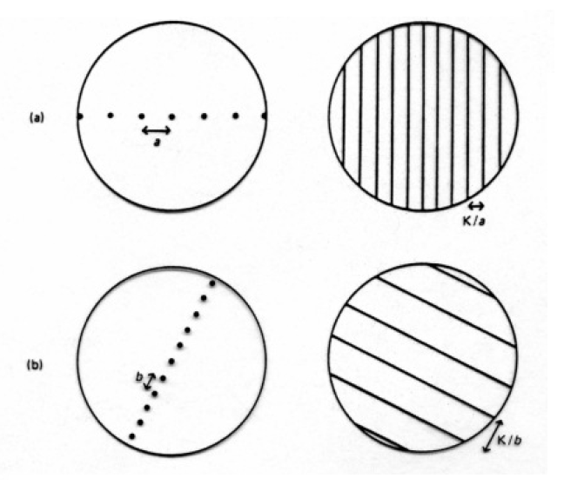
Introduction to X-ray Crystallography
One dimensional Reciprocal Lattice using optical gratings:
Left:
Holes in a grating
Right:
Resultant diffraction pattern (monochromatic light, e.g. laser pointer)
From: Glusker & Trueblood, Crystal Structure Analysis, 2nd ed., Oxford Univ. Press, 1985.

Slide 56
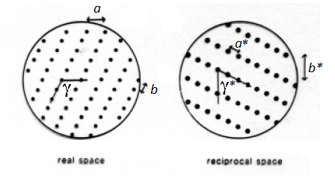
Introduction to X-ray Crystallography
Two dimensional Reciprocal Lattice using optical gratings:
Left:
Holes in a grating
Right:
Resultant diffraction pattern
Note: a* ⊥ b, b* ⊥ a
From: Glusker & Trueblood, Crystal Structure Analysis, 2nd ed., Oxford Univ. Press, 1985.

Slide 57
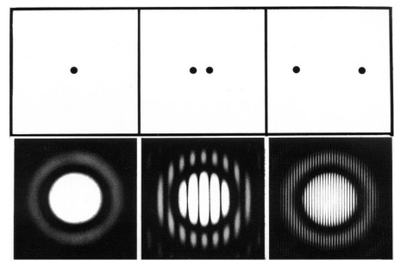
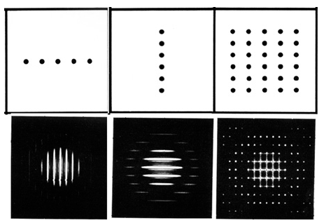
Introduction to X-ray Crystallography
Two dimensional Reciprocal Lattice using optical gratings:
More Examples:
https://www.xtal.iqfr.csic.es/Cristalografia/parte_05_3-en.html

Slide 58
Introduction to X-ray Crystallography
Symmetry Elements & Operations

Slide 59
Introduction to X-ray Crystallography
Symmetry Elements & Operations
• Symmetry Element: A symbol defining a specific (conceptual) motion about a point, axis, or plane in an object*, that - when carried out - leaves the system
invariant.
• A symmetry operation is the actual motion (e.g. rotation, reflection, etc.) associated with a symmetry element.
*the object must have identity for this to hold true

Slide 60
Introduction to X-ray Crystallography
Types of Symmetry Operations in Crystals
1. Point Symmetry leaves at least one point invariant (unmoved) during the symmetry operation. It can consist of rotation, inversion, reflection, and rotoinversion (combined rotation + inversion). Individual molecules can have point symmetry.
2. Translational Symmetry is present in crystal structures, but not single molecules; e.g. a lattice translation that leaves the entire system invariant.
3. Space Symmetry is the combination of point & translational symmetry; there are three possible space symmetry elements – lattice centering, glide planes & screw axes (the latter two are usually just called translational symmetry elements).

Slide 61
Introduction to X-ray Crystallography
Symmetry, In a Nut Shell
Types of point group symmetry:
Center of Inversion
Rotational axes (rotation by 360°/n, where n = 1, 2, 3, 4, 6)
Rotary inversion axes (2-, 3-, 4-, 6-fold rotation combined with inversion)
Mirror planes (this is actually a two-fold rotary inversion axis)
Types of translational symmetry:
Simple translations (by one unit cell, creates crystal)
Lattice translations (Lattice centering: P (primitive), A, B and C (base), I (body), F (face) or R (rhombohedral) centering)
Combinations of point and translational symmetry:
Screw axes: Combines rotational axis with translation by a fraction of the
unit cell dimension (2₁, 3₁, 3₂, 4₁, 4₃, 6₁, 6₅ screw axes, etc)
Glide planes: Combines mirror plane with translation by half a unit cell axis
(a, b, c, n glide planes) or a quarter unit cell axis (d-glides)

Slide 62
Introduction to X-ray Crystallography
Point Group (Molecular) Symmetry
Schönflies (or
Schoenflies) vs
Hermann-Maugin
notations

Slide 63
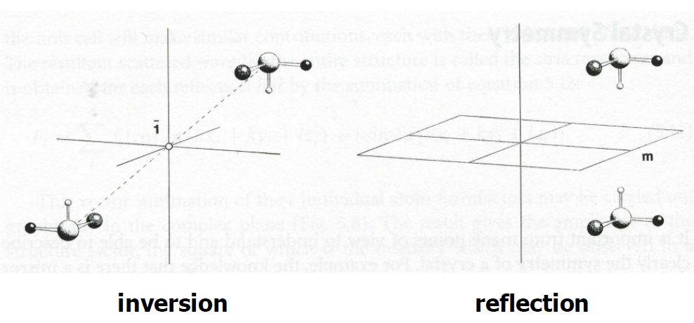
Introduction to X-ray Crystallography
Examples of Point Group Symmetry:
From: Werner Massa, Crystal Structure Determination, Springer Science & Business Media, 2013

Slide 64
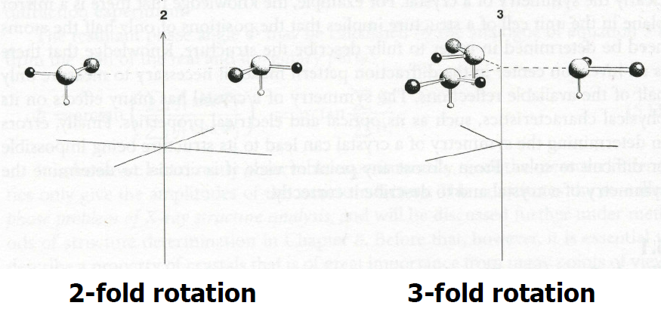
Introduction to X-ray Crystallography
Examples of Point Group Symmetry:
From: Werner Massa, Crystal Structure Determination, Springer Science & Business Media, 2013

Slide 65
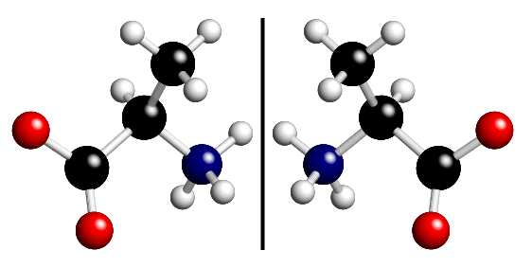
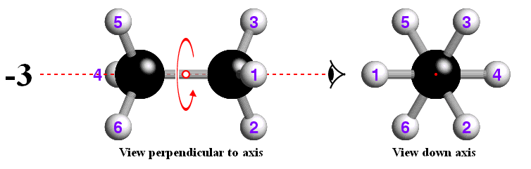
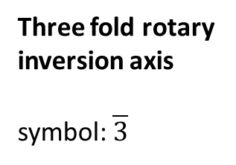
Introduction to X-ray Crystallography
Examples of Point Group Symmetry:
Mirror plane
symbol: m
Three fold rotary
inversion axis
symbol: $\overline{3}$
http://pd.chem.ucl.ac.uk/pdnn/symm1/invert2.htm ibid/invert3.htm

Slide 66
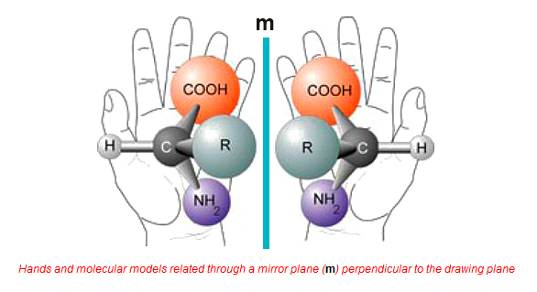
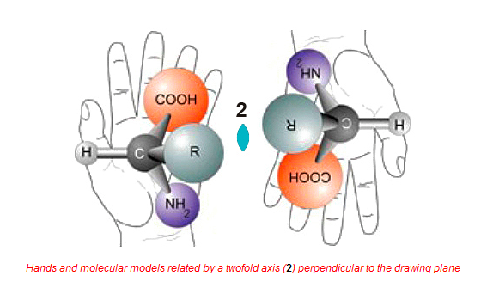
Introduction to X-ray Crystallography
Examples of Point Group Symmetry:
Mirror plane
symbol: m
Two-fold axis
symbol: 2
http://www.xtal.iqfr.csic.es/Cristalografia/parte_03-en.html

Slide 67
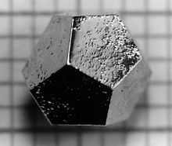
Introduction to X-ray Crystallography
5, 7, 8, 9-fold rotation axes?
A five-fold rotation axis is a perfectly good choice in molecular symmetry (cyclopentadienyl anion in the gas phase), but it is incompatible with translational symmetry in the solid state. It is not possible to pack pentagons to fill all space while retaining exact translational symmetry.
Try it!
(also true for 7-fold, 8-fold, etc. symmetry)...
Note: There are crystals with five-fold symmetry (quasicrystals, Nobel prize 2011 to Dan Shechtman). They do NOT have exact translational symmetry. Their discovery made it necessary to change the definition of what a crystal is!
Dodecahedron shaped Ho–Mg–Zn quasicrystal with 2mm
edges (https://en.wikipedia.org/wiki/Crystal)

Slide 68
Introduction to X-ray Crystallography
Symmetry exercise 1:
Exploring molecular symmetry (point group symmetry)
http://symmetry.otterbein.edu/gallery/index.html

Slide 69
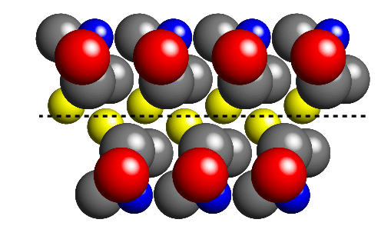
Introduction to X-ray Crystallography
Combinations of point group and translational symmetry:
Glide planes
Reflection of molecule across
the dashed line (glide plane),
then translation by half a
unit cell along a direction within
the glide plane
http://pd.chem.ucl.ac.uk/pdnn/symm1/glide1.htm

Slide 70
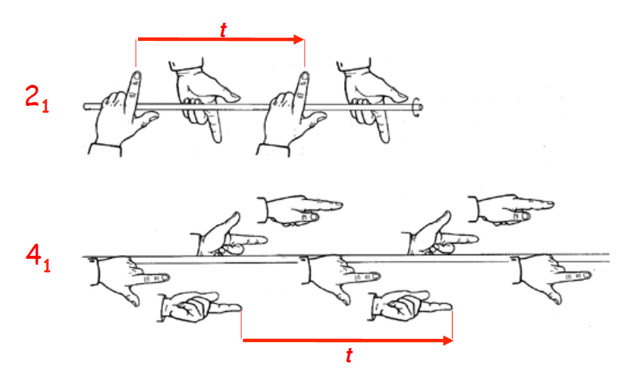
Introduction to X-ray Crystallography
Example of Symmetry:
Screw axes
Translation by 1/2 t per 180° rotation
Translation by 1/4 t per 90° rotation
From: LMB Crystallography Course, 2013, Crystals, Symmetry and Space Groups, Andrew Leslie

Slide 71
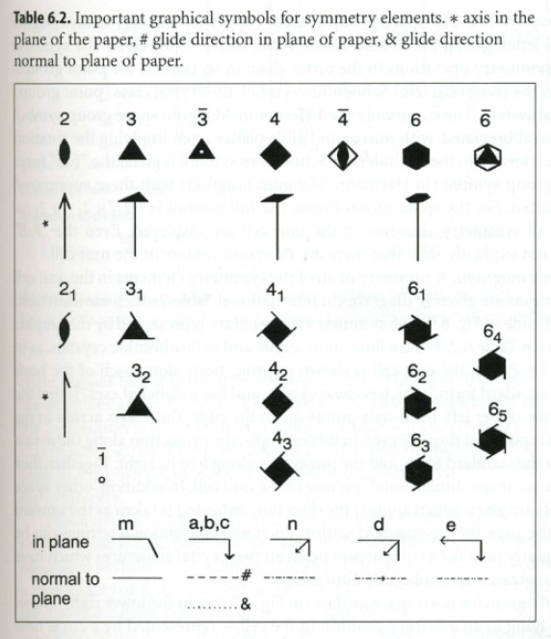
Introduction to X-ray Crystallography
Symmetry Symbols used in Crystallography:
From: Werner Massa, Crystal Structure Determination, Springer Science & Business Media, 2013

Slide 72
Introduction to X-ray Crystallography
Point Groups & Space Groups

Slide 73
Introduction to X-ray Crystallography
Point Group
A point group is a collection of symmetry elements that operate on a molecule or crystal to leave a point in the system invariant.
For individual molecules, symmetry elements can be combined in a nearly infinite number of combinations (seven-fold rotation axis with perpendicular and parallel mirror planes, etc)
For crystals, the necessity to combine point group symmetry with translational symmetry reduces the number of possible point groups to 32 unique combinations.
The 32 crystallographic point groups are referred to as the 32 crystal classes.

Slide 74
Introduction to X-ray Crystallography
Space Group
A space group is the symmetry group of a configuration in space, usually in three dimensions.
In three dimensions, there are 219 distinct types, or 230 if chiral copies are considered distinct.
The 230 space groups are created by combination of the 32 crystallographic point groups with the 14 Bravais lattices (each of the latter belonging to one of the 7 crystal or lattice systems).
Merging of chiral copies of the 32 point groups creates the 11 unique Laue Groups of crystallography.
The 32 point groups are the same as used in group theory and spectroscopy (C3v, Td, etc), but a different naming convention is used for easier combination with translational symmetry in crystals. Spectroscopy uses the Schönflies notation, crystallography the Hermann-Maugin notation.

Slide 75
Introduction to X-ray Crystallography
To obtain the point group associated with a crystallographic space group, all glide planes and screw axes are converted into their respective mirror planes and axes.
Example: The point group of P2₁ is 2
P2₁/c is 2/m
Pbca is mmm
Pca2₁ is mm2
P6₃ is 6
P6₃/mmc is 6/mmm
The Laue group of a space group is the highest symmetry space group of the crystal system the space group belongs to (note: there are separate Laue groups for high and low symmetry tetragonal, trigonal, hexagonal and cubic).
Example: The Laue group of P2₁ is 2/m
P2₁/c is 2/m
Pbca is mmm
Pca2₁ is mmm
P6₃ is 6/m (low symmetry hexagonal)
P6₃/mmc is 6/mmm (high symmetry hexagonal)

Slide 76
Introduction to X-ray Crystallography
Laue Class, Hermann-Maugin and Schönflies point groups

Slide 77
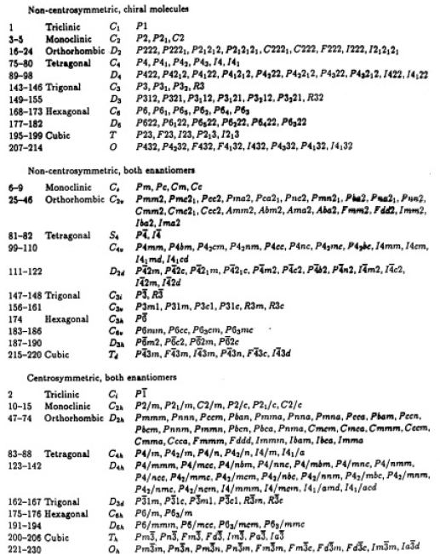
Introduction to X-ray Crystallography
The 230 Space Groups
A bit busy, but you get the idea …
Glusker et al., Crystal Structure Analysis for Chemists and Biologists, Wiley-VCH, 1994, Table 4.6.

Slide 78
Introduction to X-ray Crystallography
Space Group Naming Convention
We use the shortened Hermann Maugin notation following the recommendations of the International Union of Crystallography (IUCr) and the International Tables of Crystallography (published by the IUCr).
The notation describes the lattice and some (not all) symmetry generators for the space group. It usually consists of a set of four symbols.
The first is the Bravais lattice centering (P, A, B, C, I, R or F).
The next three describe the most prominent symmetry operation visible when
projected along one of the high symmetry directions of the crystal. Used are
point group symbols, glide planes and screw axis.

Slide 79
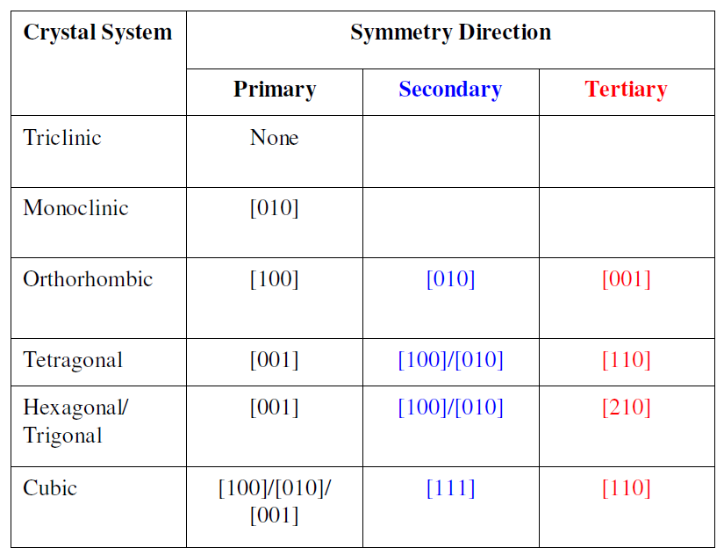
Introduction to X-ray Crystallography
Space Group Naming Convention

Slide 80
Introduction to X-ray Crystallography
Space Group Naming Convention
The long HM symbol shows both rotation or screw axes running parallel to the specific symmetry direction, and mirror or glide planes perpendicular to the same direction. The two symbols are separated by a forward slash (/).
e.g. P 2/m 2/n 2₁/a
The short HM symbol typically contains only the mirror/glide plane component corresponding to each symmetry direction, or in the absence of a mirror/glide plane the rotation/screw axis present will be shown. In certain cases (monoclinic, tetragonal and hexagonal), both the rotation/screw axis and the mirror/glide plane symbols are retained in the short HM symbol (for the primary direction only).
e.g. Pmna vs. P 2/m 2/n 2₁/a, P6₃/mmc vs. P 6₃/m 2/m 2/c
Adapted from: http://www.chemistry.ohio-state.edu/~woodward/ch754/symmetry.htm

Slide 81
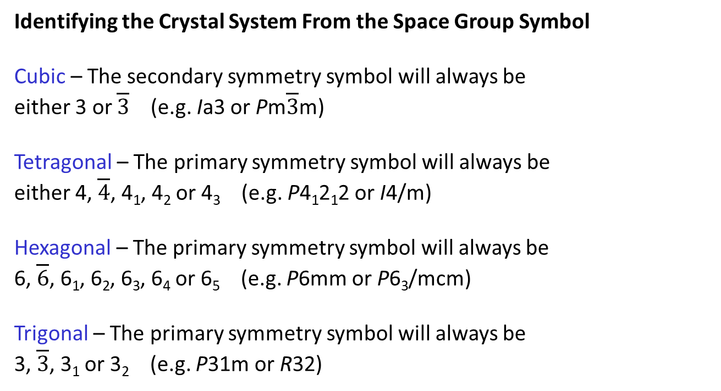
Introduction to X-ray Crystallography
Space Group Naming Convention
Identifying the Crystal System From the Space Group Symbol
Cubic – The secondary symmetry symbol will always be
either 3 or $\overline{3}$ (e.g. Ia3 or Pm$\overline{3}$m)
Tetragonal – The primary symmetry symbol will always be
either 4, $\overline{4}$, 4₁, 4₂ or 4₃ (e.g. P4₁2₁2 or I4/m)
Hexagonal – The primary symmetry symbol will always be
6, $\overline{6}$, 6₁, 6₂, 6₃, 6₄ or 6₅ (e.g. P6mm or P6₃/mcm)
Trigonal – The primary symmetry symbol will always be
3, $\overline{3}$, 3₁ or 3₂ (e.g. P31m or R32)
Adapted from: http://www.chemistry.ohio-state.edu/~woodward/ch754/symmetry.htm

Slide 82
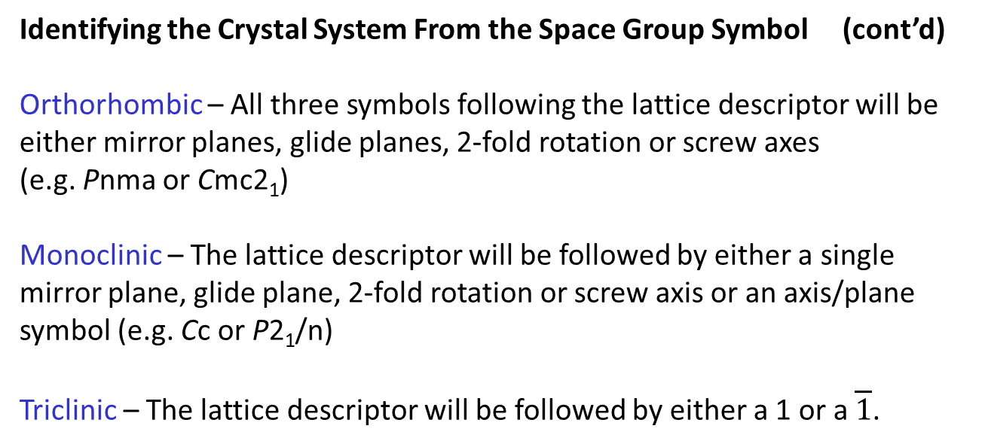
Introduction to X-ray Crystallography
Space Group Naming Convention
Identifying the Crystal System From the Space Group Symbol (cont’d)
Orthorhombic – All three symbols following the lattice descriptor will be either mirror planes, glide planes, 2-fold rotation or screw axes
(e.g. Pnma or Cmc2₁)
Monoclinic – The lattice descriptor will be followed by either a single mirror plane, glide plane, 2-fold rotation or screw axis or an axis/plane symbol (e.g. Cc or P2₁/n)
Triclinic – The lattice descriptor will be followed by either a 1 or a $\overline{1}$.
Adapted from: http://www.chemistry.ohio-state.edu/~woodward/ch754/symmetry.htm

Slide 83
Introduction to X-ray Crystallography
Space Group Naming Convention
P2₁/c (or P12₁/c1) (the most common space group)
Primitive centering of the motif (i.e., one lattice point per unit cell)
Two-fold screw axis along the b-axis, c-glide plane perpendicular to the b-axis
(by convention the monoclinic axis is always the b-axis; the a-axis should be smaller than the c -axis)
No symmetry along the first and third directions (a- and c-axes).
Note: The screw axis and glide plane necessarily create an inversion center. This is NOT explicitly part of the space group name.

Slide 84
Introduction to X-ray Crystallography
Space Group Naming Convention
P3₁21 (space group of quartz)
Primitive centering of the motif (i.e., one copy per unit cell)
Threefold screw axis along the c-axis (the major axis in a trigonal structure)
Twofold rotation axis along the a and b axes (the secondary axes in a
trigonal structure).
No symmetry along the tertiary direction, [2 1 0].
(Note, there also exists a trigonal space group P3₁12. In this space group the twofold axes are not along the a and b-axes but in a direction rotated by 30°, [2 1 0]).

Slide 85
Introduction to X-ray Crystallography
Comments on Symmetry and Space Groups:
There are Sohnke space groups (have no mirror planes, glide planes or inversion centers), centrosymmetric space groups (have an inversion center) and non-centrosymmetric space groups (have no inversion center, but have either a mirror or glide plane).
Chiral compounds have to crystallize in a Sohnke space group (all proteins and most sugars and natural compounds). Chiral space groups are a subset of Sohnke space groups that occur in two enantiomorphic variants (e.g. P4₁-P4₃, but not P2₁, which has no distinct enantiomorph)
Achiral compounds or racemic mixtures can crystallize in chiral space groups (“resolution”) but tend to crystallize in centrosymmetric space groups.

Slide 86
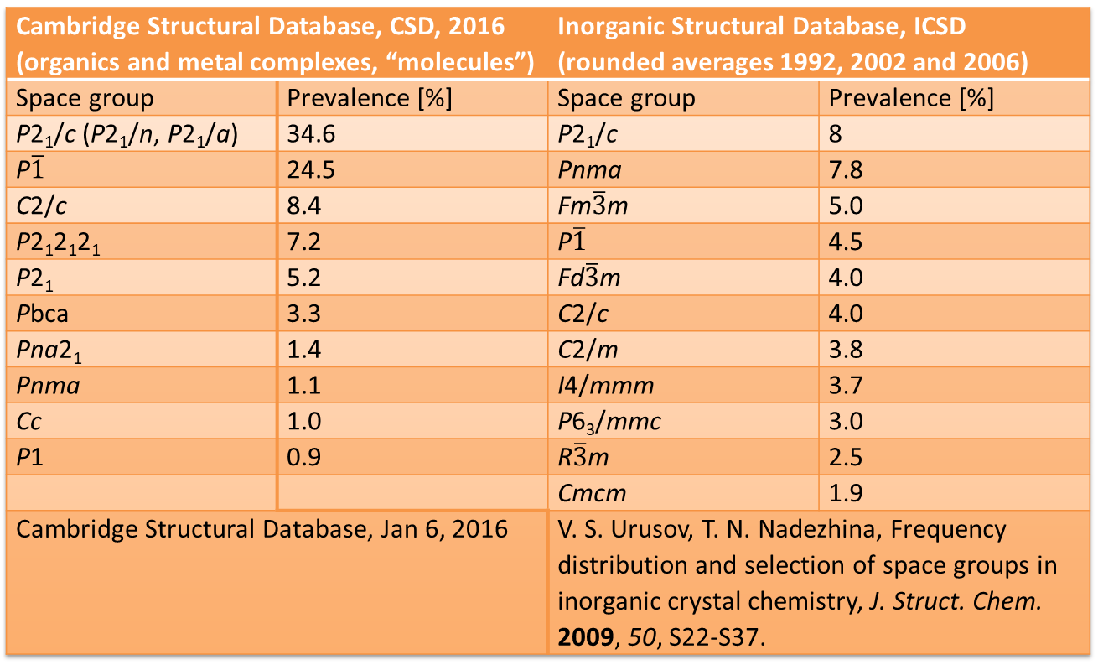
Introduction to X-ray Crystallography
Space Groups Statistics:
Cambridge Structural Database, CSD, 2016 (organics and metal complexes, “molecules”) |  | Inorganic Structural Database, ICSD (rounded averages 1992, 2002 and 2006)
Space group | Prevalence [%] | Space group | Prevalence [%]
P2₁/c (P2₁/n, P2₁/a) | 34.6 | P2₁/c | 8
P$\overline{1}$ | 24.5 | Pnma | 7.8
C2/c | 8.4 | Fm$\overline{3}$m | 5.0
P2₁2₁2₁ | 7.2 | P$\overline{1}$ | 4.5
P2₁ | 5.2 | Fd$\overline{3}$m | 4.0
Pbca | 3.3 | C2/c | 4.0
Pna2₁ | 1.4 | C2/m | 3.8
Pnma | 1.1 | I4/mmm | 3.7
Cc | 1.0 | P6₃/mmc | 3.0
P1 | 0.9 | R$\overline{3}$m | 2.5
 |  | Cmcm | 1.9
Cambridge Structural Database, Jan 6, 2016 |  | V. S. Urusov, T. N. Nadezhina, Frequency distribution and selection of space groups in inorganic crystal chemistry, J. Struct. Chem. 2009, 50, S22-S37.

Slide 87
Introduction to X-ray Crystallography
Space Groups Statistics:
Organic: Only Triclinic, Monoclinic and Orthorhombic > 1%
Inorganic: All Crystal Systems are present
Organic: Very narrow distribution (two space groups > 50%)
Inorganic: More equal distribution
Organic: Several Sohnke and non-centrosymmetric space groups > 1%
Inorganic: No Sohnke or non-centrosymmetric space groups > 1% (Pna2₁ = 0.9%)
Organic: Glide planes and screw axes dominate (“Banana packing”)
Inorganic: Mirror planes and rotation axes dominate (“Apple packing”)
Metal Organic Frameworks (MOFs) behave similar as inorganic compounds.

Slide 88
Introduction to X-ray Crystallography
Homework assignment 3:
Space Groups and Symmetry

Slide 89
Introduction to X-ray Crystallography
Systematic Absences
&
Space Group Determination

Slide 90
Introduction to X-ray Crystallography
Reflection Conditions and Systematic Absences:
Space groups assignment
Symmetry operations that include translational components yield
systematic absences in the diffraction pattern (reflections that have zero intensity) regardless of the cell content due to perfect destructive interference of waves separated by one translation.
This helps to identify these symmetry operations and narrows down the number of possible space groups (we do that in the program XPREP).
Symmetry operations with translational components are:
Screw axes
Glide planes
Bravais translations

Slide 91
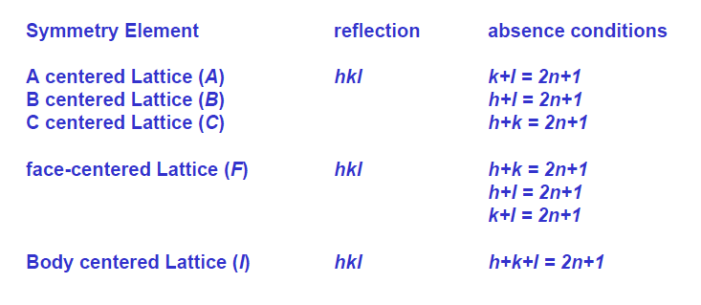
Introduction to X-ray Crystallography
Systematic Absences due to Lattice Centering:

Slide 92
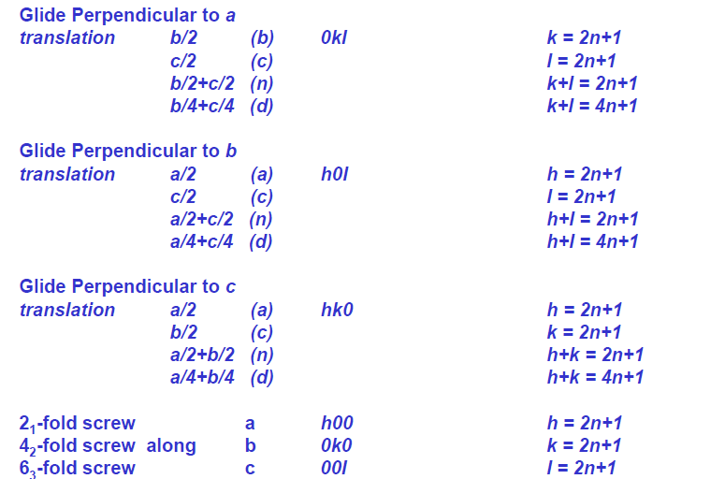
Introduction to X-ray Crystallography
Systematic Absences due to Glide Planes and Screw Axis:

Slide 93
Introduction to X-ray Crystallography
Systematic Absences due to Glide Planes and Screw Axis:
Do I really have to remember all these systematic absence rules and equations?

Slide 94
Introduction to X-ray Crystallography
Systematic Absences due to Glide Planes and Screw Axis:
Do I really have to remember all these systematic absence rules and equations?
Usually not. Space group assignment is done using software tools that automatically analyze the structure factor file (list of reflection intensities) for possible systematic absences.
Knowing what those tables mean does however help a lot when the choice is not that obvious.
The software choice can be wrong. Systematic absences might be obscured because of:
a) Pronounced extinction and double diffraction (very intense signal)
b) When spots are close by and intensity “bleeds over” (long unit cell axes)
c) Crystals with multiple overlapping domains (twinned and split crystals)
d) Low quality data

Slide 95
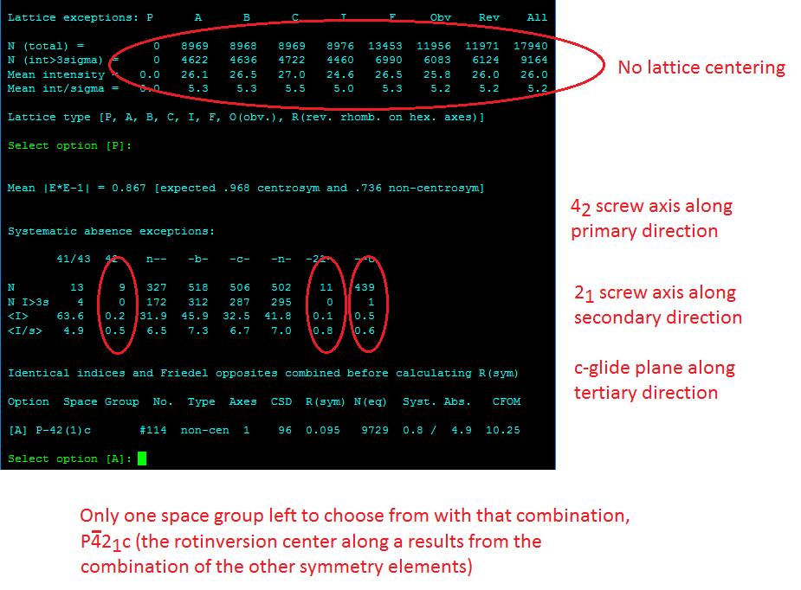
Introduction to X-ray Crystallography
Space Group Assignment using Systematic Absences: The program XPREP

Slide 96
Introduction to X-ray Crystallography
Space group assignments: When Systematic Absences are not enough:
Assignment of screw axes, glide planes and Bravais translations is often not sufficient for unambiguous space group assignment
Mirror planes, rotational axes and inversion centers cannot be identified from systematic absences
Statistical differences between intensity distributions can help to distinguish between centrosymmetric space groups and non-centrosymmetric and chiral space groups. Centrosymmetric space groups have a larger variability of their intensities (in form of their “normalized amplitudes” |E |), with more high and low intensity reflections.
Space group statistics also help. Very rare space groups are unlikely.

Slide 97
Introduction to X-ray Crystallography
2nd Laboratory Exercise:
Setup of files and Space Group Assignment for Example 1
for step-by-step instructions for using the program XPREP, please see the Purdue Apex5 user manual at https://www.chem.purdue.edu/xray/instructional.php
Skip to chapter “Solving Structures”

Slide 98
Introduction to X-ray Crystallography
3rd Laboratory Exercise:
Solving of Structure for Example 1 and Assignment of First Atoms

Slide 99
Introduction to X-ray Crystallography
How do Reflections relate to a Structure?
From Scattering to Electron Density and Atoms

Slide 100
Introduction to X-ray Crystallography
Structure Refinement: How do Reflections relate to a Structure?
Scattering:
Scattering describes the interaction of matter with waves.
Scattering is coherent (elastic), when the incoming and outgoing waves have the same wavelength/frequency.
Scattering is incoherent (inelastic) if some of the energy of the incoming photon is lost (frequency of the emitted wave is longer than that of the incident beam).

Slide 101
Introduction to X-ray Crystallography
Raleigh and Compton Scattering:
Elastic and inelastic scattering at polarizable entities (such as a molecule). The incident light induces a dipole moment, which re-radiates. The size of the “scatterer” has to match the wavelength of the wave (oil droplets in milk scatter visible light → milk appears white):
Coherent (Rayleigh) and incoherent (Compton) scattering
Mikael Otendal, Doctoral Thesis, Royal Institute of Technology, Stockholm, Sweden 2006

Slide 102
Introduction to X-ray Crystallography
Thompson Scattering:
Elastic scattering at a free charged particle (unpolarizable). E.g. scattering of an electromagnetic wave at a free electron.
Thompson scattering of X-rays at electrons (of an atom) is the basis of X-ray diffraction.
The electron oscillates in the electric field of the incoming X-ray beam; the oscillating electric charge of the electron radiates off X-rays of the same frequency as the primary beam, but mostly perpendicular to the incoming beam (i.e. the beam is scattered).

Slide 103
Introduction to X-ray Crystallography
Thompson Scattering (continued):
Electrons radiate (mostly) 180° out of phase of the incoming X-ray beam. The exact phase change depends on how much the motion of the electron is dampened.
If the energy of the X-ray beam is close to the excitation energy of the electron (i.e. close to the X-ray absorption edge), then the electron becomes resonant and its motion is heavily dampened. In such cases the relative phase of the incoming and outgoing X-rays is closer to 90°.
This is the origin of anomalous (resonant) scattering in X-ray diffraction (used among others to determine the absolute configuration of chiral molecules).

Slide 104
Introduction to X-ray Crystallography
Structure Refinement: How do Reflections relate to a Structure?
In X-ray diffraction, we use scattering at
whole atoms rather than at individual
electrons (it dramatically simplifies the
math!).
At a scattering angle (θ, theta) of 0° the
scattering factor f is defined to be
the numbers of the atom’s electrons.
Above 0° θ there is a path difference
between X-rays scattered from different
parts of the same atom (or an equivalent
translated atom), resulting in destructive
interference.
The reduction of scattering with θ is
described in the dampened atomic
scattering factor f’.

Slide 105
Introduction to X-ray Crystallography
Structure Refinement: How do Reflections relate to a Structure?
Above 0° f’ decreases with angle.
f’ for common X-ray wavelengths are
tabulated for all atoms (in the
International Tables of Crystallography)
and programmed into the refinement
software suites.

Slide 106
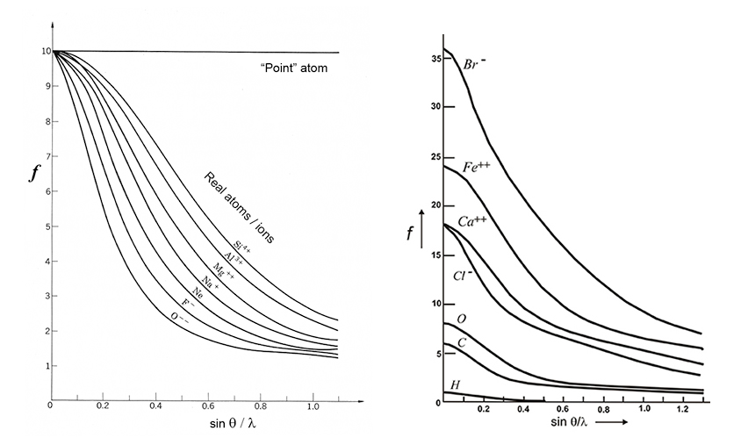
Introduction to X-ray Crystallography
Structure Refinement: How do Reflections relate to a Structure?
Left: Atomic scattering factors calculated for several ions with the same number of electrons as Ne. The scattering of O²⁻ (more diffuse electron cloud) decays faster than Si^{4+.}
Right: Atomic scattering factors calculated for atoms and ions with different numbers of electrons. Hydrogen will therefore be "difficult to see".
https://www.xtal.iqfr.csic.es/Cristalografia/parte_05-en.html

Slide 107
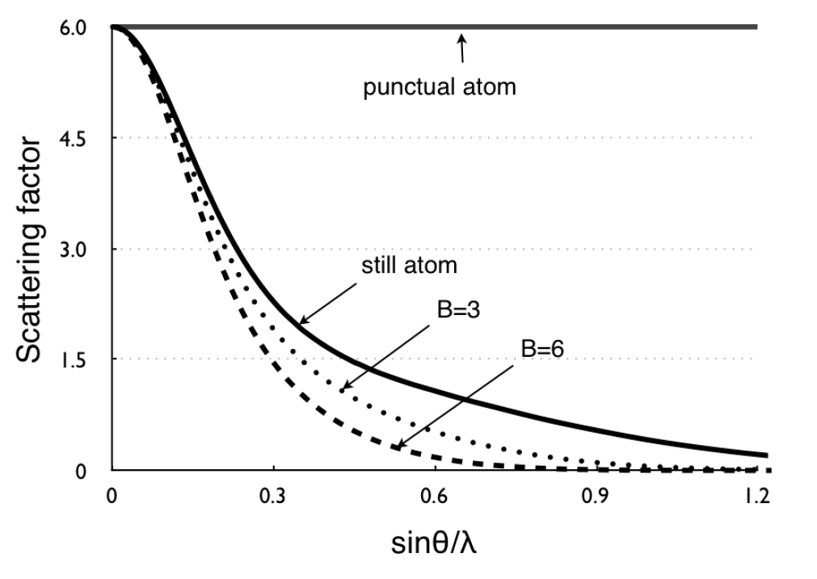
Introduction to X-ray Crystallography
Structure Refinement: How do Reflections relate to a Structure?
For the tabulated scattering
factors it is assumed that
atoms are stationary.
Thermal vibration or
disorder modifies the
scattering factor and
have to be taken into
account.
High angle diffraction peaks
are weaker when atoms
move more.
Cool your crystal!!!!
B (the Debye Waller factor) is a measure of atomic vibration (used in protein and powder XRD. Small molecule single crystal XRD uses “u” instead).
from: Reviews in Mineralogy & Geochemistry 2014, 78, 1-31.

Slide 108
Introduction to X-ray Crystallography
Structure Refinement: How do Reflections relate to a Structure?
Scattering at a group of atoms:
Beginnings of a diffraction pattern

Slide 109
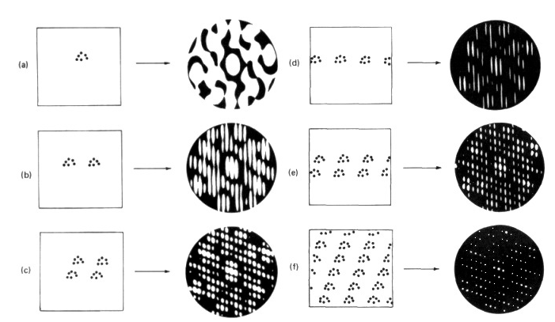
Introduction to X-ray Crystallography
Structure Refinement: How do Reflections relate to a Structure?
Scattering at groups of atoms. Beginnings of a diffraction pattern:

Slide 110
Introduction to X-ray Crystallography
Structure Refinement: How do Reflections relate to a Structure?
Scattering at a real lattice of atoms/molecules:
Real diffraction

Slide 111

Introduction to X-ray Crystallography
Structure Refinement: How do Reflections relate to a Structure?
Same molecule, different “packing”: polymorphs

Slide 112

Introduction to X-ray Crystallography
Structure Refinement: How do Reflections relate to a Structure?
The intensity of a Reflection hkl (one atom system, e.g. primitive cell of aluminum):
F(hkl) = |F(hkl)|$e^{\text{i}α(hkl)}$ = |F(hkl)|$e^{\text{i}\text{(}\text{2}\text{π}\text{(}\text{hx}\text{ + }\text{ky}\text{ + }\text{lz}\text{)}}$
F(hkl) is the structure factor of the reflection hkl (intensity and phase of the diffracted beam)
|F(hkl)| is the max. amplitude, or magnitude of a diffracted beam in phase with the direct beam (α = 0).
x, y and z are the fractional coordinates of the atom in the crystal lattice
2π(hx + ky + lz) = α is the phase of the diffracted beam
For a one atom system: |F(hkl)| = f’
(the dampened atomic structure factor).

Slide 113

Introduction to X-ray Crystallography
Structure Refinement: How do Reflections relate to a Structure?
F(hkl) = |F(hkl)|$e^{\text{i}α(hkl)}$ = |F(hkl)|$e^{\text{i}\text{(}\text{2}\text{π}\text{(}\text{hx}\text{ + }\text{ky}\text{ + }\text{lz}\text{)}}$
What does this mean for us?
The diffraction peak intensity depends on:
The type of atom:|F(hkl)| = f’ , which is atom type dependent
The position x, y, z of the atom
The diffraction angle:
Miller indices h, k and l
|F(hkl)| = f’, which is angle dependent

Slide 114

Introduction to X-ray Crystallography
Structure Refinement: How do Reflections relate to a Structure?
For a multi-atom system, the contributions of all atoms in the unit cell have to be added up for every diffracted beam hkl:
F(hkl) = $\sum_{j}{\text{f}\text{′}\text{j} e^{\text{i}αj(hkl)}}$ = $\sum_{j}{\text{f}\text{′}\text{j} e^{\text{i}\text{(}\text{2}\text{π}\text{(}\text{hxj}\text{ + }\text{kyj}\text{ + }\text{lzj}\text{)}}}$ or
$\sum_{j}{\text{f}\text{′}\text{j}}[(cos \text{2}\text{π}\text{(}\text{hxj}\text{ + }\text{kyj}\text{ + }\text{lzj}) +i sin \text{2}\text{π}\text{(}\text{hxj}\text{ + }\text{kyj}\text{ + }\text{lzj})]$
F(hkl) is the structure factor of the reflection hkl (intensity and phase of the diffracted beam)
f’_{j} is the dampened structure factor of the atom j
x_{j}, y_{j} and z_{j} are the fractional coordinates of the atom j in the crystal lattice
α_{j} = 2π(hx_{j} + ky_{j} + lz_{j}) is the phase of the diffracted beam for the atom j

Slide 115
Introduction to X-ray Crystallography
Structure Refinement: How do Reflections relate to a Structure?
Now that we know how to calculate the intensity and phase of a diffraction peak for a known structure,
we would like to do the reverse,
obtain the structure from the measured diffraction intensities.

Slide 116


Introduction to X-ray Crystallography
Structure Refinement: How do Reflections relate to a Structure?
F(hkl) = $\sum_{j}{\text{f}\text{′}\text{j} e^{\text{i}αj(hkl)}}$ = $\sum_{j}{\text{f}\text{′}\text{j} e^{\text{i}\text{(}\text{2}\text{π}\text{(}\text{hxj}\text{ + }\text{kyj}\text{ + }\text{lzj}\text{)}}}$
Fourier transform yields the electron density in the crystal lattice as a function of F(hkl) (intensity and phase of the reflection):
V = volume of the unit cell
F(hkl) = structure factor for reflection hkl (intensity and phase, see previous pages)
X, Y and Z are arbitrary points on the e- density map, not atomic positions!
ρ_{XYZ} = $1/{V }\sum_{hkl}{F(hkl) e^{−iα(hkl)}}$ = $1/{V }\sum_{hkl}{F(hkl) e^{−i2π}(hX+kY+lZ)}$

Slide 117

Introduction to X-ray Crystallography
Structure Refinement: How do Reflections relate to a Structure?
Rewriting as a continuous function (rather than a sum) yields:
F(hkl) = $\int{ρ}$(XYZ) $e^{i(hkl)}$dV
and
ρ(XYZ) = $1/{V }\sum_{h}{\sum_{k}{\sum_{l}{F(hkl) e^{−iα(hkl)}}}}$
In this form, F(hkl) is the inverse FT of ρ(XYZ), and ρ(XYZ) is the FT of
F(hkl)

Slide 118
Introduction to X-ray Crystallography
Solving of an X-ray Crystal Structure, the phase problem:
Determination of a Crystal Structure requires to know the unit cell dimensions, the space group, and identify the positions of the atoms within the unit cell.
Mathematically, the electron density function and the X-ray structure factors are related to each other by Fourier transformation.
To calculate the electron density function – i.e. atom positions - from the reflections, one would have to perform a Fourier synthesis using amplitudes and phases of all reflections.
However, only the intensities (squared amplitudes) can be measured. The phase information is lost (measurement is not time- resolved, the relative phase shifts of the reflections hitting the x-ray detector cannot be determined).
Unfortunately, the phases are more important for Fourier synthesis than the intensities. They contain all the information about the x, y and z positons of the atoms! This difficulty is known as the phase problem of crystallography.

Slide 119

Introduction to X-ray Crystallography
Solving of an X-ray Crystal Structure, the phase problem:
G. Taylor, The phase problem, Acta Cryst. D 2003, 59(11), 1881-1890.

Slide 120
Introduction to X-ray Crystallography
How to solve the phase problem:
Measure phases directly (three-beam interference experiments, very complicated and uncommon).
Derive phases mathematically from reflection intensity differences based on anomalous scattering (works only for non-centrosymmetric structures, important for macromolecular/protein crystallography). MAD/SAD phasing are examples.
“Direct Methods”: Derives phases statistically from intensities using only the intensities and a random starting set of phases. XS and XM in XPREP are using this approach. Direct methods need atomic resolution data to work.
“Patterson Methods”: This method calculates first the coordinates of heavy atoms, which can be calculated from the Patterson function without the knowledge of phases. From the positions of the heavy atoms approximate phases can be calculated.
For more details on solving structures, see e.g. http://shelx.uni-ac.gwdg.de/tutorial/english/shelxs.htm

Slide 121
Introduction to X-ray Crystallography
Practical aspects of the phase problem:
The phase problem remains a fundamental problem in crystallography and is not intrinsically “solved”.
Modern software has however eliminated most practical problems associated with the phase problem and “solving” a structure.
In small molecule crystallography structure solving is now a routine procedure that rarely requires more than a couple of minutes using either direct or Patterson methods or some combination of the two. It nearly never completely fails (sometimes a few procedures need to be tested).
For macromolecular crystallography structure solving is somewhat more involved (structures rarely have atomic resolution). MAD/SAD phasing requires data from at least two experiments; SAD from a native and “density modified” crystal, MAD from at least two wavelengths. But it also is no fundamental problem anymore.

Slide 122
Introduction to X-ray Crystallography
Now that we have initial phases:
With initial phases now at hand, we can calculate the electron density distribution inside the unit cell:
• Collect Diffraction Intensities ∝ |F_{obs}(hkl)|²
• Get |F_{obs}(hkl)| values
• Determine α (= resultant phase) for F(hkl) using Direct, Patterson or other methods
• Calculate ρ(XYZ) for grid points 0.2 to 0.3 Å apart
• Deduce atom positions
• Calculate Structure Factors, F_{calc}(hkl)
• Calculate agreement factors between |F_{obs}(hkl)| and |F_{calc}(hkl)| (“R values”)

Slide 123
Introduction to X-ray Crystallography
Least Square Refinements:
The atom positions located from any structure solution method are only approximate. Initial phases are quite inaccurate.
Starting atom positions need to be optimized in a process called refinement.
Model and phases can be improved by modification to give better agreement between |F_{obs}(hkl)| and |F_{calc}(hkl)|

Slide 124

Introduction to X-ray Crystallography
Least Square Refinements:
The refinement process is a mathematical minimization process
A least squares process is used to minimize the difference Δ between
observed and calculated structure factors:
Δ =$\sum_{h,k,l}{whkl(}$ |F_{o}| - |F_{c}|)²
» w_{hkl} are weights related to the quality of the observation
» |F_{o}| are the observed structure factor magnitudes
» |F_{c}| are the structure factor magnitudes calculated from the model

Slide 125
Introduction to X-ray Crystallography
Least Square Refinements:
There is no function that can be solved to mathematically unambiguously
determine the smallest value of Δ possible.
Instead, least squares methods are used to obtain a set of parameter shifts that
improve the agreement between F_{obs} and F_{calc}
The least squares process is repeated until the suggested shifts are
insignificantly small (until the parameter shift is much smaller than the
esd on the parameter)
See http://en.wikipedia.org/wiki/Least_squares for more details on least
squares refinement

Slide 126
Introduction to X-ray Crystallography
Least Square Refinements:
After each refinement cycle the optimized structure needs to be inspected and manual changes to the model have to be made:
Add or delete atoms
Change atom types
Other manual changes
Another set of refinement cycles follows until the model cannot be improved upon any further.

Slide 127

Introduction to X-ray Crystallography
Least Square Refinements:
The level of agreement between F_{obs} and F_{calc} is commonly indicated using the R value and the Goodness of Fit (GooF):
R = ${\sum_{h,k,l}{whkl(}\text{|}\text{F}\text{o}\text{| − |}\text{Fc}\text{|)}}/{\sum_{h,k,l}{whkl}\text{| }\text{Fo}\text{|}}$
GooF = S = $\sqrt[2]{{\sum_{h,k,l}{whkl(}\text{F}\text{o}\text{2}\text{ − }\text{Fc}\text{2}\text{)}2}/{(n−p})}$
n and p are the number of data and parameters, (n-p) is the excess of data vs parameters.
R should be as small as possible (zero, if model and data agree perfectly). If the model is complete and good, the R value should be close to the average error for the experimental diffraction intensities.
Goof needs to be adjusted by optimization of the weighting factor w to ensure meaningful esds on reported numbers (mostly automated in Shelxl). The final GooF value for a good quality dataset is usually slightly above 1.

Slide 128

Introduction to X-ray Crystallography
Least Square Refinements:
Least square refinement requires values to always be positive. For weak reflections $\text{|}\text{Fo}\text{| − |}\text{Fc}\text{|}$ can however sometimes become slightly negative.
During the least square refinement process a weighted squared R value, wR² is used instead:
wR² = $\sqrt[2]{{\sum_{h,k,l}{whkl(}\text{F}\text{o}\text{2}\text{ − }\text{Fc}\text{2}\text{)}2}/{\sum_{h,k,l}{whkl}\text{(}\text{F}\text{o}\text{2}\text{)}\text{2}}}$
($\text{F}\text{o}\text{2}\text{ − }\text{Fc}\text{2}\text{)}2 cannot become negative$
$\text{wR}\text{2}$ is the value that is minimized by the software. The R value (sometimes called R1) is what is commonly reported.

Slide 129
Introduction to X-ray Crystallography
4th Laboratory Exercise:
Refining of a Single Crystal Structure,
Example 1

Slide 130
Introduction to X-ray Crystallography
Structure Refinement
Software, Procedures and Tricks

Slide 131




Introduction to X-ray Crystallography
Refinement software
There are few commonly used crystal structure refinement packages for small molecule crystallography.
Shelxl (formerly XL-97), written by George Sheldrick, is the by
far most widespread package.
Today usually used in combination with a graphical user interface
(GUI). The two most common are ShelXle (Hübschle, Dittrich,
Sheldrick, 2011, University of Göttingen) and Olex² (Puschmann,
Dolomanov et al., 2003, Durham University)
Crystals is a viable alternative to Shelxl (David J. Watkin et al, 2003,
University of Oxford). Crystals uses a slightly different refinement
Algorithm than Shelxl.
Sheldrick
Puschmann
Hübschle
Dolomanov
Watkin

Slide 132
Introduction to X-ray Crystallography
Refinement software
We use Shelxl (version Shelxl2019/3) in combination with ShelXle
Freeware, download at:
http://shelx.uni-goettingen.de/index.php
http://www.shelxle.org
Or use preinstalled copies on computer lab and laboratory computers

Slide 133
Introduction to X-ray Crystallography
The .ins / .res file
A typical ins file as produced by XPREP (before the structure is solved):
TITL 13RN007_0m in P2(1)/c
CELL 0.71073 12.6854 6.3408 14.1903 90.000 95.991 90.000
ZERR 2.00 0.0015 0.0007 0.0017 0.000 0.002 0.000
LATT 1
SYMM -X, 0.5+Y, 0.5-Z
SFAC C H N O V SE
UNIT 12 44 8 28 4 4
TEMP 23.000
SIZE 0.12 0.27 0.49
TREF
HKLF 4
END
Shelxl uses only four-letter codes (originally written in Fortran)

Slide 134
Introduction to X-ray Crystallography
The .ins / .res file
Line Number in .ins file | Command | Variables and Explanation
1st line | TITL | This line contains by default the name and space group of the sample, written in plain text. Can be edited.
2nd line | CELL | λ, a, b, c, α, β, γ The wavelength of the radiation used and the unit cell axial lengths and angles
3rd line | ZERR | Z esd(a) esd(b) esd(c) esd(α) esd(β) esd(γ) The number of formula units in the unit cell and the estimated standard deviations of the unit cell axial lengths and angles.
4th line | LATT | The lattice type (i.e., 1 for primitive (P), 2 for body centered (I), 3 for rhombohedral (R), 4 for face centered (F), 5 for A centered (A), 6 for B centered (B), or 7 for C centered (C). For non-centrosymmetric space groups the number is negative while it is a positive for a centrosymmetric space group.

Slide 135
Introduction to X-ray Crystallography
The .ins / .res file
Line Number in .ins file | Command | Variables and Explanation
5th line | SYMM | The following values are the symmetry operations for the space group. They are the “general positions” of the space group taken from the “International Tables” and they can be used to convert any random position in the unit cell (i.e., X, Y, Z) into all its equivalent positions. For some high symmetry space groups this may correspond to many lines of SYMM codes. For triclinic space groups this line is absent. [Note: the identity operation, operations related by a center of symmetry, and cell centering operations are omitted.]
6th line | SFAC | Structure Factors (element symbols) This line gives the symbols for the elements present in the crystal. The first two elements are always C followed by H (if they are present). When using standard wavelengths (Mo, Cu, Ag, Ga and In) the program will use the element identities to look up the scattering power of each atom type when it is doing calculations.
7th line | UNIT | number of atoms of each type in the unit cell These numbers have to be in the same order as the SFAC lists. If necessary, update using the “Update UNIT instruction” in ShelXle
NOTE: THE ORDER OF THE ABOVE SEVEN LINES MUST NOT BE CHANGED AND YOU CAN’T INSERT ANY OTHER COMMAND LINES IN HERE (exception: DISP and NEUT when an unusual wavelength or neutron radiation are used)

Slide 136
Introduction to X-ray Crystallography
The .ins / .res file
Line Number in .ins file | Command | Variables and Explanation
8th line | TREF or PATT or FIND 58 PLOP 77 MIND 1.0 -0.1 NTRY 1000 | The command for a Direct methods structure search using ShelXS. The command for a Patterson methods structure search using ShelXS. The commands for a Direct methods structure search using ShelXD. No commands are needed for a default Dual methods search using ShelXT These lines will be omitted once the structure is solved.
second last line | HKLF # | 4 or 5, for all practical purposes (5 for crystals that are twinned by non-merohedry, 4 for all other single crystal data sets)
last line | END
For all Shelxl instructions, see http://shelx.uni-goettingen.de/shelxl_html.php

Slide 137
Introduction to X-ray Crystallography
The .ins / .res file
Typical ins/res file during refinement procedure:
TITL 13RN007_0m in P2(1)/c
CELL 0.71073 12.6854 6.3408 14.1903 90.000 95.991 90.000
ZERR 4.00 0.0015 0.0007 0.0017 0.000 0.002 0.000
LATT 1
SYMM -X, 0.5+Y, 0.5-Z
SFAC C H N O V SE
UNIT 20 52 8 36 4 4
LIST 4
TEMP -173.5
SIZE 0.12 0.27 0.49
L.S. 4
BOND $H
ACTA
CONF
FMAP 2
PLAN 20
HTAB
WGHT 0.017400 0.900200
FVAR 0.57706
C1 1 0.037990 0.090484 0.494350 11.00000 0.00569 0.00913 =
0.00929 0.00085 -0.00016 -0.00048
...
HKLF 4
END

Slide 138
Introduction to X-ray Crystallography
The .ins / .res file, Atom Lines:
1st Column: atom name
2nd Column: SFAC number. Refers to the SFAC line, unambiguously defines the element/scattering factor.
3rd-5th Column: Fractional coordinates (x, y, z).
6th Column: SHELX code for the occupancy of the atom. The number is divided in two parts. The first part (usually single digit, e.g. 1) refers to a free variable. This number can be changed if the occupancy needs to be refined (e.g. if a site with a water molecule is only 80% occupied. Change 1 (referring to the 1st value in the FVAR line, the overall scale factor) to 2 (referring to the 2nd value, a free variable). Add a value in the 2nd position of the FVAR line to refine the free variable. If the second free variable is already taken, use FVAR 3 or 4, etc
The second part of the number is 1 or smaller (e.g. 1.00000 or 0.50000). It is used to define an occupancy that does not need to be refined, e.g. if the occupancy is known, or if the atom lies on a special position. If an atom lies e.g. exactly on a rotation axis, thus 'with one half' in one asymmetric unit and with one half in another one, the occupancy has to be 0.5. The number should then be 10.50000. The two parts of the number can be used together, e.g. 20.50000 if the atom on the rotation axis is also only partially occupied.

Slide 139
Introduction to X-ray Crystallography
Atom Lines (Continued):
7th Column: Displacement Parameter U. Indicates how well the electron density is defined. Thermal motion of atoms, unrecognized reduced occupancies or wrongly assigned atom types (heavier than they really are) can be responsible for less well-defined electron density represented by larger U values than normal. Starting value is 0.05.
When changing to anisotropic refinement (command ANIS), the single value for the displacement parameter (isotropic displacement parameter) is changed to six values for an anisotropic displacement parameter, which takes better into account asymmetric movements of atoms (e.g. perpendicular vs along a covalent bond).
Six parameters U_{ij} are used to describe anisotropic thermal motion (i, j = 1, 2, 3). They are diagonal and off diagonal terms of a three-by-three tensor. The diagonal elements U₁₁, U₂₂ and U₃₃ are the displacement values along the reciprocal cell axes a*, b* and c*, respectively. An isotropic ellipsoid would have all off-diagonal terms equal to zero, all diagonal elements equal.

Slide 140
Introduction to X-ray Crystallography
The .ins / .res file
Once the structure is solved, the following lines should be put in between the UNIT and the first atom lines (many are placed automatically by XS, XD, XT or ShelXle).
LIST | 4 or 6, for practical purposes (4 for writing an old fashioned fcf file for use with some older programs (e.g Rotax) and for running Checkcif, 6 for displaying good quality difference electron maps)
SIZE | The three dimensions of the crystal in mm.
TEMP | The temperature of the data collection in °C.
L.S. | Number of least square refinement cycles to run. Needs to be > 0 to write a cif file.
PLAN | This gives the number of Fourier peaks (Q peaks) that will be written to the res file. Default is 20.
FMAP | How to write Q peaks. Default is 2. -2 can be used to also display negative peaks.
ACTA | Writes a cif file.
BOND $H | Writes bond distances and angles (including for H atoms) to the cif file.
CONF | Writes dihedral angles to cif file.
HTAB | Calculates possible H bonds. HTAB and EQIV commands will be appended to the res file after the END line after a refinement cycle. Replace the HTAB line by these (after thorough checking).
WGHT | Weighting scheme. Use the default (0.1) until all atoms are located. Then update using the “Update WGHT instruction” in ShelXle.
FVAR | Free Variables. The first is the overall scaling factor. The others can be used as needed.

Slide 141
Introduction to X-ray Crystallography
Parameters:
A parameter is any value that is refined. It can be e.g.:
  A fractional atom position (x-coordinate of an oxygen atom)
  A thermal parameter of an atom (how much does the atom move)
  An occupancy factor (how much of an atom is in that position)
  A twinning fraction
  etc etc
Three parameter are needed to define an atom position (x, y, z)
Six parameter are needed to define anisotropic thermal libration
Usually, about 10-20 times more data (independent diffraction spots) are needed as one would like to refine parameters

Slide 142
Introduction to X-ray Crystallography
The steps of the refinement process:
Solving of structure (XS (TREF, PATT), XD, XT, charge flipping, etc.)
Analyze the result. The initial result from the structure solution will usually not display all atoms, but a mixture of atoms and “Q-peaks” (atoms that are displayed might be wrongly assigned). Q-peaks are positions within the unit cell that might represent a possible atom, and you will have to decide which Q-peaks might be actual atoms. Q-peaks with a lower number (Q1, Q2, …) have a higher electron density count (last number in atom lines of the res file) and are more likely to be real atoms.
If you are not able to identify any fragments of the expected molecule, the initial guess might be wrong. Go back and try XS again with higher TREF numbers or use PATT, or use XD or XT instead of XS.

Slide 143
Introduction to X-ray Crystallography
The steps of the refinement process:
Decide, which of the Q-peaks might be unwanted “ghost atoms” and which might be actual atoms.
If you are not sure, rather delete some actual atoms than assigning questionable ones.
Run a refinement cycle. The refinement program <XL> will run several consecutive cycles. Before closing the window, inspect the parameters obtained during all cycles. wR2, Goof, Max. dU and Maximum should all decrease.
After the refinement cycle the atom positions and thermal parameters of already defined atoms are optimized and positions of still missing atoms will be suggested (new Q peaks).

Slide 144
Introduction to X-ray Crystallography
The steps of the refinement process:
Correct atom assignments and assign new atoms as necessary. Atoms with very large thermal parameters (when compared to other atoms) may be wrongly assigned and could be much lighter atoms or no atoms at all. Atoms with very small thermal parameters may be heavier atoms.
The electron density map: In addition to Q peaks (suggested atom positions), ShelXle also displays electron density maps. Large green clouds (positive electron difference densities) indicate missing atoms or atoms that should be heavier. Large red clouds (negative difference densities) indicate excess electron densities. Atoms nearby might need to be deleted or assigned a less heavy element type.
Correct changes should result in lower values for R1, wR2 and GooF in the next set of refinement cycles. Continue with corrections, additions and refinement cycles until no changes are observed for R1, GooF, Max. dU and Maximum.

Slide 145
Introduction to X-ray Crystallography
The steps of the refinement process:
Make non-H atoms anisotropic. Continue refinement procedure. Make last corrections to atom types. Look for problems (disorder, extinction, twinning, etc etc). Apply restraints or constraints if needed.
Finalize the atom naming, sort the atoms. Continue refinement procedure.
Add hydrogens using the “automatic HFIX” button. Verify that H atoms are placed correctly using Q peaks and electron density maps. Continue refinement procedure.
Check for wrongly placed or missing H atoms that might have to be added by hand. Continue refinement procedure.
Continue with corrections, additions and refinement cycles until no changes are observed for R1 and GooF, and until Max. dU and Maximum are basically zero.

Slide 146
Introduction to X-ray Crystallography
The steps of the refinement process:
Add a line ACTA (a refinement cycle will now create a cif file)
Add BOND $H or change BOND to BOND $H (a refinement cycle will now add X-H bonds and X-Y-H angles to the cif file)
Add a line CONF (a refinement cycle will now add dihedral angles to the cif file)
Add a line HTAB (possible hydrogen bonds will be suggested at the end of the next res file)
Update the formula (“Update Unit Instruction”). Continue refinement procedure.
Add HTAB and EQIV lines from bottom of res file (check each of the HTAB lines. Some might be meaningless). Continue refinement procedure. Run first CheckCif report (see validation section below)

Slide 147
Introduction to X-ray Crystallography
Hydrogen Atoms: Refining or Letting Them Ride?
It is difficult to locate hydrogen atoms accurately using X-ray data because of their low scattering power and lack of core electrons, and because the valence electron density is asymmetrical and located in the X-H bond rather than around the nucleus (the position of the nucleus can be determined by neutron diffraction).
Hydrogen atoms tend to have larger vibrational and librational amplitudes than other atoms.
For many purposes it is preferable to calculate the hydrogen positions based on excellent reference structures and then “let them ride” on their parent atom.
H atoms are always refined isotropically, not anisotropically (exception: neutron diffraction).

Slide 148
Introduction to X-ray Crystallography
Hydrogen Atoms: How to do it in Shelxl:
Where calculated positions are predictable, H atoms are added using “HFIX” commands (converted by the program into “AFIX” commands in the atom list). For most functional groups, the “automatic H-Fix” function works. Sometimes, you have to manually add or correct HFIX or AFIX commands. Distances used are temperature dependent (TEMP instruction).
This is not possible for some atoms with varying X-H bond distances or if there is no info on angles such as e.g. for some amines, acidic hydroxyls or water molecules. Their positions (not U_{iso} values) need to be refined. Usually, distance restraints should be used here.
The U_{iso} values are usually tied to the atom the H atom is bonded to, being set to 1.2 or 1.5 times U_{eq} of the carrier atom.

Slide 149
Introduction to X-ray Crystallography
Hydrogen Atoms: Common HFIX commands
C(sp³)H HFIX 13 (saturated tertiary alkanes)
C(sp²)H HFIX 43 (alkenes, benzenes, etc)
N(sp²)H HFIX 43 (amides, planar secondary amines, usually conjugated to unsaturated atoms)
C(sp²)H₂ HFIX 93 (terminal alkenes)
N(sp²)H₂ HFIX 93 (planar primary amines, usually conjugated to unsaturated atoms)
C(sp³)H₂ HFIX 23 (saturated secondary alkanes)
N(sp³)H₂⁺ HFIX 23 (protonated secondary amines)
C(sp³)H₃ HFIX 33 (methyl group, not rotating)
C(sp³)H₃ HFIX 137 (methyl group, rotating)
N(sp³)H₃⁺ HFIX 33 (protonated primary amine, not rotating)
N(sp³)H₃⁺ HFIX 137 (protonated primary amine, rotating)
O(sp³)H HFIX 83 (alcohol, not rotating)
O(sp³)H HFIX 147 (alcohol, rotating)
O(sp³)H HFIX 148 (alcohol, rotating, O-H distance refined)

Slide 150
Introduction to X-ray Crystallography
Hydrogen Atoms: U_{iso}(H) values
O-H (alcohols, water) 1.5 times carrier atom
CH₃, NH₃⁺ 1.5 times carrier atom
All others 1.2 times carrier atom
This is done by replacing the U_{iso} value in the atom line by a negative value (“-1.50000” or “-1.20000”)
Hydrogen Atoms: Common X-distance restraints
O-H (alcohols, water) 0.82 Å (room temperature),
0.84 Å (100K)
H…H (in H₂O) 1.35-1.36 Å
N-H (amines) 0.86 Å (room temperature),
0.88 Å (100K)
N-H (ammonium) 0.93 Å (room temperature),
0.91 Å (100K)

Slide 151
Introduction to X-ray Crystallography
Hydrogen Atoms in Shelxl:
DFIX 0.84 O2 H2A O2 H2B
DFIX 1.36 H2A H2B
.
.
C1 1 0.728724 0.459734 0.543593 11.00000 0.02535 0.02344 =
0.01764 0.00076 -0.00178 -0.00043
AFIX 23
H1A 2 0.723107 0.477078 0.510384 11.00000 -1.20000
H1B 2 0.706742 0.476031 0.569593 11.00000 -1.20000
AFIX 0
O2 3 0.854667 0.407606 0.777395 11.00000 0.01620 0.01753 =
0.00983 0.00582 0.00218 -0.00119
H2A 2 0.831077 0.393575 0.798367 11.00000 -1.50000
H2B 2 0.893321 0.416771 0.789511 11.00000 -1.50000

Slide 152
Introduction to X-ray Crystallography
Hydrogen Atoms in Shelxl:
DFIX 0.84 O2 H2A O2 H2B
DFIX 1.36 H2A H2B
.
.
.
C1 1 0.728724 0.459734 0.543593 11.00000 0.02535 0.02344 =
0.01764 0.00076 -0.00178 -0.00043
AFIX 23
H1A 2 0.723107 0.477078 0.510384 11.00000 -1.20000
H1B 2 0.706742 0.476031 0.569593 11.00000 -1.20000
AFIX 0
O2 3 0.854667 0.407606 0.777395 11.00000 0.01620 0.01753 =
0.00983 0.00582 0.00218 -0.00119
H2A 2 0.831077 0.393575 0.798367 11.00000 -1.50000
H2B 2 0.893321 0.416771 0.789511 11.00000 -1.50000
DFIX commands for water molecule
AFIX 23 command for CH₂ group
U_{iso}(H) values tied to last
non-H atom above
AFIX 0 command to end AFIX 23 command

Slide 153
Introduction to X-ray Crystallography
General and Special Positions
A “general position” is not located on any symmetry axis, plane or inversion center.
An “equivalent position” is obtained upon operation of a symmetry element of the space group on a general position xyz.
A “special position” is a place in the unit cell that coincides with a symmetry element such as an inversion center, rotation axis, mirror plane, etc. (e.g. a position above a mirror is repeated by mirror symmetry below the plane, but a position already on the plane is not repeated by such an operation).
Note: Positions on glide planes or screw axes are not considered special positions, because they are automatically shifted by the translational symmetry whether or not they lie on the plane or axis.
For systematic analysis of crystallographic positions in the context of symmetry Wyckoff Positions are used (see International Tables). They are of little practical value for structure refinement, especially of molecular compounds.

Slide 154

Introduction to X-ray Crystallography
General and Special Positions
“Page 2” of a typical IT entry
with general and special
positions listed
From: Introduction to the Bilbao Crystallographic
Server, Universidad del Pais Vasca, Bilbao, Spain

Slide 155
Introduction to X-ray Crystallography
General and Special Positions
An atom located directly on a special position has to be given a reduced occupancy. If located e.g. on a mirror plane it has to be half occupied – the other half of the atom is created by the mirror operation to create one complete atom
This is done by reduction of the second number of the occupancy (6th column of atom line) “11.00000 → 10.50000”
Combinations of several symmetry operators lead to further occupancy reduction. An atom located at the intersection of a two-fold axis and a mirror plane has to be given a quarter occupancy (“10.25000”)
Occupancies are generally automatically assigned correctly by the program during atom assignment
A molecule being located on or across a special position but having not the required symmetry is a common cause for disorder in crystal structures (e.g. a toluene molecule disordered around an inversion center). It requires a negative PART command to refine in Shelxl.

Slide 156
Introduction to X-ray Crystallography
The CIF File

Slide 157
Introduction to X-ray Crystallography
Databases and the CIF File
A CIF file (Crystallographic Information Format file) is a database entry file, used to store the final results of a structure refinement. It is in large parts written by the refinement program, but some manual augmentation will be needed.
It is the standard storage format for all small molecule structures determined from single crystals using either X-ray, neutron or electron diffraction data.
Slightly modified forms are also available for structures solved from powder data, and for incommensurately modulated structures.
Most scientific journals require deposition of a copy of the final cif with one of three databases. Organic and metal-organic compounds (everything with at least one C-H bond) are submitted to the Cambridge Structural Database (CSD) managed by the Cambridge Crystallographic Data Centre in the UK. CIF files of inorganic materials are submitted to the Inorganic Crystal Structures Database, ICSD, jointly operated by the Fachinformationszentrum Karlsruhe (FIZ) and the US National Institute for Standards and Technology (NIST). There are currently over 1.25 million and 300,000 structures deposited with the CSD and ICSD, respectively.

Slide 158
Introduction to X-ray Crystallography
Databases and the CIF File (cont’d)
Macromolecular data are commonly reported in a different format, the PDB file format, and are submitted to the World Wide Protein Data Base, wwPDB. Currently, there are over 220,000 protein and other macromolecular structure entries deposited with the PDB. The more rigorous mmcif (macromolecular Crystallographic Information Format) has not yet asserted itself.

Slide 159
Introduction to X-ray Crystallography
The CIF Format
Traditionally, the CIF format uses text only (ASCII characters). This means, if it is not on your (American) computer keyboard, don’t use it.
Each basic entry consists of two items: The identifier, and the value.
The identifier usually starts with an underscore, and might consist of several words connected by underscores (e.g. _diffrn_radiation_monochromator).
The identifier is followed by the value, which, depending on the item, is a number or text.
The value has to be either a single number or word, or it has to be marked as a single item with single parentheses (e.g. 'fine focus sealed tube'). If the value is not known, a question is placed. If it is not applicable, a single period should be placed.
Each line should not exceed 80 characters (that’s legacy from times when e-mails could not handle longer lines). If an entry is longer than 80 characters, you should use semicolons instead of the single parentheses. It then may stretch over several lines.

Slide 160
Introduction to X-ray Crystallography
The CIF Format (cont’d)
Values have to be in the CIF “library”. Numbers have to be in an acceptable range, words have to be from a list of allowed entries in the “CIF Dictionary” (e.g. at http://www.iucr.org/resources/cif/dictionaries/cif_core).
Tables in a cif file are following a more complicated format. The beginning of a table is indicated by a string loop_ , followed by several lines indicating the columns of the table, followed by the individual rows, which have to contain the exact same number of entries as there are columns defined (a period indicates not applicable, a question mark unknown). Typical tables contain the atom coordinates, thermal parameters, bond distances, angles, torsion angles, etc.
A typical table may look like this (here the beginning of a bond distances table):
loop_
_geom_bond_atom_site_label_1
_geom_bond_atom_site_label_2
_geom_bond_distance
_geom_bond_site_symmetry_2
_geom_bond_publ_flag
Ni1 N11 1.911(6) . ?
Ni1 C1B 1.931(17) . ?

Slide 161
Introduction to X-ray Crystallography
The CIF Format (cont’d)
A CIF may contain more than one structure (but this is becoming less common). The beginning of every structure has to be marked by a data entry, which is the word “data” followed by an underscore and an identifier, but no underscore in front, different from a data entry (e.g. data_struc1). Some older programs have a limit of eight characters for the identifier.
The data_ entry may also contain author information, literature references, and other useful info. For some article formats published by the International Union of Crystallography or the Zeitschrift für Kristallographie, the cif might contain the whole article (IUCr Data, Acta Cryst. C and E, Z. Krist NCS, etc).
Beware of typos!!
For a complete description of the CIF file format for reporting crystal structures, and for current developments regarding cif files, see http://www.iucr.org/resources/cif.

Slide 162
Introduction to X-ray Crystallography
Using a CIF
The CIF is intentionally kept in a format that is readable and understandable by a human without the use of any software other than a simple text editor. This contrasts it from other database formats such as SQL. The format does however not lend itself for immediate comprehension, detailed analysis, or straight forward use in a publication or presentation.
For easier use, CIF data are commonly either converted into Tables or Text, or they are read into 3D graphics programs.
The program FinalCif is the by far easiest way to finalize cifs and make publication quality tables. Several templates are available (or you can make your own).
For 3D rendering, CIFs can be read into programs such as Chem3D (comes with Chemdraw), Mercury (of the CCDC), Vesta, CrystalExplorer, Platon, or Ortep. Several specialized commercial packages are available as well (CrystalMaker, Diamond), and several smart phone apps.
CIF files are also readable by most quantum mechanical computational packages.

Slide 163
Introduction to X-ray Crystallography
Structure Validation

Slide 164
Introduction to X-ray Crystallography
Structure Validation
Once a structure refinement is close to complete, it needs to be validated. This can be done by hand (very difficult for a novice crystallographer), or with the help of software and online tools. The most commonly used tools are Platon, and especially Checkcif:
Checkcif web page
http://journals.iucr.org/services/cif/checking/checkform.html
Platon web page (windows)
http://www.chem.gla.ac.uk/~louis/software/platon/
Checkcif uses the cif file and the hkl file, which is appended to the cif file. Files created with XL-97 (now obsolete) have no hkl file appended and a LIST 4 format fcf file is needed to run checkcif. The fcf file is a copy of the merged hkl file with calculated structure factors added.

Slide 165
Introduction to X-ray Crystallography
Structure Validation
Structure validation addresses three simple but important questions:
(i) Is the reported information complete?
(ii) What is the quality of the analysis?
(iii) Is the structure correct?
Validation issues are subdivided into four categories:
(i) Missing or inconsistent data.
(ii) Indicators that the structure model may be wrong or deficient.
(iii) Indicators that the quality of the results of the study may be low.
(iv) Cosmetic improvements, queries and suggestions.
Acta Crystallogr D (2009). 65(2): 148–155.

Slide 166
Introduction to X-ray Crystallography
Structure Validation
There are four levels of Alerts, A, B, C, and G, depending on the severity of the alert.
Generally, all alerts that are unnecessary (i.e. that can be corrected), should be corrected, independent of the severity of the alert.
The checkcif procedure is far from perfect. Not all alerts report a real problem.
For publications, Level A and B alerts must be corrected or explained (using a “Verification Reply” that has to be appended to the cif file).
Acta Crystallogr D (2009). 65(2): 148–155.

Slide 167
Introduction to X-ray Crystallography
Structure Validation
The cif file as created by Shelxl is incomplete. It thus will not pass checkcif until some essential data are added by hand. Missing are for example the type of instrument used, the type of corrections used during data processing, etc.
First run checkcif without adding the missing items to check if there are other serious problems. When you think no further refinement cycles are needed, start filling in the missing items. Use the files provided:
CIF Entries for Purdue Quest instruments (on class web page)
There are also programs that help with completing a cif file, such as FinalCif
https://dkratzert.de/finalcif.html

Slide 168
Introduction to X-ray Crystallography
5th Laboratory Exercise:
Preparing of Cif File,
Validation of a Single Crystal Structure,
Example 1

Slide 169
Introduction to X-ray Crystallography
Data, Parameter
&
Resolution

Slide 170
Introduction to X-ray Crystallography
Data to Parameter Ratio
A parameter is any quantity that is refined during structure determination. To define any atom located in a general position three positional parameters are needed, and either one or six displacement parameters (for isotropically or anisotropically refined atoms). Other parameters may be occupancy factors, twinning ratios, extinction parameters, etc. The number of parameters to be refined is usually around ten times the number of non-H atoms in the asymmetric part of the unit cell (it can be substantially higher for heavily disordered structures).
Data (or observations) in single crystal XRD are symmetry independent reflections. The number of independent reflections depends on the completeness of the collected data set, and on the angle (resolution) the data were collected to.
Due to the phase problem, no direct calculation of a structure’s electron density (and thus of its atom positions) is possible. About 2/3rd of the data required are missing (the phase changes), and only the intensity data are reliably measured. To be able to obtain a reliable structure, the data to parameter ratio should be at least 10:1 (as per IUCr recommendation). This corresponds roughly to a resolution of 0.84 Å (50° in 2θ_{max} for Mo radiation; and 134° for Cu K_{α} radiation).

Slide 171
Introduction to X-ray Crystallography
What is resolution?
Resolution, usually measured in Ångström, roughly describes how far atoms of a structure need to be apart to be independently resolved. Atoms/fragments closer together than the resolution of the experiment can rarely be independently refined.
If atoms are closer together than the resolution of the experiment, then their electron densities “blur” into each other. Parameters of the atoms start to be “correlated”. I.e., changing the parameter of one atom affects the value of the parameter of another. Correlation can affect atom positions as well as thermal parameters.
Resolution is defined as the “d-spacing” of Braggs’ law where θ is the highest diffraction angle to which data were observed or collected:
2d sinθ = nλ

Slide 172
Introduction to X-ray Crystallography
What is resolution?
The best resolution that can be obtained is radiation type dependent! It is half the wavelength used for data collection (the d-value for 2θ = 180 °):
d = λ / 2 sinθ = λ / 2 sin(90°) = λ / 2
The best resolution for Mo radiation is 0.305 Å, but only 0.72 Å for Cu radiation! (these values can rarely be achieved due to geometric instrument constraints).
To collect really high resolution data (e.g. for a charge density data set) one has to use a wavelength shorter than that of molybdenum (e.g. silver K_{α})

Slide 173
Introduction to X-ray Crystallography
Intrinsic and actual resolution
The resolution limit of an experiment can be intrinsic to a compound/crystal. I.e., the positions of the atoms have an intrinsic error that cannot be improved upon. It is independent from the way the data are collected (instrument, X-ray intensity, exposure time, etc), but is a property of the crystal used. Large thermal libration, extensive disorder or sections of essentially liquid content in the unit cell limit the resolution that can be achieved for a crystal at hand.
The achievable resolution limit of a dataset can be “seen” in the diffraction data by looking at the diffraction pattern. The highest angle diffraction peaks that are still resolved coincide with the resolution of the experiment.
Low resolution data are especially a problem in macromolecular crystallography. Protein and nucleic acid structures often feature ill-resolved solvent/water (> 50% of the entire structure) and disordered segments and loops.
Intrinsic low resolution in small molecule crystallography is not as common, but does exist, e.g. in highly porous materials (MOFs, COFs) and structures with a high solvent content.

Slide 174


Introduction to X-ray Crystallography
Intrinsic and actual resolution
Examples of low resolution (above) and medium resolution macromolecular datasets
(left).

Slide 175
Introduction to X-ray Crystallography
Intrinsic and actual resolution
The resolution of a dataset can also be artificially limited due to the way data were collected. If high angle data are resolved, but were not included in the data collection (e.g. to save time or reduce the R-values), then the resolution of the data is artificially lowered.
To improve the resolution of the data, collect higher angle diffraction spots.
For small molecule data the IUCr has set a strict resolution limit of 0.84 Å that has to be adhered to. This is 50° in 2θ_{max} for Mo radiation and and 134° for Cu K_{α} radiation.

Slide 176
Introduction to X-ray Crystallography
What to do if the resolution is not sufficient?
Exceptions can be made for data sets that have intrinsically low resolution. However, all attempts have to be made to obtain better resolution data by first optimizing the data collection procedure before a “waiver” for the resolution limit can be granted.
Measure at lower temperature to reduce libration.
Increase the X-ray exposure time per frame / degree.
Use a larger crystal. Screen more crystals from the batch. Crystal quality often varies dramatically between crystals.
Grow a better crystal. Grow crystals slower. Ask for help growing crystals!
Try forcing the compound to form a different polymorph.
Avoid forming a solvate (disordered solvate molecules often limit resolution). Try different solvents, solvent combinations and crystallization techniques.
Use a longer (better diffracted) X-ray wavelength to obtain higher intensity data
Collect data using a better instrument with higher X-ray intensity, better optics, more sensitive detector, etc. Better software also helps.
Collect data using a synchrotron X-ray source.

Slide 177
Introduction to X-ray Crystallography
And if I cannot get any better data?
If all else fails, a low-resolution small molecule dataset might still be publishable.
Admit that the data are low quality and be prepared to explain your (failed) attempts to obtain better data to a reviewer or editor (document your attempts!)
The conclusions drawn from the structure have to be based on the observed data. Do not overinterpret weak data.
Special care has to be taken when refining a structure based on low resolution data.
Describe in detail your structure refinement strategy. List all restraints and constraints used and explain your choice and reasoning.

Slide 178
Introduction to X-ray Crystallography
Strategies for the refinement of low-resolution data
Reduce the number of parameters that need to be refined:
Place all hydrogens in calculated positions (“riding”) and base their thermal parameters on those of the heavy atoms they are bonded to.
Do not refine minor disorder
Use constraints (AFIX 66 for benzene rings etc)
Leave out excessively disordered sections of the structure (“Squeeze”)
Refine atoms isotropically (common in macromolecular crystallography; should be avoided in small molecule work)
Increase the number of data:
Use all data still observed (even if the R value increases)
Use data other than from the diffraction experiment:
Use restraints for geometry: similarity restraints, bond distance restraints, angle restraints, etc
Use restraints for thermal parameters: Rigid bond restraints, similarity restraints, “ISOR” restraints, etc

Slide 179
Introduction to X-ray Crystallography
Anomalous Scattering
&
Absolute Structure

Slide 180
Introduction to X-ray Crystallography
Anomalous Scattering
Basic scattering factors are calculated assuming that the frequency of the incident radiation is different from any absorption frequency of the electrons in the atoms.
If the frequency of the used X-ray wavelength is “close enough” to the absorption edge of an element, then the phase angle is shifted relative to a normally scattered wave (of atoms with an absorption edge far away from wavelength frequency).
This effect is called anomalous scattering, anomalous dispersion, or resonant scattering (programmed into f’ used for structure refinement).
This is used for solving of protein crystal structures by means of SAD and MAD phasing:
SAD phasing (single wavelength anomalous dispersion): a structure is density modified (an element is replaced by a heavier one with an edge closer to the X-ray frequency; common is changing S to Se)
MAD phasing (multi-wavelength anomalous dispersion): collecting data using multiple wavelengths and extracting phases from the difference in anomalous dispersion.

Slide 181

Introduction to X-ray Crystallography
Determination of absolute structure
Anomalous scattering also allows to determine absolute structure (“chirality”)
For samples that crystallize in noncentrosymmetric space groups anomalous scattering causes a small but measurable difference between the intensities of the (h k l) and ($\overline{h}$ $\overline{k}$ $\overline{l}$) peaks (“Friedel pairs”).
The intensity differences between Friedel pairs can be used to determine the correct absolute structure (chirality) of a compound.
The difference is very small for light atom structures using Mo K_{α} radiation (radiation wavelength too far from the atoms’ absorption edges). At least one atom heavier than Na needed.
Anomalous scattering is more pronounced for longer wavelength radiation. Cu K_{α} radiation can be used for determining absolute structure of organic compounds without heavy atoms. A large fraction of Friedel pairs needs to be collected.

Slide 182
Introduction to X-ray Crystallography
Determination of absolute structure
The Flack parameter or a similar number (e.g. Pearson’s parameter) can be used to determine absolute structure
If the esd of the Flack parameter is small (0 to 0.1):
Value close to 0: correct absolute structure.
Value close to 1: wrong absolute structure. Invert the structure or use the enantiomorph space group.
Value between 0 and 1: structure might be racemically twinned.
Value exactly 1/2: structure might be perfectly racemically twinned, or you missed an inversion center. Check your space group!
If the esd of the Flack parameter is large (0.2 or larger):
Absolute structure cannot be determined reliably from this dataset.
Recollect data using Cu K_{α} radiation.
If Cu K_{α} was already used: make sure the fraction of Friedel pairs is close to 100%
Still ambiguous: Is the overall data quality too low?

Slide 183
Introduction to X-ray Crystallography
Mosaicity, Double Diffraction
&
Extinction

Slide 184

Introduction to X-ray Crystallography
Mosaicity
Most crystals used in SC-XRD are actually composed of a mosaic pattern of tiny blocks that are slightly misaligned relative to one another. These mosaic blocks are typically about 10⁻⁴ mm (10³ Å) in diameter.
A crystal with such mosaic character is considered "imperfect" because the internal periodicity is not exact. If a truly monochromatic beam of X-rays were to hit a "perfect" crystal, Bragg condition would be satisfied only at discrete 2θ values. However, because radiation is not exactly monochromatic and most crystals exhibit a "mosaic spread“, the spots really occur over a small 2θ range.
The degree of “imperfection” is expressed by
the mosaicity of a crystal (in degrees)
http://www.structbio.vanderbilt.edu/xray/tutorials/flash/mosaic.php

Slide 185

Introduction to X-ray Crystallography
Mosaicity: why does my crystal diffract like this?
Left: crystal composed of a set of discontinuous mosaics.
Diffraction maxima on the diagrams become wider and diffuse.
Mosaics that change their orientation
The diffraction images show emergent circles.
Taken to the limit, this would result in complete circles, typical of a microcrystalline powder.
https://www.xtal.iqfr.csic.es/Cristalografia/parte_05_3-en.html

Slide 186
Introduction to X-ray Crystallography
Extinction and Double Diffraction
Diffraction that involves multiple scattering events is called extinction.
Extinction is significant for crystals with small mosaic spread because parts of the scattered X-ray beam can be scattered a second time from parallel planes in the crystal (not possible if planes are misaligned).
The multiply scattered beams reduce the intensity that arrives at the detector for the original singly scattered diffraction spot.
Extinction typically occurs for large crystals with small mosaic spread and is most significant for the strong, low angle peaks. For these peaks, secondary extinction is observed if the |F_{c}|² are significantly greater than |F_{o}|² values.
This becomes evident during refinement by appearance of large negative difference electron densities around the heaviest atoms* in your structure (“red clouds” in Shelxle).
The same effect is observed when intense peaks are obstructed by the beam stop. Check this first before applying extinction correction in your refinement!
* the strongest peaks suffering most from extinction have large contributions from the strongest scatterers in a structure

Slide 187
Introduction to X-ray Crystallography
Handling of Extinction in Shelxl
Warning signs for extinction
Large negative values in difference electron density maps around heavy and medium heavy elements (“red clouds” in Shelxle)
The largest outliers in the F_{obs}-F_{calc} map are the strongest diffracted peaks
What to do?
Check for reflections obstructed by the beam stop first: Look up the table of “most disagreeable reflections” in the .lst file / Shelx dropdown menue.
Check for low angle reflections (d-spacing > 6 Å) that have F_{obs} << F_{calc} (e.g. zero or even negative). Omit these reflections in the refinement (Add lines “OMIT h k l”).
Do the warning signs for extinction persist? Add a line “EXTI” and continue refining.
Does the R value drop? Do the warning signs for extinction become less pronounced? Does EXTI refine to a non-zero value? Keep extinction correction.

Slide 188
Introduction to X-ray Crystallography
Disorder
&
Disorder Refinement

Slide 189
Introduction to X-ray Crystallography
Disorder
Repeating units in crystals do not always have to be perfectly identical.
Disorder in crystal structures can fall into several common categories:
Static disorder: Groups or entities are disordered over two (or more) energetic minima. The disordered entities were locked into place during crystallization or slowly convert into each other (with a measurable activation barrier).
Substitutional disorder: One atom, ion or fragment replaces another similar sized atom, ion or fragment. E.g. disorder of Fe and Zn in many minerals.
Orientational disorder: A molecular fragment is disordered over two alternative orientations. This can be a whole entity (such as a solvent molecule), or a fragment of a larger entity (rotated isopropyl group).
Whole molecule disorder: Extreme case of orientational disorder involving a whole molecule (possibly the whole structure).
Fluxional disorder: Groups or entities are not locked into energetic minima.
Freely or nearly freely rotating groups. Common for CF₃ and (less so) for tert-butyl groups.
Semi liquid content of voids and channels (the “Squeeze” procedure of Platon can be used to correct for this).
Fluxional disorder can be minimized, converted into static disorder or eliminated altogether by reducing the data collection temperature.

Slide 190


Introduction to X-ray Crystallography
Disorder
Disorder can often be symmetry imposed. A toluene molecule might be located atop of an inversion center or mirror plane.
P. Müller et al., Crystal Structure Refinement. A Crystallographer's Guide to Shelxl

Slide 191

Introduction to X-ray Crystallography
Disorder
http://www.xray.cz/xray/csca/kol2014/abst/moncol.htm

Slide 192

Introduction to X-ray Crystallography
Disorder
http://www.xray.cz/xray/csca/kol2014/abst/moncol.htm

Slide 193

Introduction to X-ray Crystallography
Disorder
http://www.xray.cz/xray/csca/kol2014/abst/moncol.htm

Slide 194

Introduction to X-ray Crystallography
Disorder
http://www.xray.cz/xray/csca/kol2014/abst/moncol.htm

Slide 195
Introduction to X-ray Crystallography
How to refine disorder
In well defined structures collected to high resolution disordered atoms can sometimes be refined just the same as “normal” atoms.
In lower quality structures, or when disordered atoms are very close to each other (when they “do overlap”) this is not the case anymore.
If atoms are closer to each other than the “resolution” of the dataset, then they become indistinguishable in the electron density map and only their sum can be effectively refined. If refined individually, parameters of the two atoms become “correlated”.
To refine the individual parts in a chemically or physically meaningful way, special refinement procedures are needed:
Use of geometric restraints that force equivalent bond distances and angles to be similar or close to a known target value
Restraints for thermal parameters to make neighboring ADPs similar, or to make individual ADPs more well behaved
P. Müller et al., Crystal Structure Refinement. A Crystallographer's Guide to Shelxl

Slide 196
Introduction to X-ray Crystallography
Restraints and Constraints
Common constraints used:
EADP: Equivalent Anisotropic Displacement Parameter – makes ADPs of listed atoms identical.
EXYZ: Equivalent XYZ coordinates – keeps positions of listed atoms identical.
AFIX 66: Constrains a six membered ring to resemble an ideal hexagon (aromatic ring with 120° angles and 1.39 Å atom distances, good for benzenes and pyridines).
CHIV 0: CHIral Volume 0 – Constrains an atom with three bonds to be exactly planar.

Slide 197
Introduction to X-ray Crystallography
Common restraints used:
SADI: SAme DIstance – restrains the distances between the atom pairs listed to be similar.
SAME: makes the 1,2 and 1,3 distances (bonds and angles) of the atoms listed similar to those of the atoms following the SAME command.
DFIX: Distance FIXed: Restrains the distances between listed pairs of atoms to a target value (given before the atom pairs).
ISOR: ISOtropic Restraint - Makes listed atoms less anisotropic.
RIGU: RIGid Us along bonds – A rigid bond restraint for bonded and second next atoms. Covalent bonds required. Replaces DELU (only for next neighbors).
SIMU: SIMilar Uij components – makes the APDs of listed atoms similar to each other, even if not bonded. A distance cutoff (default 2 Å) is used instead. Commonly used esd is 0.01 Å² (“SIMU 0.01 atomnames”).
FLAT: Restrains the atoms listed to lie approximately within one plane.
DAMP: DAMPens atom movements, good when structure “falls apart” during refinement. Use only while building the structural model, not in the final refinement. Commonly used values are 2000 or 200 (higher value → more dampening)
For all Shelx instructions, see http://shelx.uni-ac.gwdg.de/SHELX/shelxl_html.php

Slide 198

Introduction to X-ray Crystallography
P. Müller et al., Crystal Structure Refinement. A Crystallographer's Guide to Shelxl

Slide 199
Introduction to X-ray Crystallography
How to refine disorder
To identify disorder, look for the following:
Are there additional electron density peaks that do not match the already defined atoms? They could belong to a second minor moiety.
Are ADPs unusually large? Maybe this atom is only partially occupied. Look for electron density that might match a second moiety.
Are ADPs unusually elongated? Maybe this atom is disordered and should be split.
Are bond distances or angles unusual? Averaging of disordered atoms artificially reduces bond lengths (e.g. a THF molecule with apparent double bonds)

Slide 200
Introduction to X-ray Crystallography
How to refine disorder
Disorder in a general position:
Two or more entities are disordered with each other, but far away from any symmetry elements.
Assign the atoms of the entities and sort them into moieties. Add missing atoms by splitting existing atoms. Leave out H atoms at this time.
Place a “PART 1” before the first moiety, “PART 2” before the second, and “PART 0” after the end of the disordered segments.
Change the occupancies of the disordered atoms from 11.0000 to 21.0000 and -21.0000 (for 1st and 2nd moiety), or 21.0000, 31.0000, 41.0000 etc (if there are more than two moieties; you’ll need a SUMP command as well).
If the disordered moieties are chemically identical, place a “SAME” command before the second/third etc moiety. Make sure the sequence in the atom list is the same for all moieties!
Add a “SIMU 0.01” command for all disordered atoms in the top section of the res file.
Check again!
Run a refinement cycle. If the structure falls apart check your input again! If all seems fine, but the structure still falls apart, move atoms with identical positions slightly apart.
Refine until nothing changes any more. Check if the results are meaningful.
Swap atoms between moieties if needed. Use FLAT, SADI restraints if needed. Use ISOR and DFIX only if absolutely necessary.

Slide 201
Introduction to X-ray Crystallography
How to refine disorder
Disorder around a special position:
Two or more entities are disordered with each other around a symmetry element.
Typical are inversion centers, two-fold axes and mirror planes.
Disorder around three- and four-fold axis, intersections of multiple symmetry elements, etc, are often too complicated to refine.
Assign the atoms of ONE entity. Some atoms might be in the “wrong” position created by the symmetry element.
Place a “PART -1” command before the entity, “PART 0” after. Save the result and click “Grow” if needed.
ShelXle will show the second moiety created by the symmetry element as faded atoms (“ghost atoms”).
Use the “copy here” and “move here” features of ShelXle to place atoms meaningfully (right mouse click on ghost atoms). Rename and sort atoms (by hand).
Change the occupancies of the disordered atoms from 11.0000 to 10.5000
If there is a chemically identical unit somewhere else in the structure, place a “SAME” command before the disordered moiety. Make sure the sequence in the atom list is the same. Use SADI commands for equivalent bonds.
Add a “SIMU 0.01” command for all disordered atoms in the top section of the res file.
Check again!

Slide 202
Introduction to X-ray Crystallography
How to refine disorder
Disorder around a special position: (Cont’d)
Run a refinement cycle. If the structure falls apart check your input again! If all seems fine, but the structure falls apart, move atoms with identical positions slightly apart, and move atoms directly on symmetry elements slightly off the symmetry element.
Still falls apart? Use a “DAMP 2000” restraint if needed.
Refine until nothing changes any more. Reduce the DAMP command, then remove it and continue refining until settled.
Check if the results are meaningful.
Swap atoms between moiety and ghost moiety if needed. Use FLAT, SADI restraints if needed. Use ISOR and DFIX only if absolutely necessary.
Finish refinement.

Slide 203
Introduction to X-ray Crystallography
Special cases: When disorder is not random
Not all disorder is randomly distributed between unit cells.
There can be “order within disorder”:
Ordered domains
within a crystal at large:
diffuse scattering

Slide 204

Introduction to X-ray Crystallography
Special cases: When disorder is not random
Ordering along certain directions: “modulated crystals”, “4-dimensional crystal structures”:

Slide 205
Introduction to X-ray Crystallography
Special cases: When disorder is not random
Ordering along certain directions: “modulated crystals”, “4-dimensional crystal structures”:
4 x 0.25 x 6 supercell of a modulated structure
Red arrow indicates the modulation q-vector in real space.

Slide 206
Introduction to X-ray Crystallography
Special cases: When disorder is not random
Urea channel compounds
Quasicrystalline materials (Nobel prize Dan Shechtman 2011)
Intergrowth materials
Stacking faults

Slide 207
Introduction to X-ray Crystallography
Single Crystal Diffractometer
Instruments and Hardware

Slide 208
Introduction to X-ray Crystallography
Layout of a single crystal diffractometer:

Slide 209
Introduction to X-ray Crystallography
Single Crystal Diffractometer Hardware: X-ray Sources
Sealed tube X-ray Sources
  Typically used with in-house laboratory diffractometers
  Limited to a fixed wavelength (K_{α} emission line of the anode target material)
  X-ray intensity limited by how quickly excess heat can be removed
  Typically used for “small molecule crystallography” of organic, metal-organic and inorganic materials
  Modern microsources or liquid metal sources are extremely powerful
Synchrotron X-ray Sources
  Orders of magnitude higher intensity than sealed tube sources
  Can be tuned to any wavelength
  Typically used for “macromolecular crystallography” (proteins, DNA, etc) and for extremely small or weakly diffracting crystals.
  Sample decomposition can become a serious problem (due to the extreme brightness of the beam)

Slide 210


Introduction to X-ray Crystallography
Single Crystal Diffractometer Hardware: X-ray Sources
Basic Sealed tube X-ray Sources
http://www.panalytical.com/upload_mm/6/5/9/2017_fullimage_XRD_GlassTube%20435x355.jpg
https://www.bruker.com/fileadmin/_processed_/csm_X-ray-tubes-banner-2_0c54224a63.jpg

Slide 211


Introduction to X-ray Crystallography
Single Crystal Diffractometer Hardware: X-ray Sources
Basic Sealed tube X-ray Source: X-ray Matter Interaction
Mikael Otendal, Doctoral Thesis, Royal Institute of Technology, Stockholm, Sweden 2006
Radiative decay under emission of an X-ray photon is proportional to Z⁴. Auger emission is independent of Z. X-ray emission dominates for heavy elements.

Slide 212


Introduction to X-ray Crystallography
Single Crystal Diffractometer Hardware: X-ray Sources
Basic Sealed tube X-ray Source
Spectrum of the X-rays emitted by an X-ray tube with a rhodium target, operated at 60 kV. The smooth, continuous curve is due to bremsstrahlung, and the spikes are characteristic K lines for rhodium atoms.
https://en.wikipedia.org/wiki/X-ray_tube
http://pd.chem.ucl.ac.uk/pdnn/inst1/xtube.htm

Slide 213

Introduction to X-ray Crystallography
Single Crystal Diffractometer Hardware: X-ray Sources
Basic Sealed tube X-ray Source
Spectrum of the X-rays emitted by an X-ray tube with a rhodium target, operated at 60 kV. The smooth, continuous curve is due to bremsstrahlung, and the spikes are characteristic K lines for rhodium atoms.
https://en.wikipedia.org/wiki/X-ray_tube
http://xray0.princeton.edu/~phil/Facility/Guides/XrayDataCollection.html

Slide 214


Introduction to X-ray Crystallography
Single Crystal Diffractometer Hardware: X-ray Sources
Rotating Sealed tube X-ray Source
https://en.wikipedia.org/wiki/X-ray_tube
Mikael Otendal, Doctoral Thesis, Royal Institute of Technology, Stockholm, Sweden 2006

Slide 215
Introduction to X-ray Crystallography
Single Crystal Diffractometer Hardware: X-ray Sources
Rotating Sealed tube X-ray Source
Advantages:
Rotation of irradiated spot allows for better heat dissipation →
Higher intensity X-ray beam.
Drawbacks:
“Moving parts”, high maintenance, difficult beam alignment, often long downtimes
https://en.wikipedia.org/wiki/X-ray_tube

Slide 216

Introduction to X-ray Crystallography
Single Crystal Diffractometer Hardware: X-ray Sources
Microsource Sealed tube X-ray Source
Uses very small electron beam to irradiate much smaller area than in conventional sealed tube or rotating anode sources
Very fast heat dissipation:
No need for water cooling (air cooled)
Very high brilliance
No moving parts, low maintenance once installed
Small beam size ideal for tiny crystals (beam usually < 0.15 mm)
Beam alignment can be finicky (usually done by vendor during install)
Little to no advantage for large well diffracting crystals
Usually combined with X-ray mirrors for monochromatization (Goebel mirrors) rather than crystal monochromators
http://www.businesswire.com/news/home/20060806005026/en/Incoatec-Bruker-AXS-Announce-IuS-User-Friendly-High-Brilliance

Slide 217


Introduction to X-ray Crystallography
Single Crystal Diffractometer Hardware: X-ray Sources
Synchrotron Radiation – Beamlines
Diamond Light Source, Oxfordshire, UK
(1) electron gun, (2) linear accelerator, (3) booster synchrotron, (4) a storage ring, (5) beamlines, and (6) experiment stations.
https://www.iop.org/publications/iop/2011/img_mid_47463.jpg
https://www.bnl.gov/nsls2/glossary.asp

Slide 218


Introduction to X-ray Crystallography
Single Crystal Diffractometer Hardware: X-ray Sources
Synchrotron Radiation – Beamlines
Synchrotron radiation from a bending magnet, wiggler and undulator
https://www.cells.es/en/accelerators/insertion-devices
https://en.wikipedia.org/wiki/Synchrotron_radiation
Wiggler magnets produce intense (high flux), energetic radiation over a wide range of energies/wavelengths with a brightness 100 times that of bending magnets.
Undulators produce radiation of only selected energies (harmonics) at high brilliance with a brightness 1,000 times that of bending magnets.

Slide 219

Introduction to X-ray Crystallography
Single Crystal Diffractometer Hardware: X-ray Sources
Synchrotron Radiation – Beamlines
http://www.esrf.eu/about/synchrotron-science/synchrotron-light

Slide 220

Introduction to X-ray Crystallography
Single Crystal Diffractometer Hardware: X-ray Sources
Metal Jet X-ray Source
From: Ruf_talk_2014_1.pdf (Michael Ruf, Bruker AXS)

Slide 221

Introduction to X-ray Crystallography
Single Crystal Diffractometer Hardware: X-ray Sources
Metal Jet X-ray Source
• Electrons impacts a liquid metal target (e.g. Ga-In alloy)
• High-speed jet of liquid gallium: metal surface is constantly regenerated to provide a fresh and smooth target
• Very fast heat dissipation, much brighter X-ray beam
• Can use either Ga K_{α} or In K_{α} line
• Ca. $ 1,000,000 per instrument!
From: Ruf_talk_2014_1.pdf (Michael Ruf, Bruker AXS)

Slide 222
Introduction to X-ray Crystallography
Single Crystal Diffractometer Hardware: X-ray Sources
System | Power (W) | Actual spot on anode (µm) | Apparent spot on anode (µm) | Brilliance (photons s⁻¹ mm⁻² mrad⁻¹)
Sealed tube | 2000 | 10000 × 1000 | 1000 × 1000 | 1 × 10⁸
Rotating-anode | 3000 | 3000 × 300 | 300 × 300 | 6 × 10⁸
Microfocus sealed tube | 50 | 150 × 30 | 30 × 30 | 2 × 10⁹
Microfocus rotating-anode | 1200 | 700 × 70 | 70 × 70 | 6 × 10⁹
State-of-the-art microfocus rotating-anode generator | 2500 | 800 × 80 | 80 × 80 | 12 × 10⁹
Metal Jet | 200 | 20 × 20 | 20 × 20 | 26 × 10⁹
Adapted from: Tadeusz Skarzynski, Acta Crystallogr D Biol Crystallogr. 2013 Jul 1; 69(Pt 7): 1283–1288.

Slide 223
Introduction to X-ray Crystallography
Single Crystal Diffractometer Hardware: X-ray Sources
System | Power (W) | Actual spot on anode (µm) | Apparent spot on anode (µm) | Brilliance (photons s⁻¹ mm⁻² mrad⁻²)
Sealed tube | 2000 | 10000 × 1000 | 1000 × 1000 | 1 × 10⁸
Rotating-anode | 3000 | 3000 × 300 | 300 × 300 | 6 × 10⁸
Microfocus sealed tube | 50 | 150 × 30 | 30 × 30 | 2 × 10⁹
Microfocus rotating-anode | 1200 | 700 × 70 | 70 × 70 | 6 × 10⁹
State-of-the-art microfocus rotating-anode generator | 2500 | 800 × 80 | 80 × 80 | 12 × 10⁹
Metal Jet Synchrotron (ESRF) | 200 | 20 × 20 | 20 × 20 | 26 × 10⁹ 8 × 10²⁰
Adapted from: Tadeusz Skarzynski, Acta Crystallogr D Biol Crystallogr. 2013 Jul 1; 69(Pt 7): 1283–1288.

Slide 224
Introduction to X-ray Crystallography
Single Crystal Diffractometer Hardware: Monochromators and Collimators
All sealed tube X-ray sources produce a non-monochromatic divergent beam composed of several discrete wavelengths and background radiation (Bremsstrahlung)
For most diffraction applications, a single wavelength, monochromatic and parallel X-ray beam is needed
All but the desired wavelengths / frequencies have to be removed
This is done using filters, collimators, monochromators, and/or X-ray mirrors (Goebel mirrors)

Slide 225

Introduction to X-ray Crystallography
Single Crystal Diffractometer Hardware: Monochromators and Collimators
X-ray filters:
Using a thin foil of an element to the left of the anode target material that selectively filters out the Kβ radiation and most of the background radiation
Quite crude and ineffective, also removes large parts of desired radiation
Not used much anymore in X-ray diffractometers
http://chemwiki.ucdavis.edu/Core/Analytical_Chemistry/Instrumental_Analysis/Diffraction/X-ray_Crystallography

Slide 226


Introduction to X-ray Crystallography
Single Crystal Diffractometer Hardware: Monochromators and Collimators
Monochromators:
A single crystal (often graphite or germanium) is placed in the X-ray beam and oriented such that the wavelength of interest is in Braggs’ condition
The main undiffracted beam is stopped and discarded
The diffracted monochromatic beam is used
The monochromator crystal can be bent to produce a higher intensity parallel or focused X-ray beam (Our Bruker moly D8 Quest)
2d sinθ = nλ
http://www.xhuber.de/en/product-groups/4-accessories/42-beam/x-ray-optics/monochromator-151/

Slide 227



Introduction to X-ray Crystallography
Single Crystal Diffractometer Hardware: Monochromators and Collimators
Multilayer Optics (X-ray mirrors):
Multilayer optics also make use of (a modified form) of Braggs’ Law.
Alternating layers of materials are used rather than a crystal lattice (2D instead of 3D)
For optimum performance, the layer thicknesses during deposition has to be controlled to sub-nm precision.
Beams can be focused through a variation of thickness and curvature → a divergent beam can be converted into a parallel beam (no loss of non-parallel parts of the beam, much higher intensity).
Works better for softer X-rays (e.g. Cu radiation)
Our Bruker copper D8 quest has these optics

Slide 228



Introduction to X-ray Crystallography
Single Crystal Diffractometer Hardware: Monochromators and Collimators
Multilayer Optics (X-ray mirrors):
Helios Multilayer Optics (Bruker AXS)
TEM-Picture of a multilayer coating (Incoatec Inc.)

Slide 229
Introduction to X-ray Crystallography
Single Crystal Diffractometer Hardware: Goniometer and Goniometer Heads
The Goniometer:
A set of gears that are able to drive the crystal and/or detector and/or X-ray source into the positions desired to measure all required diffraction events
φ (phi): The spindle axis of the crystal mount
ω (omega): Base rotation of the crystal mount
θ (theta): Base rotation of the detector (rarely the source)
χ (chi): Swing axis of the crystal mount (often fixed on simpler instruments)

Slide 230




Introduction to X-ray Crystallography
Single Crystal Diffractometer Hardware: Goniometer and Goniometer Heads
The Goniometerhead:
Removable stage to mount and center the sample (single crystal, powder, capillary, diamond pressure anvil cell, etc)
Varies based on need. Single crystal goniometer heads have screws to adjust lateral and vertical position of mounted sample
http://www.crystalstructures.co.uk/Gonio.htm
http://xray.uky.edu/internal/tutorials/Kappa_help_files/Kappa_Help_8.html
http://www.xhuber.de/en/product-groups/4-accessories/44-accessories/goniometer-heads/manual-versions/1001/

Slide 231
Introduction to X-ray Crystallography
Single Crystal Diffractometer Hardware: Detectors
Single point detectors (scintillation counters)
Area detectors:
  Multi-wire detectors
  CCD Cameras
  Image plates
  CMOS detectors

Slide 232
Introduction to X-ray Crystallography
Single Crystal Diffractometer Hardware: Detectors
Single point detectors (scintillation counters)
  Low noise, high count rates
  Every diffraction spot has to be addressed individually, very long data collection times.
  Mostly last century technology, rarely used any more
  Still used in some basic powder XRD, for instrument alignment, and specialty applications

Slide 233


Introduction to X-ray Crystallography
Single Crystal Diffractometer Hardware: Detectors
Single point detectors (scintillation counters)
Siemens P4 Diffractometer with Point Scintillation Detector
(http://www.dfi.uchile.cl/~cristalografia/english/equipamiento.htm)
Modern NaI Scintillation counters
(http://www.esrf.eu/home/UsersAndScience/Experiments/XNP/ID01/equipment/detectors/pointdet.html)

Slide 234
Introduction to X-ray Crystallography
Single Crystal Diffractometer Hardware: Detectors
Area Detectors
  Area detectors allow to collect many reflections simultaneously giving inherently quicker data collection for a given crystal, especially if that crystal has a large unit cell with many reflections (“multiplex advantage”).
  The first area detector was simply a stack of X-ray films which after exposure to the X-rays were developed and then the intensities of the peaks were measured using manual or automated methods.
  Subsequently, a variety of electronic area detectors were developed: Multi-wire detectors, CCD Cameras, Image plates, CMOS detectors

Slide 235

Introduction to X-ray Crystallography
Single Crystal Diffractometer Hardware: Detectors
Multi-wire area detectors
  Work like an ionizing chamber. A wire detector grid picks up the charge of the ionized gas (e.g. helium)
  Best suited for softer X-rays (copper radiation), had been used extensively in protein crystallography
  Now mostly obsolete outside specialty physics applications
http://www.nobelprize.org/nobel_prizes/physics/laureates/1992/press.html

Slide 236
Introduction to X-ray Crystallography
Single Crystal Diffractometer Hardware: Detectors
  Image plates
  Early imaging plate systems were more sensitive to Cu radiation → heavily used in protein crystallography
  High dynamic range (no saturation problem, weak and intense data can be measured at the same time)
  Can be build in essentially any size and shape (large and curved detectors can be build)
  No cooling needed
  Long read-out times (ca. 1 minute per image)
  not well suited for fast and high throughput data collection
  Large frame widths are used to avoid as many read-out cycles as possible: overlap of reflections on images becomes a problem

Slide 237


Introduction to X-ray Crystallography
Single Crystal Diffractometer Hardware: Detectors
  Image plates
http://www.cat.ernet.in/technology/accel/srul/beamlines/edxrd.html
https://sites.utexas.edu/chem-x-ray/instruments/rigaku-r-axis-spider/

Slide 238
Introduction to X-ray Crystallography
Single Crystal Diffractometer Hardware: Detectors
  CCD (charge coupled device) detectors
  CCD detectors use a phosphorescent screen (“phosphor”) coupled optically to a CCD chip. High energy X-rays are absorbed by the phosphor and converted into low energy light photons that can be detected by the CCD chip (same as in many digital cameras).
  Demagnifying lens-coupled optics or tapered fiber reduction optics are often used → less efficient light transfer in early models.
  CCD chips need to be cooled (typically to < -50°C). Chiller needed.
  Building large CCDs is a challenge and expensive. Often several chips have to be combined and they need to be flat → Not well suited for long wavelengths (copper radiation).
  Photons from the phosphor tend to spread into adjacent pixels (especially for intense peaks).
  Early CCD had a low dynamic range → saturation problem, attenuators or fast scans needed to collect weak and intense data beside each other
  Can be tuned to any X-ray wavelength → heavily used in small molecule work using Mo-radiation
  Fast read out (few seconds) → narrow frame widths possible

Slide 239
Introduction to X-ray Crystallography
Single Crystal Diffractometer Hardware: Detectors
  CMOS (complementary metal–oxide–semiconductor) detectors
  A CMOS imaging chip is an active pixel sensor array made using the CMOS semiconductor process. Extra circuitry next to each photo sensor converts the light energy to a voltage.
  Slowly replacing CCD chips.
  Cheaper to make than CCD chips; large area CMOS detectors possible → Well suited for short and long wavelengths (dual wavelength instruments)
  Less cooling needed → air cooled, no chiller
  Photons do not spread into adjacent pixels → no smearing
  Early models had low dynamic range → saturation problem, attenuators or fast scans needed to collect weak and intense data at the same time
  Ultra-Fast read out (“shutterless operation”) → narrow frame widths possible
  Latest models now exceed the quality of CCD detectors (single photon counting detectors, better dynamic range)

Slide 240


Introduction to X-ray Crystallography
Single Crystal Diffractometer Hardware: Detectors
  CCD and CMOS detectors
Bruker Apex II CCD detector (discontinued)
Bruker Photon CMOS detector (> four times the pixel size of Apex II)

Slide 241
Introduction to X-ray Crystallography
Single Crystal Diffractometer Hardware: Detectors
  Further Reading:
  "Two-dimensional X-ray Diffraction" Bob He, Wiley; 2 edition 2018, Chapter 4, X-ray Detectors.
  Single-Photon Imaging, Peter Seitz, Albert J. P. Theuwissen (Editors), 354 pages, Springer, 2011.
  Semiconductor X-Ray Detectors, B. G. Lowe, R. A. Sareen, 624 pages, CRC Press, 2013.

Slide 242
Introduction to X-ray Crystallography
Absorption Correction and Scaling

Slide 243
Introduction to X-ray Crystallography
Absorption Correction and Scaling
  Besides being diffracted, X-ray radiation is also subject to other interactions with matter, such as:
  Absorption
  Fluorescence
  For small crystals or crystals of roughly spherical shape these effects can be generally neglected
  For larger crystals, especially absorption effects have to be taken into account and corrected for. This process is called Absorption Correction

Slide 244
Introduction to X-ray Crystallography
Absorption Correction and Scaling
  X-ray radiation, when travelling through matter, is absorbed. The degree of absorption depends on
  The size of the crystal / distance traveled (Lambert Beer behavior)
  The medium traveled through (heavy atoms absorb stronger)
  The X-ray wavelength used (softer X-rays are absorbed more effectively)

Slide 245
Introduction to X-ray Crystallography
Absorption Correction and Scaling
  The degree X-rays are absorbed is reflected by the linear attenuation coefficient (µ)
  µ describes the fraction of a beam of X-rays or gamma rays that is absorbed or scattered per unit thickness of the absorber.
  I = I₀ e^{-µ x} (same as Lambert-Beer’s Law)
  (x = distance traveled through crystal)
  µ has a dimension of a reciprocal length. In X-ray diffraction usually mm⁻¹
  µ is calculated from the mass attenuation coefficients μ/ρ for the individual elements (ρ = density of material), which are tabulated for each wavelength (International Tables for Crystallography Vol C., chapter 6).

Slide 246

Introduction to X-ray Crystallography
Absorption Correction and Scaling
  To calculate the total µ for your structure, the individual elemental contributions from your compound have to be summed up, taking its density into account:
  µ = {$\sum_{i}{wi(}$μ/ρ)_{i} } × ρ
  with
  (μ/ρ)_{i} the tabulated elemental values of the i^{th} atomic constituent
  w_{i} the fraction by weight of the i^{th} atomic constituent
  ρ the density of the crystal (or powder)
  µ for your crystal will also be automatically calculated during structure refinement and listed in the cif, assuming that unit cell size and the given sum formula are correct (_exptl_absorpt_coefficient_mu entry in cif)

Slide 247



Introduction to X-ray Crystallography
Absorption Correction and Scaling
  Absorption correction is especially important for large crystals made up from mostly heavy atoms
  Mostly organic, Cu radiation: µ = 0.178 mm⁻¹
  Metal alloy (TlGaSe₂), Mo radiation: µ = 56.861 mm⁻¹
  Metal complex with some heavy atoms (Cd, Br, S), Mo radiation: µ = 2.973 mm⁻¹

Slide 248
Introduction to X-ray Crystallography
Absorption Correction and Scaling
  Absorption correction is especially important for large crystals made up from mostly heavy atoms
  Metal alloy (TlGaSe₂), Mo radiation: µ = 56.861 mm⁻¹
  Let’s assume a max crystal size of 0.3 mm. The intensity still passing through is 0.000004 %.
  No intensity makes it through at all! The crystal needs to be not larger than a few microns.

Slide 249
Introduction to X-ray Crystallography
Absorption Correction and Scaling
  Important absorption correction techniques:
  psi-scan corrections (“psi scans”): not used much any more
  symmetry-related measurements (“multi-scan”): “the” default method
  face indexing (“analytical”): When multi-scan is not enough. Uses the measured size and orientation of the crystal.

Slide 250
Introduction to X-ray Crystallography
Absorption Correction and Scaling
  Psi-Scan Corrections
  Rotates the crystal around one axis and measures the intensity of three or four of the most intense reflections, while keeping the associated Miller plane in diffraction condition
  The beam travels through different lengths of the asymmetrically shaped crystal, resulting in a curve that can be used for absorption correction
  To calculate the minimum and maximum transmission the size of the crystal has to also be measured (optical microscope)
  Corrects for absorption, but other effects (scaling, inhomogeneous beam, etc) are barely touched
  Many data points but only for a few reflections. Mostly used with single point detectors when only a minimum number of reflections was collected

Slide 251
Introduction to X-ray Crystallography
Absorption Correction and Scaling
  Symmetry-Related Measurements (“Multi-Scan”)
  With area detectors large numbers of redundant data can be collected. If enough symmetry related reflections are available, they can be used to correct for absorption effects (the path through the crystal is different for symmetry related reflections).
  Redundancies of at least 2-3 (for light absorbers) or > 8 (for heavy absorbers) are usually needed.
  A mathematical model is employed to reduce the overall agreement factors (data R values) to the smallest possible value that is consistent with the variances of all measured symmetry equivalent reflections (“even and odd spherical harmonics”).
  Also corrects for other systematic errors (inhomogeneous beam, etc). Is usually combined with scaling (to correct for parts of the crystal rotating in and out of the beam during measurement).
  The procedure yields accurate numbers for the ratio of minimum to maximum transmission, but not for the actual values. Scaling of transmission values using the measured crystal sizes is usually required.

Slide 252

Introduction to X-ray Crystallography
Absorption Correction and Scaling
  Face Indexing (“Analytical”)
  A video is taken while the mounted crystal is rotated around its phi axis
  The “faces” of the crystals are indexed to their respective Miller planes and the distances of the planes to the crystal center are measured.
  This is repeated until the shape and size of the crystals is well described by a series of Miller planes.
  Provides (with a correct formula) the most accurate absorption correction possible. Works for very absorbing crystals where other methods fail.
  Is usually combined with multi-scan absorption correction to correct for other systematic errors, and with scaling.
  More time consuming than multi-scan and usually not needed for medium absorbers.

Slide 253
Introduction to X-ray Crystallography
Scaling
  Corrects for (small) parts of a crystal rotating in and out of the beam (different volume fractions of the crystal being in the beam).
  Usually built into the absorption correction software.
  More important with small beam sizes (“microsource”)
  When need for both scaling and absorption correction are prominent, e.g. for a heavy absorber in a small beam, manual adjustment might be required (In Apex5/Sadabs, increase the “restraint esd for scale factors”)
  If you have trouble with scaling, check your crystal centering or consider using a much smaller crystal.
  If problems persist, check the alignment of your diffractometer.

Slide 254
Introduction to X-ray Crystallography
Twinning
merohedral, pseudo-merohedral
&
non-merohedral

Slide 255
Introduction to X-ray Crystallography
Twinning
  There is a difference between a split crystal or two crystals stuck together, and a twinned crystal. Twinned crystals are single crystals!
  Twinning means that somewhere inside your crystal a symmetry element was applied that is not part of the space group symmetry of your crystal.
  Simple example: A racemic organic compound that crystallizes in space group P1. It does not have an inversion center, and the crystal should contain only one enantiomer of your compound. If sometime during crystal growth the molecules of the other enantiomer are docked onto the surface of the crystal (and so that they are exact inversion images of the molecules on the surface), then you have started growing a racemic twin.

Slide 256
Introduction to X-ray Crystallography
Twinning
  Twinning is an unlikely process (much higher in energy than just continuing to grow the crystal the normal way). It will not happen often, maybe only once in the whole crystal. The crystal then consists of two or just of few twin domains. These can usually be seen under a polarizing microscope (and can possibly be cut apart).
  In some cases twinning can happen more easily, and a crystal might consist of many twin domains, with half of the domains belonging to one twin orientation, and the other half to the other (in rare cases more than two orientations).
  This often happens with layered compounds, where twinning happens between layers (polysynthetic or lamellar twinning).
  If individual domains are too thin (say just a few ten thousand layers), no untwinned part can be cut out (but domains might still be visible using polarized light).

Slide 257

Introduction to X-ray Crystallography
Twinning, a few examples
  Simple two component twin (contact twin)
  Multi-component twin
  Interpenetration two-component twin
  Layered (polysynthetic or lamellar twinning)
From: https://learning.uonbi.ac.ke/courses/SGL201/scormPackages/path_2/159_twinning_in_crystals.html

Slide 258
Introduction to X-ray Crystallography
Twinning
  Types of twinning:
  If a crystal is twinned by merohedry, then the twinning symmetry element is compatible with the Laue group and Crystal System of your crystal but is not part of the Space Group of your crystal. An inversion center, for example, is compatible with the triclinic crystal system. Its application does not change the shape of the unit cell. But it is NOT part of the space group P1. Inversion twinning is thus a special case of twinning by merohedry.
  In twinning by merohedry all reflections always overlap exactly with another reflection of the other twin domain. There are no partial overlaps, or not-overlapped reflections.
  Other examples of twinning by merohedry:
  Low symmetry tetragonal, hexagonal or cubic twinned by a symmetry element of high symmetry tetragonal, hexagonal or cubic, emulating the higher symmetry

Slide 259
Introduction to X-ray Crystallography
Twinning
  Twinning by non-merohedry. The twinning symmetry element is NOT compatible with the Laue group and Crystal System of your crystal.
  Application of the symmetry element creates a reciprocal pattern that does not coincide with the original pattern.
  Reflections do NOT always overlap with another reflection of the other twin domain. There are partial overlaps, not-overlapped reflections, and overlaps.
  Typically around 1/4 to 1/2 of reflections do overlap, the remainder does not or partially overlap.

Slide 260
Introduction to X-ray Crystallography
Twinning
  Twinning by pseudo-merohedry. The twinning symmetry element is accidentally compatible with the Laue group and Crystal System of your crystal.
  Application of the symmetry element creates a reciprocal pattern that does accidentally coincide with the original pattern (within margin of error).
  E.g. a monoclinic cell with β = 90°, rotated by 180 degrees around the a or c-axis.
  Behaves exactly like twinning by merohedry, but usually more difficult to detect and resolve.

Slide 261
Introduction to X-ray Crystallography
Twinning
Twinning by pseudo-merohedry. Monoclinic twin with β = 90°. All reflections overlap.
Top: individual “twins”
Bottom left: 1:1 twin
Bottom right: 80:20 twin
(Clegg, page 275)

Slide 262
Introduction to X-ray Crystallography
Twinning
Twinning by non-merohedry. Orthorhombic with b = 2a. Half of all reflections overlap
Left, Center: individual “twins”; Right: 1:1 twin (Clegg, page 281)

Slide 263
Introduction to X-ray Crystallography
Twinning
 | Merohedric and Pseudo-merohedric twinning | Non-merohedric twinning*
Overlaps? | All reflections overlap | Overlaps, non-overlaps, sometimes partial overlaps
Unit cell determination | As for non-twinned crystals. Only one domain. | Several domains need to be indexed (“Cell Now”)*
Data processing | As for non-twinned crystals. Only one domain. (Re)integrate in actual Laue group. | All domains need to be integrated at the same time. Check the _0m._ls file for number of rejections and data completeness.*
Absorption correction | As for non-twinned crystals (Sadabs or face indexing). Use the emulated symmetry for 1:1 twins, the real symmetry when one domain dominates. | Use Twinabs. hklf 4 format file with non overlaps and corrected reflections, hklf 5 format file with all reflections. For noncentrosymmetric space groups, do not merge Friedel pairs.*
Structure solution | Often difficult. Use “detwin” option in XPREP. Try various structure solution programs. | Use hklf 4 format file for structure solution.*
Structure refinement | Identify the twin law (ShelXle, Rotax in WinGX, TwinRotMat in Platon, intuition). Add a TWIN command with the twin matrix and a BASF line for the twin ratio. | Use the hklf 4 or 5 format file for refinement (whichever gives better results). For HKLF 5, add a BASF line for the twin ratio. *
CIF file | Mostly as for non-twinned crystals | Lots of manual editing required.*
* See twinning manual at https://www.chem.purdue.edu/xray/instructional.php for step-by-step procedure

Slide 264
Introduction to X-ray Crystallography
Twinning
If non-merohedral twinning is suspected, it is best to recognize it at the unit cell determination stage. Warning signs for non-merohedral twinning at this stage are:
The unit cell determination fails.
The unit cell found is unusually large, but many predicted spot positions show no intensity.
The unit cell size is normal, but many intense spots are not assigned to the predicted cell.
Some reflections are unusually close to each other or appear to be “split”.
The percentage of the fitting reflections is low (under 90% for a well diffracting crystal with no other obvious problems).

Slide 265

Introduction to X-ray Crystallography
Twinning
Unit cell indexing result (Apex2 software) window with easily recognizable warning signs for non-merohedric twinning.

Slide 266
Introduction to X-ray Crystallography
Twinning
For more details on twinning, see the relevant chapters in
Peter Müller, Crystal Structure Refinement: A Crystallographer's Guide to SHELXL
William Clegg, Crystal Structure Analysis, Principle and Practice
and
The Purdue non-merohedric twinning manual:
https://www.chem.purdue.edu/xray/instructional.php

Slide 267
Introduction to X-ray Crystallography
Growing Crystals

Slide 268
Introduction to X-ray Crystallography
Crystal Growing
  What is a good crystal?
  Consider the following (not all applies to all types of crystals and growing techniques)
  0.1 mm to 0.4 mm in size (in at least two dimensions)
  Clear and uniform in color with well defined faces and edges
  Grown from a clear not cloudy solution
  Maintains integrity after cutting to an appropriate size (no splintering)
  Uniform colour under polarized light; extinguishes polarized light when rotated (exception: cubic space groups)
  Faces glitter in direct light or with flashlight
  Diffracts X-rays with discrete spots, well spaced apart, that move with each new frame
Adapted from: Growing X-ray Quality Crystals, Ana Torvisco, TU Graz

Slide 269
Introduction to X-ray Crystallography
Crystal Growing
  General considerations:
  Regardless of technique used:
  Make sure your sample is pure, clean, without decomposition and side products and free of dust and other debris (silica gel, broken glass, moisture, filter paper, stir bar, etc). The largest impediment towards growing X-ray quality crystals is impure sample.
Be patient! Crystals need time to grow at near equilibrium conditions. Crystals that form rapidly are most likely of poor quality. Several days to weeks is ideal.
  Avoid disturbance. Set up crystallization experiments in a quiet corner far away from pumps, compressors, fridges, glove boxes, foot traffic, your lab mates, etc.
  Do not pick up the sample until you can either see crystals using a flashlight, or several weeks have passed.
Adapted from: Growing Crystals That Will Make Your Crystallographer Happy, Paul D. Boyle
North Carolina State University, http://www.xray.ncsu.edu/GrowXtal.html

Slide 270
Introduction to X-ray Crystallography
Crystal Growing
  Commonly used techniques are
  From the melt/flux
  Slow evaporation
  Slow cooling
  Solvent diffusion (layering)
  Vapor diffusion
  Reactant diffusion
  Sublimation
  Convection
  Co-crystallizing
  Ion exchange and ionization of neutral molecules
  Evaluate different techniques! Don’t use only one method. Talk to other labs and check how they do it!
Adapted from: Growing Crystals That Will Make Your Crystallographer Happy, Paul D. Boyle, North Carolina State University, http://www.xray.ncsu.edu/GrowXtal.html
Growing X-ray Quality Crystals, Ana Torvisco, TU Graz

Slide 271
Introduction to X-ray Crystallography
Crystal Growing
  Before getting started:
  Check the physical properties of your compound.
  What’s the compound’s polarity? Will it form hydrogen bonds? Will it form halogen bonds?
  What is its solubility? Is a solution-based method the right thing to try?
  How stable is it? Can I warm it up? Is it air or moisture sensitive? Is it light sensitive?
  Is it clean (NMR!)? Don’t try to crystallize impure samples or mixtures.
Adapted from: Growing X-ray Quality Crystals, Ana Torvisco, TU Graz

Slide 272
Introduction to X-ray Crystallography
Crystal Growing
  Solution methods
  The most common methods used, in the order of complexity, are:
  slow evaporation, slow cooling, solvent diffusion (layering) and vapor diffusion
  For slow evaporation and slow cooling, find a solvent that your compound is moderately soluble in. Use mixtures if needed.
  Make sure the compound is completely dissolved. Use gentle heating if needed.
  Be patient. Make sure evaporation or cooling is as slow as possible
  Never completely evaporate the solvent. Always keep the crystals moist.
Adapted from: Growing X-ray Quality Crystals, Ana Torvisco, TU Graz

Slide 273
Introduction to X-ray Crystallography
Crystal Growing
Commonly used solvents :
•Water
•Acetic acid
•Diethyl ether
•THF
•Dioxane
•Methanol
•Ethanol
•Dichloromethane
•Chloroform
•Fluorobenzene
•Chlorobenzene
•Acetonitrile
•Ethyl acetate
•Acetone
•Pyridine
•DMF
•DMSO
•Toluene
•Benzene
•Pentane
•Hexane
•Heptane
•Cyclohexane
•Hexamethyldisoloxane
•All have inherent advantages and disadvantages
•Trial and error!!!!
Adapted from: Growing X-ray Quality Crystals, Ana Torvisco, TU Graz

Slide 274
Introduction to X-ray Crystallography
Crystal Growing
Alternatives to commonly used solvents :
• Methylene Chloride, Chloroform:
Benzotrifluoride (BTF, C₇H₅F3)
Fluorobenzene, Chlorobenzene
1,2-Dichlorobenzene,
1,4-Dichlorobenzene
1,2-Dichloroethane,
1,1,2,2-Tetrachloroethane
• THF:
Benzotrifluoride (BTF, C₇H₅F₃)
2-Methyltetrahydrofuran (2-MeTHF)
• Diethyl ether:
tert-butyl methyl ether (TBME)
Cyclopentyl methyl ether
Diisopropyl ether (still forms peroxides)
• Pentane:
Hexane, Heptane, Octane
Methyl cyclohexane
Cylcohexane
• Other useful solvents:
Ethyl acetate
Methyl acetate
Methyl ethyl ketone
Methyl isobutyl ketone
Dimethoxyethane (DME)
Ethyl Formate
Methyl Formate
Cyclohexanone

Slide 275
Introduction to X-ray Crystallography
Crystal Growing
Solution methods: Avoiding disorder
Flexible close to symmetric molecules tend to rotate in place: difficult to refine disorder results (THF, dichloromethane, chloroform, acetone, isopropanol)
Rigid molecules are easier to refine, even if disordered (benzene, toluene, fluorobenzene)
Hydrogen bonding can lock molecules in place: less disorder
Excessive disorder with one type of solvent: Try a chemically similar solvent with slightly different size (methanol vs ethanol, dichloromethane vs chloroform, THF vs dioxane, pentane vs hexane vs heptane, etc)
Rapidly desolvating crystals with excessive disorder: try solvents of the heavier analogues
Adapted from: Growing X-ray Quality Crystals, Ana Torvisco, TU Graz

Slide 276

Introduction to X-ray Crystallography
Crystal Growing
  Slow Evaporation
  Do not let all solvent evaporate. Leave crystals in residual solvent.
  Slow evaporation and cooling are easy, but often don’t work. Diffusion methods have a much higher success rate.
http://www.chemistryviews.org/details/education/2538941/Tips_and_Tricks_for_the_Lab_Growing_Crystals_Part_2.html

Slide 277

Introduction to X-ray Crystallography
Crystal Growing
  Slow Cooling: Normal slow cooling is generally too fast. Slow down the process.
  Leave standing at RT for several days. Then move to fridge, then freezer.
  Use an insulated vessel to cool slowly (e.g. vial in water in Styrofoam pack).
  If you have a programmable oven, try different cooling rates and concentrations.
  Slow evaporation and cooling are easy, but often don’t work. Diffusion methods have a much higher success rate.
http://www.chemistryviews.org/details/education/2538941/Tips_and_Tricks_for_the_Lab_Growing_Crystals_Part_2.html

Slide 278
Introduction to X-ray Crystallography
Crystal Growing
  Diffusion Methods
  You need a solvent and an antisolvent. They have to be mixable with each other.
  Dissolve compound in solvent. Slowly change the dipolar moment of the solution by adding antisolvent by slow diffusion or vapor diffusion to induce crystal growth.
  Vapor diffusion tends to work better than layering (exception: some halogenated solvents).
  More than two solvents can be used.
Adapted from: Growing X-ray Quality Crystals, Ana Torvisco, TU Graz

Slide 279

Introduction to X-ray Crystallography
Crystal Growing
  Solvent Diffusion
  Use solvent diffusion (layering) when the solvents used have different densities and can be easily layered. E.g. a solution in chloroform or methylene chloride layered with hexanes as the antisolvent.
  Avoid mixing. Add a thin intermediate solvent layer with no compound and intermediate density (mixture of solvents).
http://www.chemistryviews.org/details/education/2538941/Tips_and_Tricks_for_the_Lab_Growing_Crystals_Part_3.html

Slide 280

Introduction to X-ray Crystallography
Crystal Growing
  Diffusion methods
  For vapor diffusion, the antisolvent should have a decent vapor pressure.
  Use a small amount of solvent in the inner vial (1-2 mm high). Make sure it is quite concentrated, but not supersaturated.
  For organic compounds, this is the by far most likely method to succeed.
http://www.chemistryviews.org/details/education/2538941/Tips_and_Tricks_for_the_Lab_Growing_Crystals_Part_3.html

Slide 281

Introduction to X-ray Crystallography
Crystal Growing
  Reactant Diffusion
  Good for highly insoluble materials
  Can be combined with anion/cation exchange or salt formation (ammonium salt from amines)
http://www.chemistryviews.org/details/education/2538941/Tips_and_Tricks_for_the_Lab_Growing_Crystals_Part_2.html

Slide 282


Introduction to X-ray Crystallography
Crystal Growing
  Convection Crystal Growth
http://www.chemistryviews.org/details/education/2538941/Tips_and_Tricks_for_the_Lab_Growing_Crystals_Part_2.html

Slide 283

Introduction to X-ray Crystallography
Crystal Growing
  Sublimation: Might work for heat stable solids with decent vapor pressure
  Use small heat gradient to grow larger crystals
http://www.chemistryviews.org/details/education/2538941/Tips_and_Tricks_for_the_Lab_Growing_Crystals_Part_3.html

Slide 284
Introduction to X-ray Crystallography
From the melt/flux
Mostly used for very high melting extended solids (metals, semiconductors, ceramics, etc)
To form the melt, solids are heated to sufficiently high temperatures in a furnace, then slowly cooled to give time for nucleation & growth to occur.
Single crystals are often difficult to “work out” of the solid conglomerate of material that is obtained.
An alternative is using a flux (a “solvent” for metals and ceramics)
The flux method involves adding an ‘inert’ solid with a lower melting point into the reaction mixture
Adding a flux lowers the melting point of the mixture, allowing growth of crystals with very high melting points (beyond what many furnaces can achieve)
Often the flux can be drained from the crystals (while still hot), or can be selectively chemically removed to isolate single crystals

Slide 285

Introduction to X-ray Crystallography
From the melt/flux
Flux crystal growth, e.g.: Prep of BaGa₁₂O₁₉ using Bi₂O₃ flux
BaCO₃ + 6Ga₂O₃ + (Bi₂O₃ flux) BaGa₁₂O₁₉ ; heat to 1300 °C
M.P. 1740°C 1900°C 860°C cool @ 20°C/hr
Phase diagram showing melting point depression of mixture

Slide 286
Introduction to X-ray Crystallography
Crystal Growing
  Derivatization
  If your compound won’t crystallize, try a derivative:
  For salts, try anion or cation exchange
  For amines, try to grow crystals of an ammonium salt
  Change some of the non-essential substituents (Me, Et, iPr, tBu, CF₃, …)
http://www.chemistryviews.org/details/education/2538941/Tips_and_Tricks_for_the_Lab_Growing_Crystals_Part_3.html

Slide 287
Introduction to X-ray Crystallography
Powder / Multicrystalline
X-ray Diffraction
-
An Overview

Slide 288

Introduction to X-ray Crystallography
Powder Diffraction
  In powder diffraction (or multi-crystalline X-ray diffraction) a sample consisting of hundreds to thousands of small crystallites is used rather than one single crystal.
  The orientation of individual crystals is (ideally) random.
  For every Miller plane, at least a few crystallites are always in diffraction condition, regardless of orientation of the sample
  All angular information other than the diffraction angle θ is lost
  Individual diffraction spots originating from Miller planes with identical d-spacing merge into rings at the same θ-angle
  The result are powder rings rather than diffraction spots

Slide 289
Introduction to X-ray Crystallography
Powder Diffraction

Slide 290

Introduction to X-ray Crystallography
Powder Diffraction

Slide 291
Introduction to X-ray Crystallography
Powder Diffraction
  The three dimensional data of single crystal XRD are folded into one single dimension, the diffraction angle θ
  Powder diffraction is much less data rich than single crystal XRD: It is not ideal for structure determination and analysis (data to parameter ratio is much too low)
  It should however not be only seen as a “last resort choice” when no single crystal can be obtained, but as a whole different type of analysis that provides data that cannot be obtained from SC-XRD.

Slide 292
Introduction to X-ray Crystallography
Powder Diffraction
  Uses of P-XRD:
  Quick identification of materials based on the powder pattern (search/match against databases of known structures and patterns)
  Quantification of mixtures of crystalline materials (Rietveld refinement) from chemical reactions, crystallizations, minerals and other geological and natural samples, etc
  Crystallite size measurement (via line broadening of powder peaks)
  Preferred orientation of crystallites (rolled sheets of metals, films on surfaces, etc)
  Residual stress and strain analysis, texture analysis,
  Precision lattice parameter measurements (more accurate than from SC-XRD)

Slide 293
Introduction to X-ray Crystallography
Powder Diffraction
  Uses of P-XRD: (cont’d)
  Analysis of thin films, layered materials (glancing angle measurements)
  X-ray reflectivity (XRR)
  Real time analysis. With modern instruments patterns are collected in minutes/seconds.
  Phase changes due to temperature, pressure or magnetic field (single crystals are often destroyed when undergoing a phase change)
  Solid state reactions and other chemical changes
  Corrosion, stability under test conditions, etc

Slide 294
Introduction to X-ray Crystallography
Powder Diffraction
  Uses of P-XRD: (cont’d)
  Analysis of materials that do not form usable single crystals such as paints, nanoparticles, highly insoluble materials, high temperature and pressure phases and polymorphs, samples obtained from solid state reactions or mechanochemically (grinding and solvent assisted grinding), many polymers, excessively twinned samples and samples with too many stacking or other faults, and many more
  Examples include many technologically important materials such as zeolites, high-Tc superconductors, magnetic materials, conducting oxides, multiferroics, ionically conducting materials,

Slide 295
Introduction to X-ray Crystallography
Powder Diffraction
  Types of instrumentation
  Debye-Scherrer geometry. Also called parallel beam or transmission geometry. Often in combination with capillary sample holders.
  Bragg-Brentano geometry. Also called focused beam geometry, reflection mode, or cup mode.
  Most modern instruments can switch between modes. Simpler diffractometers (“tabletops”) usually run only Bragg-Brentano

Slide 296
Introduction to X-ray Crystallography
Powder Diffraction
  Types of instrumentation
  Typical Bragg Brentano (focusing) geometry
  (simple type without
  monochromator).

Slide 297
Introduction to X-ray Crystallography
Powder Diffraction
  Types of instrumentation
  Typical Bragg Brentano (focusing) geometry
  (advanced type with monochromator).

Slide 298

Introduction to X-ray Crystallography
Powder Diffraction
  Debye Scherrer Camera
  Film based, oldest type of powder diffractometer with Debye Scherrer geometry
http://www.slideshare.net/praying1/972-b3102005-diffraction-direction

Slide 299

Introduction to X-ray Crystallography
Powder Diffraction
  Debye Scherrer Camera (cont’d)

Slide 300

Introduction to X-ray Crystallography
Powder Diffraction
  Debye Scherrer Diffractometer, not so different from an old film camera …

Slide 301
Introduction to X-ray Crystallography
Powder Diffraction
  Debye Scherrer and Bragg Brentano Geometry: which to use for powders
  Bragg Brentano (focusing beam, reflection mode):
  ⊕ Covered sample size can be much larger, much more signal
   Not ideal for small amounts of sample (background from sample holder, etc)
  ⊕ Sample packing is quite easy
   Sample is packed: preferred orientation possible
   Selection of slit sizes etc is more involved, more knowledge needed for good data
  ⊕ Beam much larger. Sample alignment very easy and fast, and quite forgiving
  ⊕ Beam refocused into a point at detector. No peak broadening from beam width.
  The most common method used in a laboratory setting and for metal and ceramic samples
  Debye Scherrer (parallel beam, capillary mode)
   Sample packing difficult, especially for sticky and electrostatically loaded samples
  ⊕ Preferred orientation less of a problem
   Sample centering requires skill and takes time.
  ⊕ Can handle very little sample
   An intense X-ray source is needed
  ⊕ Usually no change of slit sizes needed
   Beam width determines peak broadening (unless complicated optics are used)
  Often used for very high-quality datasets of organic samples at a synchrotron (for structure solution and refinement)

Slide 302

Introduction to X-ray Crystallography
Powder Diffraction
  Line broadening and particle size
  The Scherrer equation:
  The Scherrer equation is limited to nano-scale particles. It is not applicable to grains larger than about 0.1 μm. The Scherrer formula provides a lower bound on the particle size. Other factors (instrumental, etc) might contribute to line broadening.
  τ = mean size of the ordered (crystalline) domains, which may be smaller or equal to the grain size
  K = shape factor (dimensionless), typically around 0.9, but varies with the shape of the crystallites
  λ = X-ray wavelength
  β = line broadening at half the maximum intensity (FWHM), in radians
  θ = Bragg angle
Particle Size and Strain Analysis Application Note, H & M Analytical Services, Inc., NJ 2002

Slide 303

Introduction to X-ray Crystallography
Powder Diffraction
  Line broadening and particle size
  Top: Nanometer sized particles, ca. 90 Å diameter
  Bottom: bulk Si powder, particles > 20 μm
  (note the visible Kα₂ lines)
Particle Size and Strain Analysis Application Note, H & M Analytical Services, Inc., NJ 2002

Slide 304

Introduction to X-ray Crystallography
Preferred Orientation
• Refers to aligned orientation of needles, platelets, blocks or cube-shaped crystals, etc. in a polycrystalline sample (powder, cut piece of metal or ceramic or other material).
• Results in higher intensities for some reflections relative to random orientation. E.g., if needles are oriented along (001), one will see greater (001) peak intensity than expected.
• Often happens during packing of a power, but also in rolled metals, thin films, stretched polymers, etc

Slide 305


Introduction to X-ray Crystallography
Powder Diffraction
  Rietveld Refinement
  Devised 1969 by Hugo Rietveld, Dutch/Australian Crystallographer
  The equivalent of single crystal structure refinement using powder data
  The hkl file is replaced by a continuous powder pattern (the “profile”)
  A pattern is calculated from the model and refined against the experimental pattern using least square refinement procedures.
  At a given position more than one diffraction peak may contribute to the profile. The intensity is simply the sum of all reflections contributing at the point 2θ_{i}.
  The principle of the Rietveld Method is to minimize a function M which analyzes the difference between a calculated profile y^{calc} and the observed data y^{obs}:
  M = $\sum_{i}{wi}${$y_{i}^{obs}$- $\frac{1}{c}y_{i}^{calc}\}2$
  where w_{i} is the statistical weight and c is an overall scale factor such that y^{calc} = c y^{obs}
https://en.wikipedia.org/wiki/Rietveld_refinement

Slide 306

Introduction to X-ray Crystallography
Powder Diffraction
  Rietveld Refinement
Neutron diffraction pattern and Rietveld refinement for La_{0.5}Pb_{0.5}FeO₃
From: Budapest Neutron Center, http://www.bnc.hu/?q=node/31

Slide 307
Introduction to X-ray Crystallography
Powder Diffraction
  Rietveld Refinement
  Atom positions and thermal parameters are rarely refined and are used as obtained from a database entry (in cif format)
  Commonly refined are:
  Unit cell parameters
  Line broadening (particle size)
  Peak shape optimization (Gaussian, Lorentzian, Pseudo-Voigt, etc)
  Background (instrumental and amorphous content)
  Instrumental and sample parameters (height offset, preferred orientation, etc)
  Ratios of crystalline materials (quantification, for mixtures)
  Software used: GSAS, FullProf, Maud, Topas (Bruker), HighScore (Panalytical), etc

Slide 308
Introduction to X-ray Crystallography
Powder Diffraction
  Structure Solution from Powder Data requires:
  Extremely high quality powder patterns
  Very high signal to noise
  No preferred orientation
  Absolutely clean sample
  Complete control of all sample and instrument parameters
  Structure Solution Steps:
  Peak harvesting and profile fit (to optimize peak positions)
  Indexing of pattern (Laue Group assignment)
  Space group assignment (often several candidate space groups)
  Create an “hkl-like” structure factor file
  Structure solution (highly non-trivial if no isomorphous compound is known)
  Rietveld structure refinement, including atom positions and thermal parameters
  Data to parameter ratio is too low for full refinement for most compounds: Use of many constraints and restraints is needed
  Create cif file

Slide 309
Introduction to X-ray Crystallography
Powder Diffraction
  Structure Solution from Powder Data:
  If you do not plan to do it for a living,
  ask an expert to help you!!

Slide 310
Introduction to X-ray Crystallography
Powder Diffraction
  Structure Solution from Powder Data:
  Examples: http://www.ccp14.ac.uk/solution/powder_struct_solution/
  Available software packages: http://www.ccp14.ac.uk/solution/powder_structure_solution_pathways/

Slide 311
Introduction to X-ray Crystallography
Protein and Macromolecular
X-ray Diffraction
-
An Overview

Slide 312
Introduction to X-ray Crystallography
Macromolecular Crystallography – Brief Overview
  Macromolecular crystallography is structure determination and analysis of large biomolecules such as proteins, nucleic acids, and their assemblies (up to virus fragments and small viri)
  Structures might contain orders of magnitude more atoms than typical in small molecule crystallography
  Unit cell sizes of several hundred Å are not unusual
  Macromolecules are crystallized from aqueous solutions (“buffer solutions”) and often contain large amounts of water (usually disordered)
  Large segments of the macromolecules maybe disordered
  Resolution is usually much worse than in small molecule crystallography – atomic resolution (< 2Å) is rare
  Structure refinement based on the XRD data alone is usually not possible. Additional information is needed: protein sequence, geometry of amino acid backbone, fixed bond distances for organic fragments
  Most steps of macromolecular crystal structure determination are highly automated and roboticized
  The whole process of macromolecular crystal structure determination can take years

Slide 313
Introduction to X-ray Crystallography
Macromolecular Crystallography – Brief Overview
  Before the crystal:
  Obtain clean material (isolation or synthesis, purify, e.g. by chromatography)
  Sequence the protein (e.g. by mass spectroscopy techniques)
  Evaluate physical properties of protein:
  Globular or membrane protein?
  What is the ideal pH for crystallization?
  What is the ideal buffer solution?
  Should additives be used?

Slide 314


Introduction to X-ray Crystallography
Macromolecular Crystallography – Brief Overview
  Growing protein crystals:
  Hanging and sitting drop techniques:
  Diluted protein/buffer solution in same chamber as concentrated buffer solution. Water diffuses from protein to buffer solution, protein solution slowly becomes supersaturated and crystals might grow
http://www-structmed.cimr.cam.ac.uk/Course/Crystals/Theory/methods.html

Slide 315


Introduction to X-ray Crystallography
Macromolecular Crystallography – Brief Overview
  Growing protein crystals:
  Process is highly automated
Oryx8 Protein Crystallization Robot for Sitting Drop and Microbatch Screening and Optimization
http://www.douglas.co.uk/oryx8.htm

Slide 316

Introduction to X-ray Crystallography
Macromolecular Crystallography – Brief Overview
  Evaluating protein crystals:
  Microscope evaluation with polarized light
Left to right, limpid droplet, oil, light precipitate, heavy precipitate, quasi-crystals, brushes of needle crystals.
Last three rows show well-formed crystals of different shapes.
An Overview of Biological Macromolecule Crystallization, Krauss, Merlino, Vergara, Sica, Int. J. Mol. Sci. 2013, 14(6), 11643-11691.

Slide 317
Introduction to X-ray Crystallography
Macromolecular Crystallography – Brief Overview
  Evaluating protein crystals:
  Mount crystals using “cryoprotectant” (to avoid ice-formation inside crystals)
  Evaluate diffraction using first a laboratory X-ray source
  Sort out not single crystals, crystals with odd peak shapes, “salt crystals” (not protein). Very weakly diffracting crystals might still work!
  Further evaluation of candidate batches at synchrotron using automated screening techniques
  Collection of full datasets for best crystals

Slide 318



Introduction to X-ray Crystallography
Macromolecular Crystallography – Brief Overview
  Collecting data: crystals in nitrogen dewars and mounting robots
http://smb.slac.stanford.edu/users_guide/manual/Using_SSRL_Automated_Mounti.html
http://cmcf.lightsource.ca/user-guide/samples-and-automounter/
http://www.oceaneering.com/space-systems/robotics-and-automation/actor-robotic-crystal-placement-system/

Slide 319


Introduction to X-ray Crystallography
Macromolecular Crystallography – Brief Overview
  Data Collection:
  Use long wavelength for better diffraction
  Large unit cells:
  Move detector far back to resolve peaks
https://groups.oist.jp/sites/default/files/imce/u223/Fig3.jpg
Metaljet data set, https://www.incoatec.de/scd-for-bio

Slide 320
Introduction to X-ray Crystallography
Macromolecular Crystallography – Brief Overview
  Structure Solution:
  For atomic resolution data: as for small molecule structures.
  If a similar protein has a known structure: isomorphous replacement.
  Single Anomalous Dispersion, “SAD phasing”: Dope crystal with heavy atoms, solve by Patterson methods, solve undoped structure by isomorphous replacement.
  Multiple Wavelength Anomalous Dispersion, “MAD phasing”: requires data collected using at least two wavelengths with different anomalous dispersion.

Slide 321

Introduction to X-ray Crystallography
Macromolecular Crystallography – Brief Overview
  Model building:
  Find electron density that matches (some of) the amino acids expected based on the sequence.
  Fit the peptide chain to the electron density. Run structure refinements (stepwise procedure; often only a small part of the structure is refined at once).
  Use fixed bond distances and angles in amino acids. Refine only dihedral angles ψ and ϕ, defined by the peptide main chain.
Use planarity constraints for phenyl groups, etc.
Rigid bond restraints for ADPs, or completely isotropic refinement.
H atoms usually in calculated positions or omitted.
http://www.web-books.com/MoBio/Free/Ch2B.htm

Slide 322

Introduction to X-ray Crystallography
Macromolecular Crystallography – Brief Overview
  Model building:
Automated software allows to “drag and drop”
residues into electron density
Structure too large to “see all at once”, work on fragments
Identify “water” molecules; non-protein density, etc
https://www.jic.ac.uk/staff/david-lawson/xtallog/summary.htm

Slide 323

Introduction to X-ray Crystallography
Macromolecular Crystallography – Brief Overview
  Model analysis:
Ribbon Representation: Use α-helices, β-sheets etc to show whole structure
Structure of Klebsiella pneumoniae nitrogenase component 1. Metal-sulfur clusters in space-filling representation. 1.6 Å resolution, R-factor 16%. Collected on station PX 9.6 at the synchrotron radiation source in Daresbury (UK).
https://www.jic.ac.uk/staff/david-lawson/xtallog/summary.htm

Slide 324
Introduction to X-ray Crystallography
Macromolecular Crystallography – Brief Overview
  Structure validation:
Necessarily much less stringent than in small molecule crystallography. There is no “Checkcif” for macromolecular structures.
R values of > 20% are not uncommon.
Slowly common standards are adopted (mmCIF, etc).
Protein crystallography uses R_{free} to avoid gross model mistakes. Several % of diffraction spots are set aside during refinement and an R_{free} value based on the final model is calculated from these to verify that model and these unused reflections agree.
https://www.jic.ac.uk/staff/david-lawson/xtallog/summary.htm

Slide 325
Introduction to X-ray Crystallography
Micro Electron Diffraction – Micro ED
-
An Overview

Slide 326



Introduction to X-ray Crystallography
Micro Electron Diffraction
Electron diffraction dates back nearly as far as X-ray diffraction (and much further when early observations are counted that were not understood at the time.
Until recently, electron diffraction was largely limited to qualitative measurements, involving collections and interpretations of patterns using transmission and scanning electron microscopy techniques (TEM and SEM, mostly backscattering techniques for the latter, like Kikuchi patterns).
This included both powder as well as single crystal diffraction.

Slide 327
Introduction to X-ray Crystallography
Micro Electron Diffraction
Electrons are scattered and diffracted at the combined coulomb fields of the atoms and electrons. Otherwise the same principles as in X-ray diffraction apply (Braggs’ Law, etc).
Electrons are scattered and absorbed by matter orders of magnitude more strongly than X-rays.
Much smaller samples (nm-sized) do diffract quite well.
Even with very small samples electrons are scattered multiple times within one crystal. This for a long time prevented quantitative analysis of diffraction intensities. Corrections for extinction (double diffraction) as used in SC-XRD were insufficient for electron diffraction.
Structure solution and especially structure refinement from electron diffraction data were not routinely possible.

Slide 328
Introduction to X-ray Crystallography
Micro Electron Diffraction
This slowly changes, thanks to (incomplete list):
Use of ever smaller crystals
Development of better hardware (smaller electron beams; better detectors, better goniometers)
Better software (use of supercomputers to refine data using a dynamical diffraction model)
Better understanding of theory (development of better scattering factors for electron diffraction)

Slide 329
Introduction to X-ray Crystallography
Micro Electron Diffraction
Starting around 2013 (pioneered by the Gonen Lab), Micro-ED can now be used for structure determination, for both “small molecule” as well as protein XRD.
Required are:
A good Transmission electron microscope
A cooling stage (for low temperature data collection)
Some kind of goniometer
A copper grid (to hold the dusting of crystals)
A detector
(a few dedicated Micro-ED instruments are emerging on the market, but are not yet as good as “tailor made” instruments)

Slide 330

Introduction to X-ray Crystallography
Micro Electron Diffraction
A dusting of crystals in placed on the copper grid and inserted into the TEM.
The imaging function of the EM is used to find a sufficiently small crystal that struts across a gap of the Cu-grid.
The wavelength of the electron beam is adjusted (via the acceleration voltage) to minimize radiation damage (important for organic samples). The beam is aimed at the crystal and data are measured at multiple tilt angles of the stage (in transmission mode, as in SC-XRD).
From: ACS Cent. Sci. 2018, 4, 11, 1587–1592

Slide 331

Introduction to X-ray Crystallography
Micro Electron Diffraction
Typical single Micro-ED
diffraction pattern
From: ACS Cent. Sci. 2018, 4, 11, 1587–1592

Slide 332

Introduction to X-ray Crystallography
Micro Electron Diffraction
Usually not enough reciprocal space is accessible from one crystal (limited rotation of stage, Cu grid in the way, etc). Multiple datasets need to be merged.
Data processing is similar as in SC-XRD (unit cell determination, integration, various corrections), but software options are limited and not as well developed. Often self-written scripts are still used.
Surprisingly, structures can often be solved using ShelXT using X-ray scattering factors.
Initial structure refinement is done in ShelXle using the correct electron scattering factors:

Slide 333

Introduction to X-ray Crystallography
Micro Electron Diffraction
Refinement is then done mostly as for X-ray diffraction.
From: ACS Cent. Sci. 2018, 4, 11, 1587–1592

Slide 334
Introduction to X-ray Crystallography
Micro Electron Diffraction
Model qualities that can be achieved are usually much worse than for XRD (assuming a large enough crystal of the same quality would have been available).
R values are usually double to triple that of equivalent X-ray structures.
Use of dynamical diffraction models allows some improvement.
Some aspects (such as absolute structure) are not yet well understood,

Slide 335
Introduction to X-ray Crystallography
Micro Electron Diffraction
Pros:
No large single crystals needed (∼100 nm, a billionth the size used for SC-XRD). Crystals are small enough to have no defects and are not twinned
Works on powders “as received” (cracked open pill, etc).
Mostly the same software as for SC-XRD can be used for structure solution and refinement (ShelXT, Shelxl, ShelXle).
Data quality often good enough to see H-atoms.
Can be used as a starting model for powder XRD Rietveld refinement.
Cons:
Very expensive equipment. Often instruments used for “something else” have to be used (no on-site support for what you are doing).
Much more work intensive. Much less automated than SC-XRD.
Data quality often low. High R values. Data often incomplete.
Not an established procedure yet. Difficult “to get started” on your own.
Not a mature technique yet and theory not (yet) fully understood.
Standards for reporting not yet fully established (checkcif?)

Slide 336
Introduction to X-ray Crystallography
Micro Electron Diffraction
Further Reading:
The cryo-EM method microcrystal electron diffraction (MicroED),
Brent L. Nannenga & Tamir Gonen
Nature Methods volume 16, pages 369–379 (2019)

